Slide 1
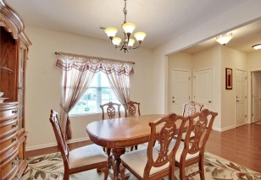
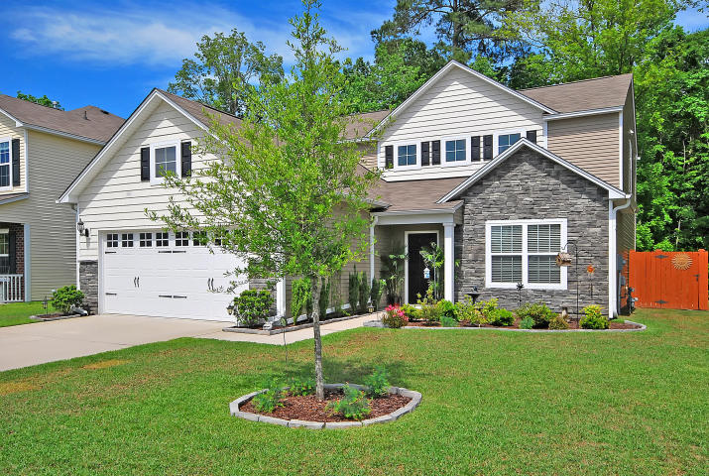
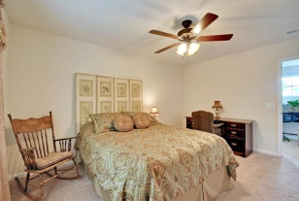
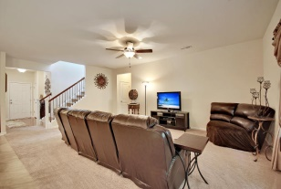
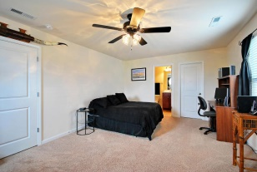
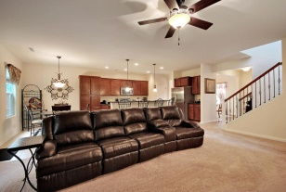
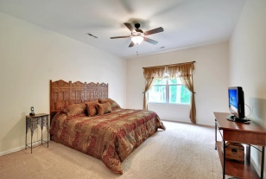
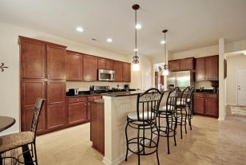
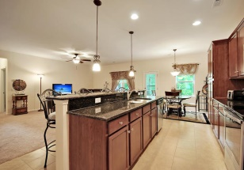
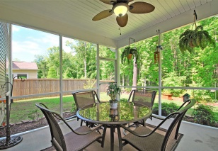
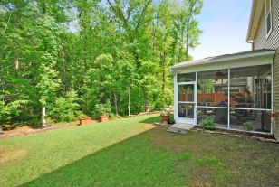
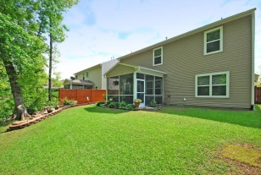
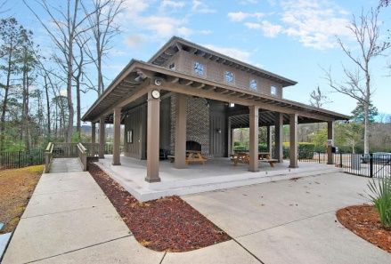
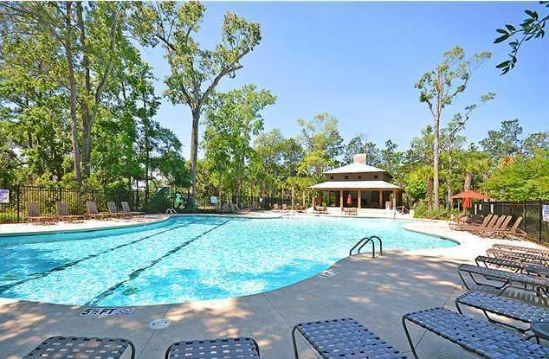
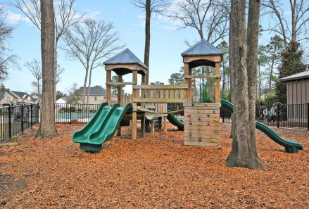
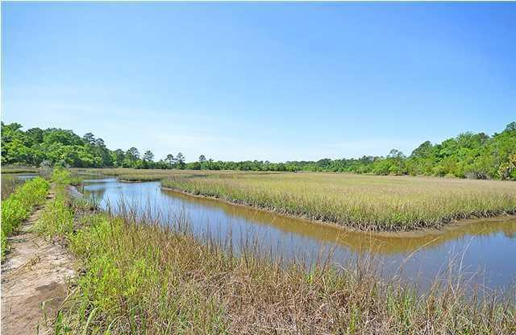

3230 Conservancy Lane
Carolina Bay | Charleston, SC 29414
MLS# 15011506 | $312,750
Totally Unique & Better Than New!
Just Reduced!
Only 2 ½ years old, and meticulously upgraded beyond anything you can get in new construction. Beautifully landscaped, WOODED lot provides the perfect backdrop for your afternoon tea on the spacious screened-in porch. Notice the Custom cherry finished pantry cabinets with roll-out shelving, just to mention another upgrade, and a custom built in kitchen DESK! Stainless steel, Whirlpool appliances, Granite counter-tops and an extra deep stainless kitchen sink with pull-out faucet makes cooking a dream. You MUST see the garage…Professionally applied Epoxy coating on garage floor, built in storage and a Work Sink plumbed into the Garage… not even an option in new construction! Wait till you see the back yard. Lovely stone path, 15 year stain on the fencing & landscaped beds are really going to make entertaining enjoyable! Gutters throughout the house, too! Just the sounds of the birds and the breeze through the trees makes this back yard an oasis. Notice the cute light fixture and upgraded ceiling fan, too. Beautiful ceiling fans & upgraded lighting throughout the home. Wrought Iron Banister posts are an expensive, yet nice touch. Upgraded hardwood flooring & carpeting. 2" Venetian Blinds included, too! Spacious bedrooms, Master Bedroom DOWNSTAIRS and a Master Upstairs to be close to the babies. Nice built-ins stay with the house. Large closets provide tons of storage. Close to Everything! 20 min to downtown, 20 min to the beach & 10 min to the Mall. Carolina Bay is West Ashley's premier neighborhood with nature trails great for walking, jogging or biking, a shaded dog park, zero entry swimming pool, and entertainment area with an outdoor fireplace.
Come see this beautiful home for yourself!
Call or email for details: (843) 214-8451 or Robin@ThePhillipsRealtyGroup.com

