Slide 1
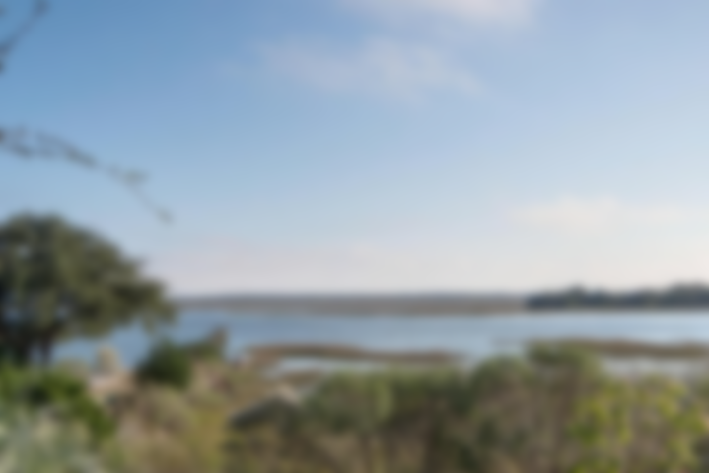
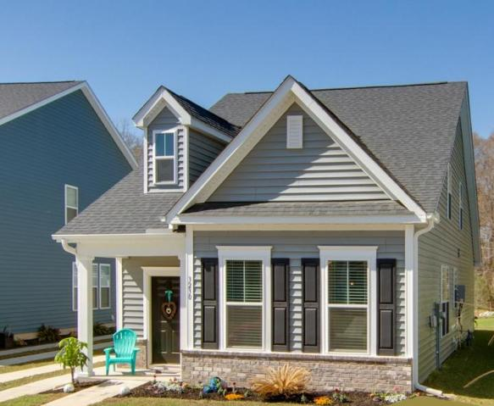
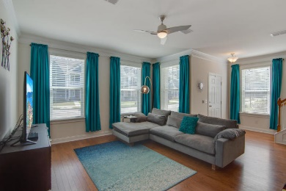
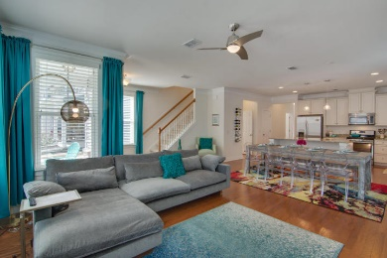
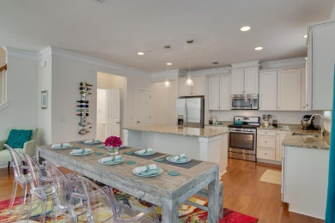
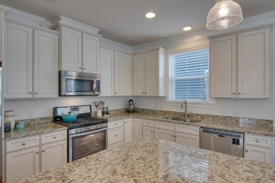
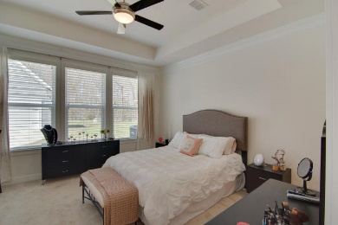
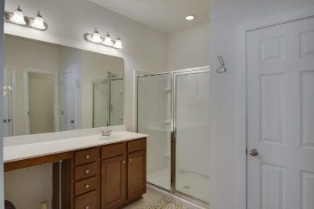
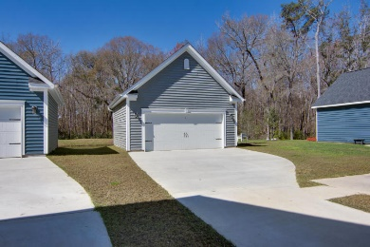
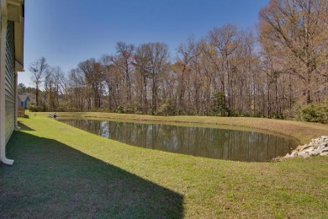

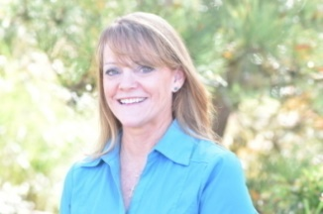
Agent Open House
Thursday 4-6
Light Hors D'Oeuvres
3230 Moonlight Drive
Boltons Landing
Charleston, SC 29414
MLS# 18005608
$309,900
Better than New!! Master down!! Tons of upgrades!! Seller offering closing costs assistance!! Cul-de-Sac lot and on pond with woods behind for added privacy. Enter this beautiful, open floor plan home, to gleaming hardwood floors flowing throughout the downstairs living area. Natural light illuminates this comfortable home which is set up for casual family gatherings or entertaining. Spacious family room at the front of the home is open to the eat-in-area and the kitchen. For the gourmet chef or the casual cook, this kitchen offers the perfect set up! Gas stove, granite counters, high-end antique white 42'' gorgeous cabinets, huge island...this is the perfect kitchen! Pantry is huge! Down the hall find the half bath, large laundry room(yes a room!), and the master bedroom.
Master is spacious with trey ceiling, walk-in closet, over-sized shower, water closet and linen closet. The home offers lots of storage! Upstairs is the loft that can be used for a second family room, office, play area, the additional 2 bedrooms and full bath are also located off the loft.
Outside is the covered porch, 2 car garage, ultra long drive way, views of the pond behind the house. Across the street is the entrance to the walking path. This is a great location on a cul-de-sac with woods behind and woods across the street. Bolton Landing is in a convenient location, with easy access off Bees Ferry or 17. Complete with a Neighborhood pool, lots of ponds and walking trails, a wonderful place to call home! Call today for a private showing and list of upgrades.
Laurie Loparo
(843) 442-1290 | laurieloparo@gmail.com
NV Realty Group | 91 Broad St, Ste A | Charleston, SC 29401
www.lauriesellscharleston.com

