Slide 1


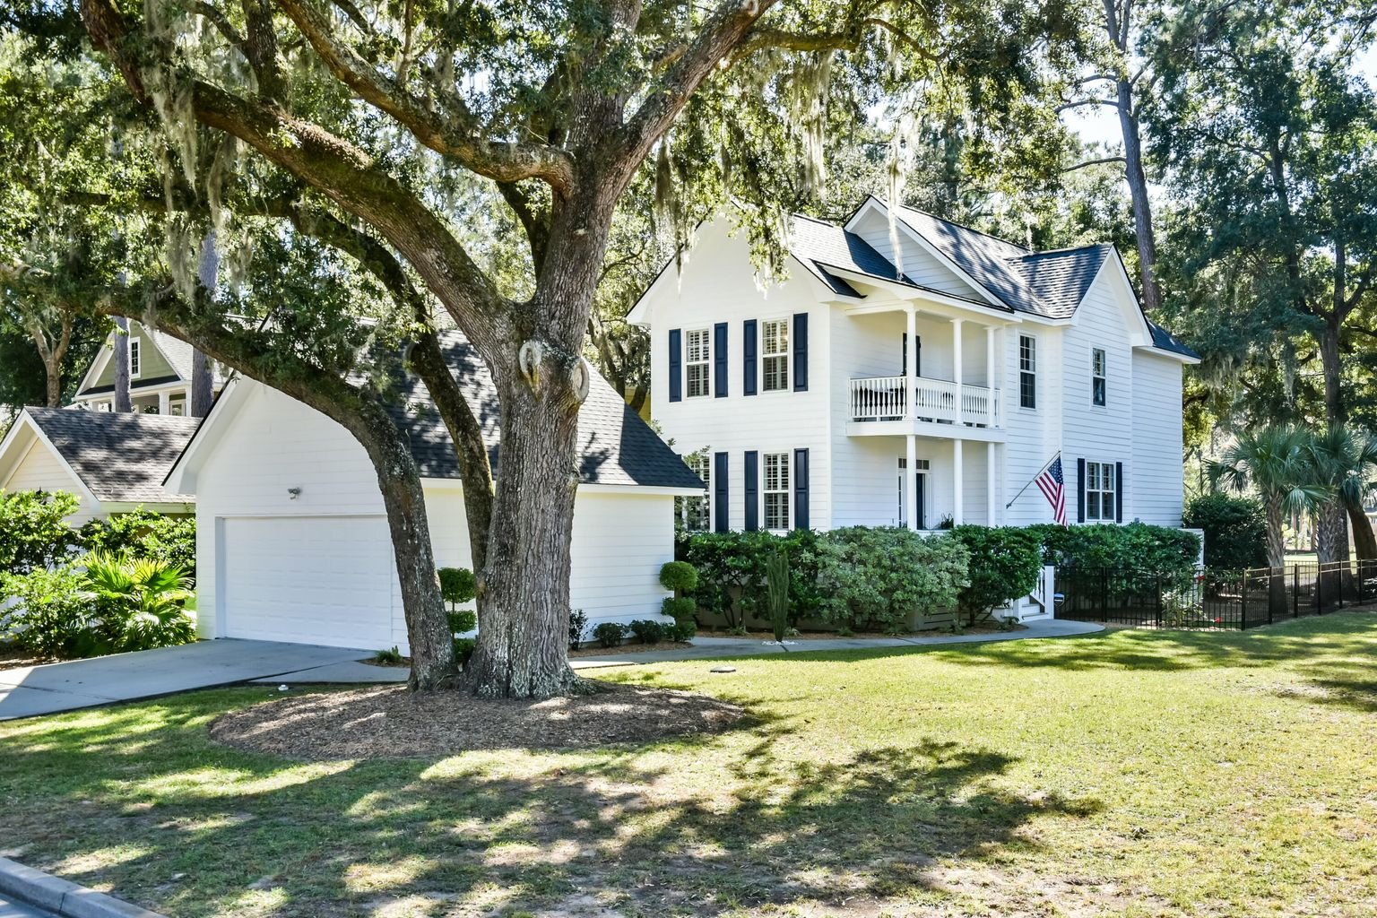
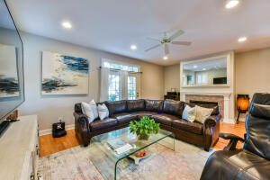
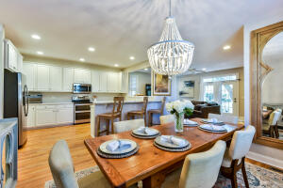


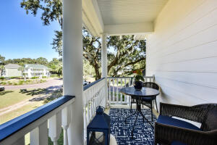
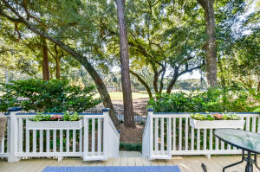
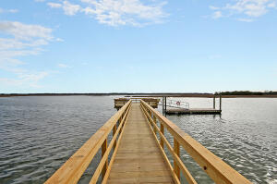


New Listing!
3231 Johnstowne Street
Kiawah River Estates | Johns Island, SC 29455
MLS# 22027228 | $835,000
Johnstowne St. is a quaint, stamped brick street within the exclusive gated community of Kiawah River Estates. Owners here not only enjoy the neighborhood amenities but also have the option to join the Kiawah Island Governor's Club to enjoy Kiawah's 10 miles of pristine beach and other amenities. This low maintenance and energy efficient 2214 square foot home has 3 bedrooms and 2 1/2 bathrooms, a detached 2-car garage, lots of recent upgrades, additional storage inside and out, and is meticulously maintained. There is a fenced yard and tranquil views of Kiawah Island Golf Resort's Oak Point Golf Course, and the back deck is south facing, providing nice sea breezes and year round sun. The home is located just 3 miles from the beach and the gate onto Kiawah Island, and only 19 miles to downtown Charleston.
Lee Lindler
Cell (843) 637-0803 | lee@akersellis.com
Akers Ellis Real Estate LLC | 3730 Bohicket Road, Suite 5 | Johns Island, SC 29455
akersellis.com

