Slide 1
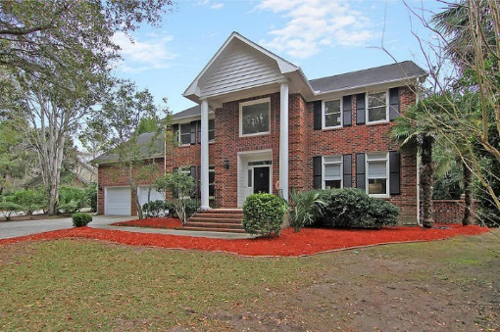
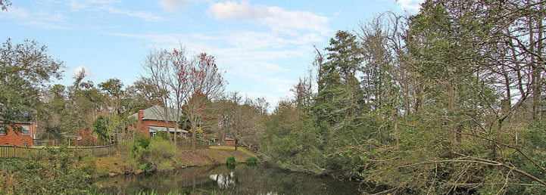
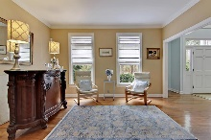
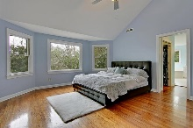
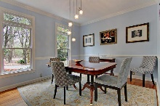
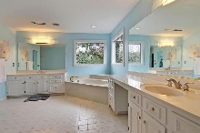
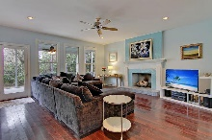
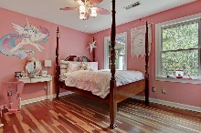
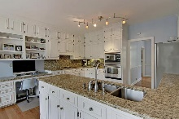
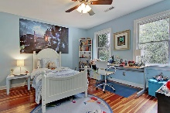
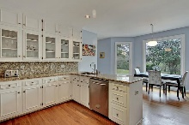
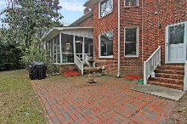
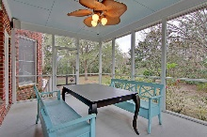
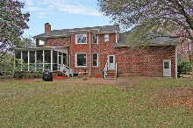


A Private Refined Beauty
3232 Hagerty Drive
Maclaura Hall · Charleston, SC 29414 · MLS# 17005782 · $479,900
4 Bed · 2.5 Bath · 3,088sf
Beautiful all brick home on a secluded lot in established MacLaura Hall. Truly a rare find. This home sits on a quiet cul de sac with a long 400+ foot private tree lined drive. Minutes from historic plantations, restaurants, shopping, and only 8 miles from downtown Charleston. This custom home features large rooms with 9 foot tall smooth ceilings, gorgeous hardwood floors throughout, a spacious kitchen with over-sized picture windows that overlook a private backyard and pond, an impressive 20 foot tall foyer, a huge master bedroom with a vaulted ceiling and over-sized picture window overlooking a private backyard and pond, an over-sized 2 car garage with attached cabinets, generous bonus room with extra storage, lots of natural light throughout, and a large screened porch overlooking a private back yard and pond.
Entering the home you encounter a large foyer with a curved staircase. To the left you will find an elegant formal dining room with both chair rail molding and crown molding. To the right you will find a parlor / library currently in use as a bar also featuring crown molding. Directly adjacent to the bar you will find a 20 foot by 20 foot living room highlighted by a custom Italian tile surround gas fireplace (which can be used as a wood burning fireplace as well) lit by recessed lighting and three large windows and one all glass door to the attached porch. The left living room wall has been pre wired for home theater to include power, video signal, and center/right/left speakers. The right wall has been pre wired for rear speakers. The kitchen is accessible from the living room or the dining room and features exceptional granite countertops and full backsplashes on each wall. You will enjoy dining in the eat in kitchen overlooking the private back yard, pond, and mature landscaping. Additional kitchen features are a granite topped desk, much cabinet space, custom and recessed lighting, and a bright cheery feel. Downstairs you will also find a half bathroom with a marble topped vanity, a full sized laundry room including sink and many cabinets, and a hidden back stairwell providing additional access to the upper floor.
Upstairs you will be pleased to find welcoming rooms with much natural light and gleaming hardwood floors. Two additional oversized bathrooms feature all white ceramic tile floors and showers. The master bath also features a separate water closet and a large jacuzzi tub surrounded by two large picture windows. The master bedroom offers his and hers walk-in closets. There are two additional bedrooms with views of mature landscaping. There is a large bonus room with a closet that could be a fourth bedroom.
Additional features: The house is equipped with in wall or in ceiling audiophile (PSB) speakers in six rooms. The home has category 6 wiring pre run to the same six rooms. The home has two wifi router locations providing wifi throughout the home and yard. The home has a dual zone NEST system with upstairs and downstairs NEST thermostats. The home has an expanded security system featuring a multiple zone motion sensor system, door contacts, and glass break sensors to include coverage in the garage. The security system is equipped with a cell phone back up system as well as multiple key fobs. The central vacuum system makes cleaning the home a breeze. Watering the large lawn is easy and economical thanks to a six zone irrigation system that has its own water meter. This home is served by your choice between two cable providers (Comcast Xfinity and WOW) and one telecom provider. (AT&T Uverse) This home has a clear view of the southeastern sky and has had both DirecTV and DISH Network installed previously. In addition to cabinets and overhead storage, the garage also has several pegboard sections convenient for storing tools and gardening items.
Don't miss this amazing opportunity. This home will not last long!
Lee Lindler Cell (843) 637-0803 | LeeL@GoldenBearRealty.com
Golden Bear Realty | 1900 Seabrook Island Rd | Seabrook Island, SC 29455
www.goldenbearrealty.com

