Slide 1


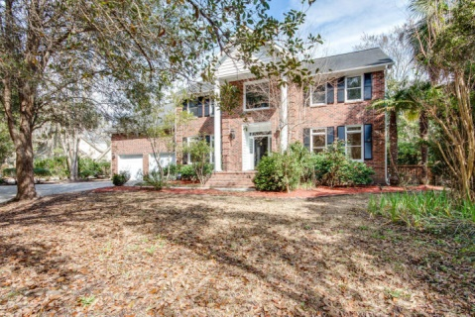
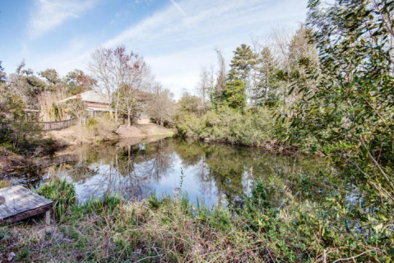
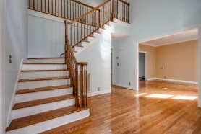
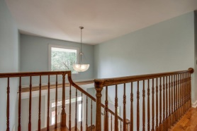
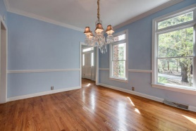
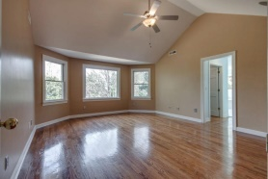
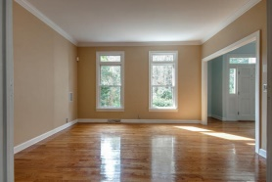
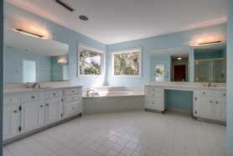
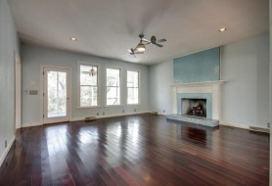
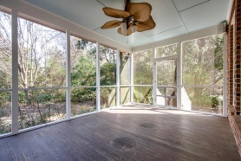
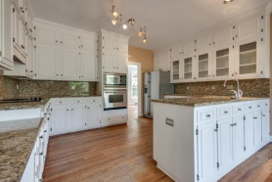
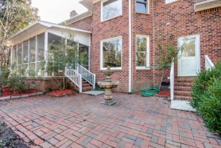


Sophisticated Private Paradise
3232 Hagerty Drive
Maclaura Hall - Charleston
MLS# 1419033 - $419,900
Welcome home to 3232 Hagerty Drive!
This beautiful all brick home is on a quiet, secluded cul-de-sac, close to the city and the historic plantations. The property has a majestic feel from the moment you drive down the long private driveway and see this stunning, formidable home with recently painted exterior trim. Time stands still when you smell the tea olives and see the sunlight shine through the Spanish Moss.
When you open the front door, you will be impressed by the great layout and roomy feel created by 20' ceiling above your head and wide staircase. Hardwood flooring runs throughout the house with the exception of the tiled bathrooms. The eat-in kitchen features custom cabinetry with tons of storage, stainless steel appliances, and granite counter tops and back splash.
There is a large and elegant dining room, a sitting room, powder room, and a living room featuring a gas fireplace with a beautiful glass tile surround. Just off of the living room there is a large screened porch overlooking the private backyard and koi pond. All four bedrooms are upstairs along with two huge bathrooms, and can be accessed by two separate staircases. The master bedroom features great views off of the back of the house and his and hers walk-in closets. The over-sized master bath has a nice soaking tub, separate shower, dual vanities, and water closet.
The house is equipped with central vacuum, has an over-sized two-car garage, is wired for home sound and theater with speakers in place, and has a security system.
This is truly an amazing home that you must see!
Lee Lindler leel@goldenbearrealty.com
www.GoldenBearRealty.com
Golden Bear Realty | 654 Coleman Blvd, Suite 100 | Mt Pleasant , SC 29464
Cell (843) 637-0803 | Office (855) 725-5890 | Fax (561) 721-3311

