Slide 1
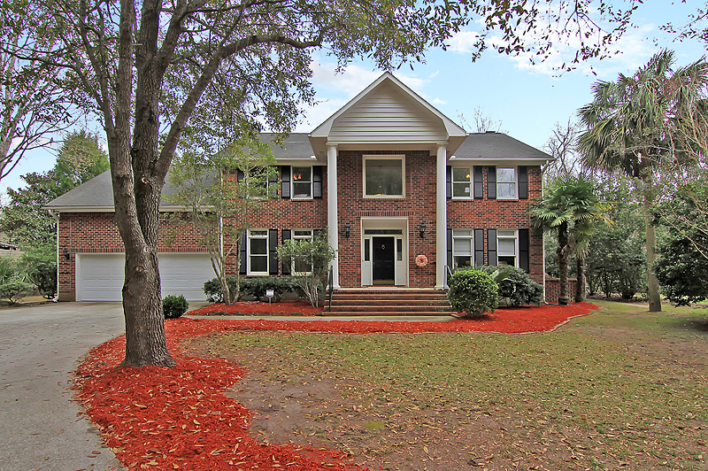
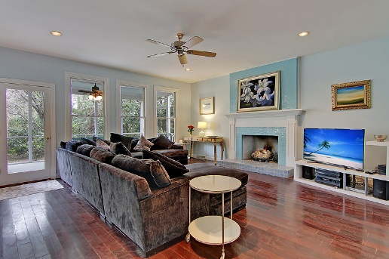
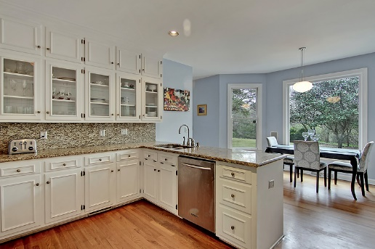
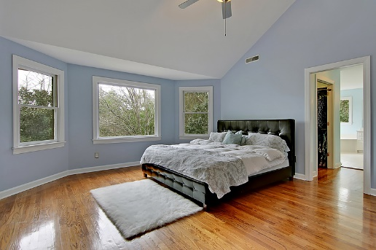
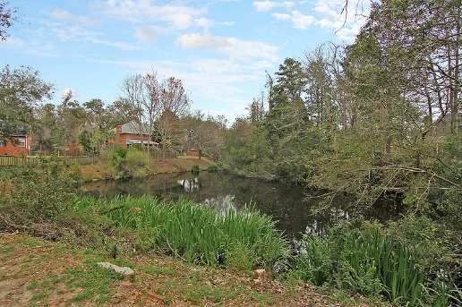


A Private Refined Beauty
3232 Hagerty Drive
Maclaura Hall · Charleston, SC 29414 · MLS# 17005782 · $469,900
4 Bed · 2.5 Bath · 3,088sf
Charleston Classic Lifestyle Awaits
3088 s.f.
4 bedrooms and 2.5 bathrooms
$469,900
Located on a very large, private lot with a lagoon in the backyard, this all brick home is stunning. Located close to downtown, the beaches, plantations, the airport, hospitals, and shopping. Features include hardwoods throughout except for tiled bathrooms and laundry room, an over-sized 2-car garage, formal dining room and eat-in kitchen, multiple living areas, large screened in porch, 400 foot oak lined driveway, amazing kitchen with beautiful granite and stainless steel appliances, central vacuum, security system, Nest thermostats, irrigation, sound system, and more.
Please contact me for your showing today!
Lee Lindler
Cell (843) 637-0803 | LeeL@GoldenBearRealty.com
Golden Bear Realty | 1900 Seabrook Island Rd | Seabrook Island, SC 29455
www.goldenbearrealty.com

