Slide 1
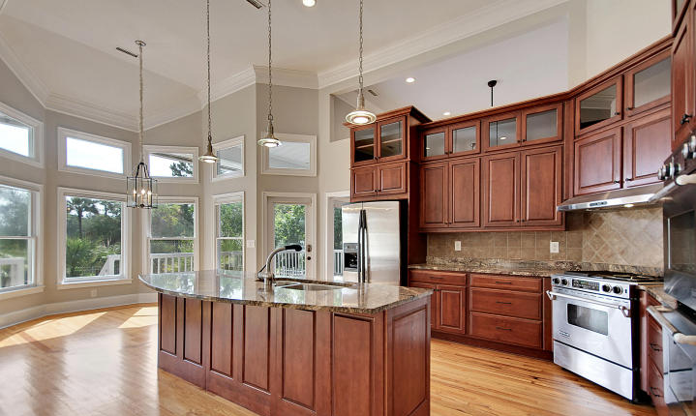
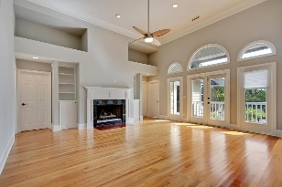
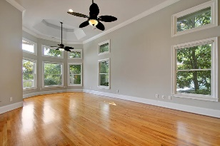
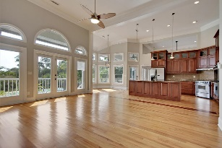
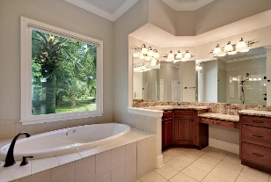
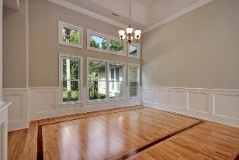
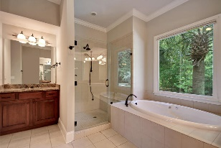
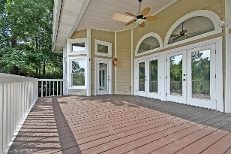
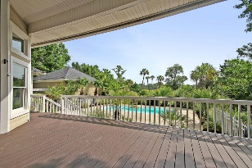
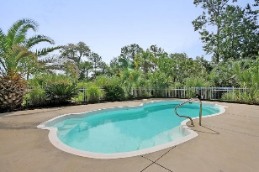
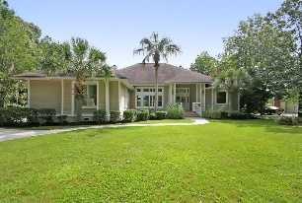
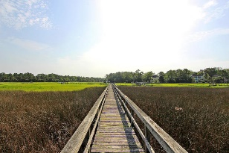
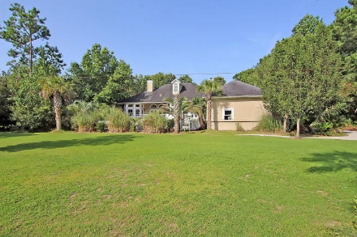
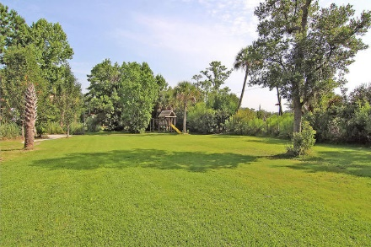
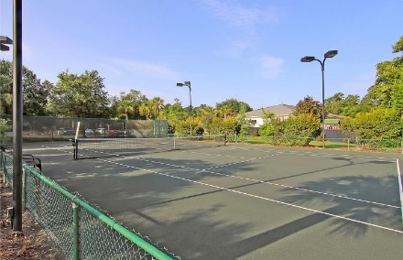
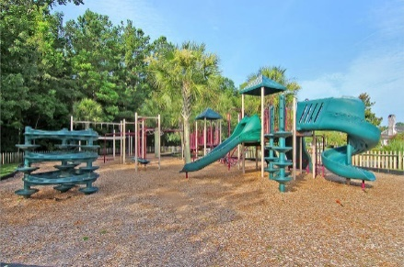

3233 Cottonfield Drive Dunes West | Mount Pleasant, SC 29466 | MLS# 15018384 | $1,149,999
Soaring Ceilings, Open Concept & Dock
Just Reduced!
Looking for the perfect Charleston Lifestyle Home? Come home to breathe….enjoy life on the water with your own Private Dock & Boat Lift, in Mount Pleasant’s premier gated community of Dunes West. Your Spacious, Private property is just minutes to award winning shopping, beaches & dining. Downtown Charleston is a short 20 min away. Uniquely built for Entertaining, the wall of windows ties the main living areas to the outdoors & pool deck. The deck spans the entire back of the house with access to the master bedroom. The pool deck is just beyond with a BONUS detached garage adjacent. This could be used as a pool or game room – it even has an unfinished space above with electrical & partial plumbing! The rooms flow generously, one to the other with soaring 14’+ high ceilings & Gorgeous in-lay flooring. The Downstairs Master Suite does not disappoint with beautiful bay windows that overlook the back yard & pool, & more soaring ceilings for breathing room. The Spa-like master bath has a huge vanity & sink just for her flanked with 3 mirrors. The dining room can accommodate your entire family for Thanksgiving & boasts views of the front garden. So well-thought-out, Two more bedrooms downstairs have bathrooms â€“ one that opens to the outside for pool access & is across from the bonus detached garage/pool house. The FROG (finished room over garage) is massive! With its own private bathroom & closet, it could be used as a Mother-in-law suite, Media Room, Bunk Room for the Grandkids or your Teenager's Dream Room! The wall space in this special home is perfect for your spectacular works of art. Freshly painted in Repose Gray, this home was completely remodeled in 2005 with new HVAC. Dunes West is a Gated Community that boasts some of Charleston's best Golfing. The Clubhouse overlooks the course with beautiful grounds and Live Oaks abound. Boat storage is available within the community as well. Ask your agent about Mount Pleasant's award-winning schools. Come live the Charleston Lifestyle to its fullest in your Gorgeous Waterfront Home. Note: Tax Rate currently at 6% - will drop to 4% if Owner Occupied.
Call or email for details: (843) 214-8451 or Robin@ThePhillipsRealtyGroup.com

