Slide 1
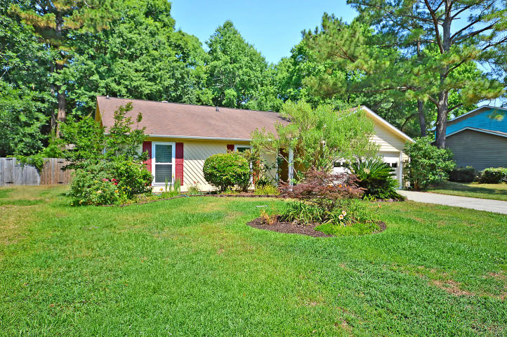
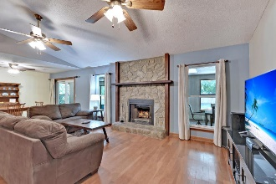
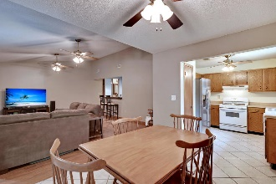
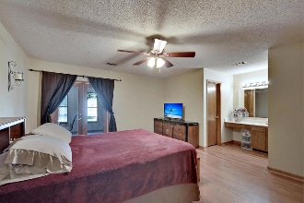
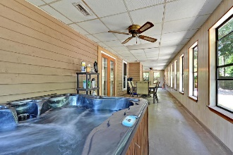
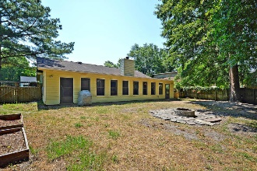


Priced to SELL!
$15,000 Agent Bonus
with ratified contract by 4/15/18
3238 Landing Parkway
Appian Landing
N Charleston, SC 29420
MLS# 19015556
$229,000
$12,100 Under
Recent Appraised Value
Welcome home! This one story home in Appian Landing has been very well maintained! Upon entering you will be greeted with an open foyer that flows into the family room and is over looked by the wet bar! The wood burning fire place is perfect for a winter night. The dining area and well appointed kitchen are in view of the family room. The home features a master suite on one side of the home and two additional guest bedrooms and guest bath on the other. Off the back of the home is a large sunroom with a hot tub! Out back is a large private fenced in yard with a fire pit and out building! This home also has newer windows! Schedule your preview before this one is gone! Age, sqft, taxes, acreage, HOA dues, and schools are approximate buyer to verify any and all information deemed necessary.
Mason Thurber
(843) 709-5109– C
(843) 576-2701 – O
mason@theeverettgroup.net
RE/MAX Pro Realty, 9209 University Blvd, Charleston, SC 29406

