Slide 1
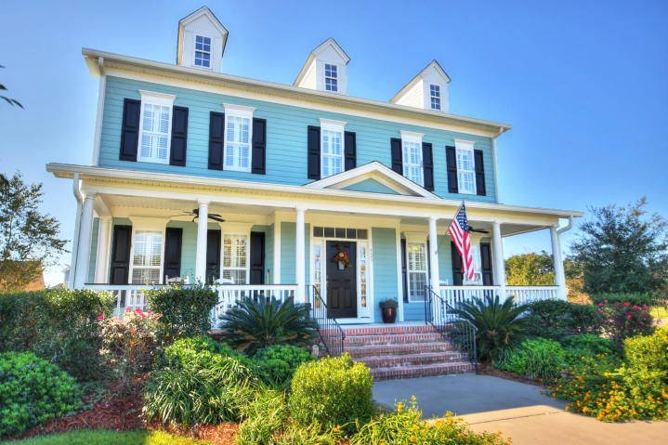
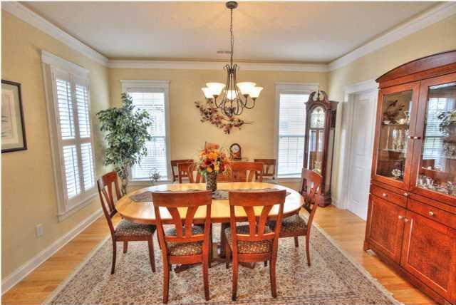
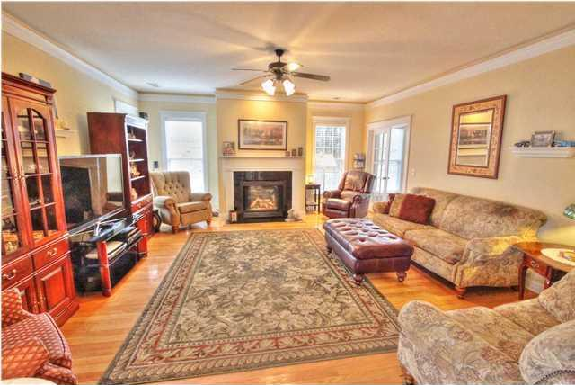
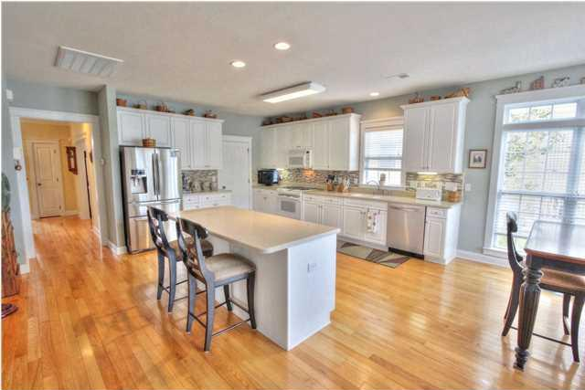
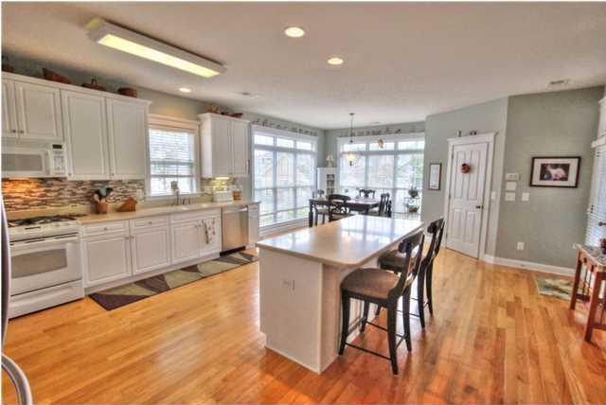
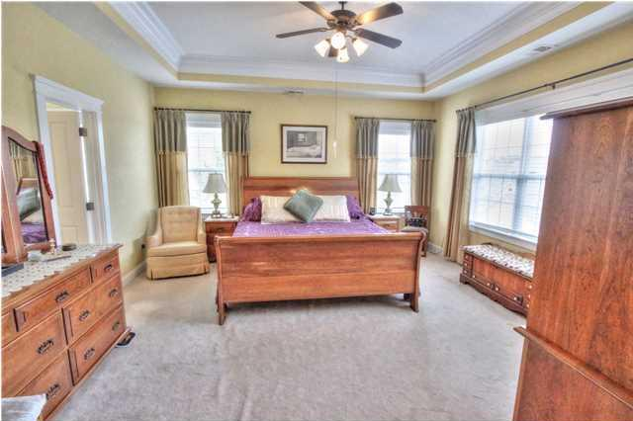
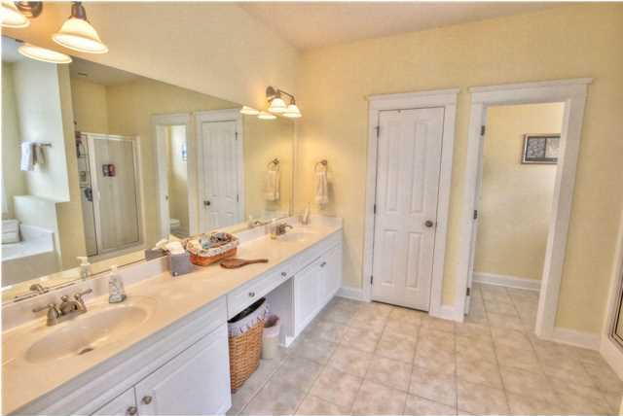
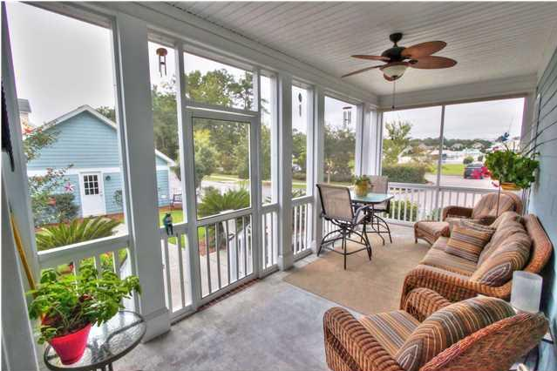
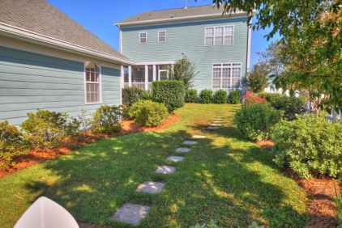



323 Amaryllis Ave
White Gables
Summerville
MLS# 1425862
$324,800
4 Bedrooms
3½ Bathrooms
3,195 Sq Ft
STUNNING FORMER WHITE GABLES MODEL HOME with ALL the EXTRAS!! This home comes with almost $100k worth of upgrades from the original builder!! AMAZING location close to all the great amenities White Gables has to offer...and in Dorchester II School District!! Not only does the home still have the look and feel of a model home but the ENTIRE yard...front, back, and sides has been meticulously landscaped and maintained!! A few of the additional outdoor features are an inviting front porch that runs the full width of the home, a peaceful screened in back porch, separate patio, a fully fenced in(white picket) back yard, and a 24' by 24' garage which is believed to be the largest in the neighborhood. As you enter this incredible home you will immediately notice gleaming hardwood floors, completely cased windows with plantation shutters, drop crown molding throughout, smooth ceilings, upgraded lighting and fans, French doors, family room with gas fireplace, formal living room, formal dining room and much more. The kitchen is INCREDIBLE!! TONS of cabinets and counter space, solid surface countertops, tile backsplash, recessed lighting, gas range and built in microwave, new dishwasher, WALK-IN pantry, and a super convenient kitchen island/breakfast bar. Upstairs you will find 4 large bedrooms, THREE full bathrooms, and the laundry room!! One of the additional bedrooms has its own private bathroom!! The master suite is very impressive...tray ceiling with double crown molding, large walk-in closet, and a tiled bathroom with double sinks, vanity, and separate garden tub and shower!! WHITE GABLES is a beautiful and convenient LOWCOUNTRY community offering a neighborhood pool, clubhouse, tennis courts, play park, soccer fields, walking trails, ponds, and lots of green space...all within steps of your home!!
Jeremy Wilson
Cell - (843) 478-8532
Jeremy@ChuckTownHomes.com
www.ChuckTownHomes.com
24-hour recorded property info 1-888-210-3348 ext 2997

