Slide 1
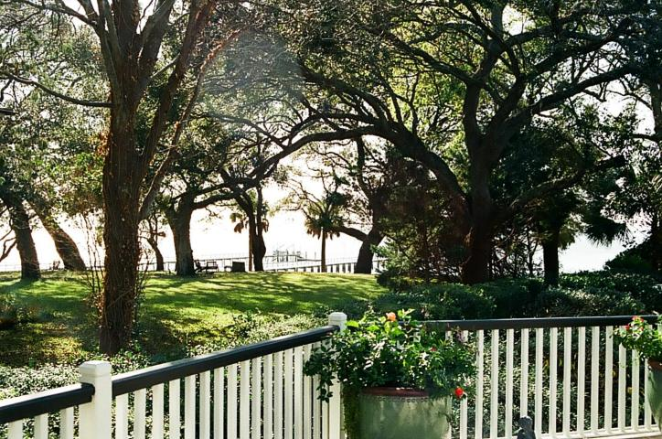
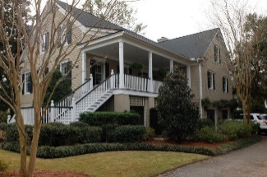
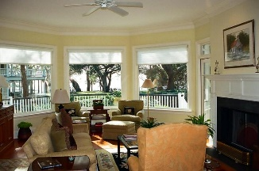
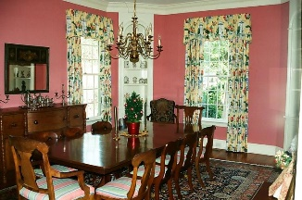
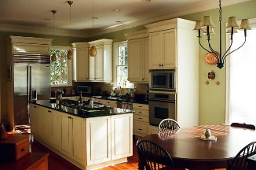
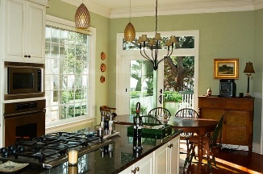
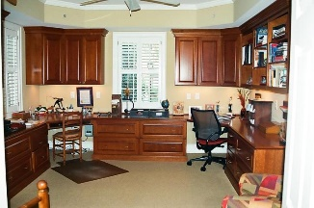
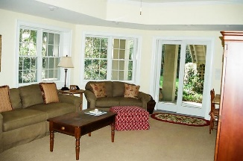
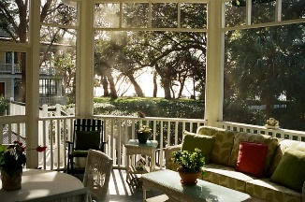

323 Bennett Street
Old Village | Mount Pleasant | MLS# 17001659 | $2,650,000
Old Village Charm With Harbor Views
~ Rare and glorious "Old Village" offering! Stately home with breath taking views ~
Enter this beautiful meticulously maintained home and experience the open floor plan with spectacular harbor views from the Great room, Master bedroom and the kitchen/breakfast room.
Heart of Pine floors
10’ ceilings
2 fireplaces
Elevator w/ 3 stops
Sub-Zero refrigerator
2 Car Garage
Delightful screened porch overlooking the Harbor
Fabulous office on ground floor with handsome built ins
MIL/guest suite with den, bedroom, and kitchenette
PERKS: 3 heat pumps, 2 hot water heaters, security, irrigation, granite counters, & Decor gas 5 burner cooktop
Frances M Horton
(843) 343-3901
fmhorton5@gmail.com
Old Dominion, REALTORS
890 Johnnie Dodds Blvd
Mt Pleasant, SC 29464-6129

