Slide 1
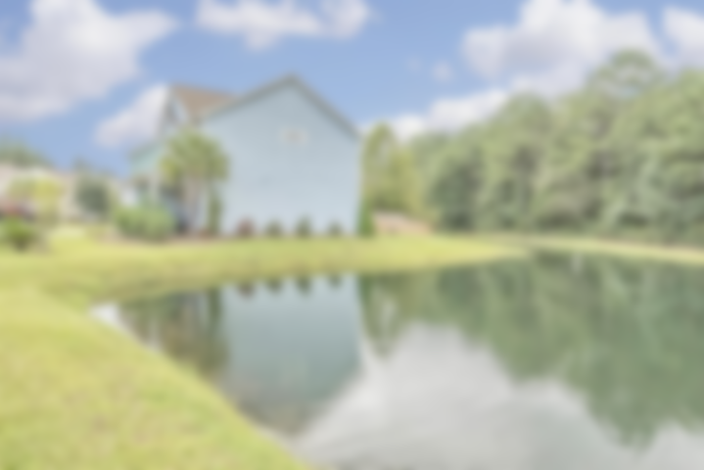
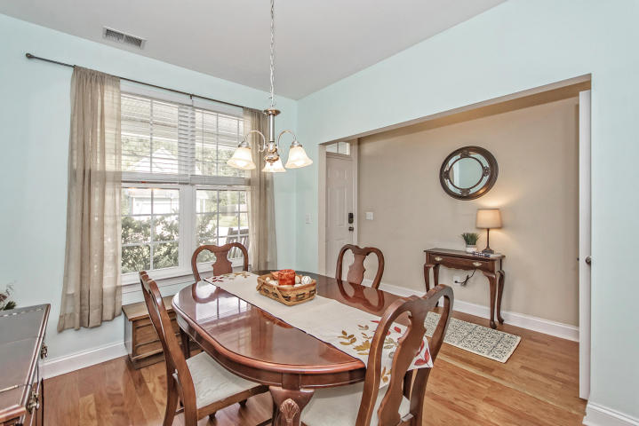
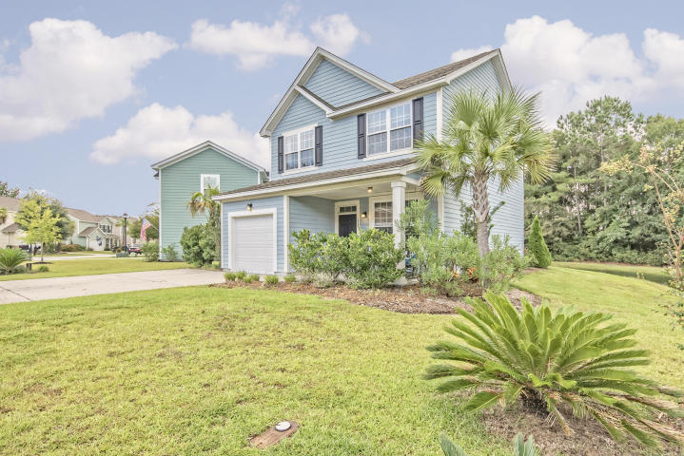
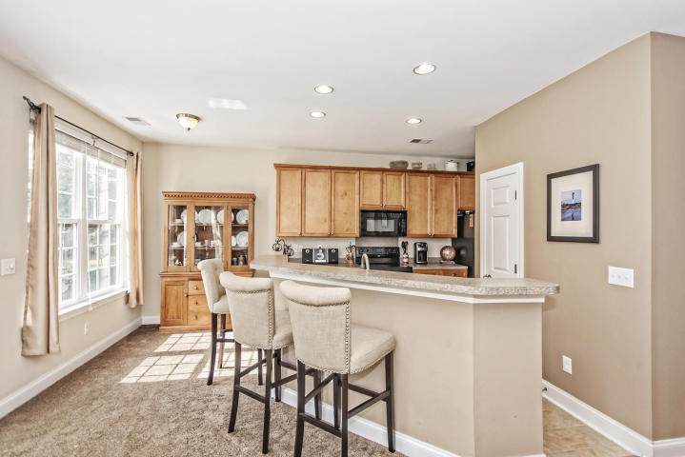
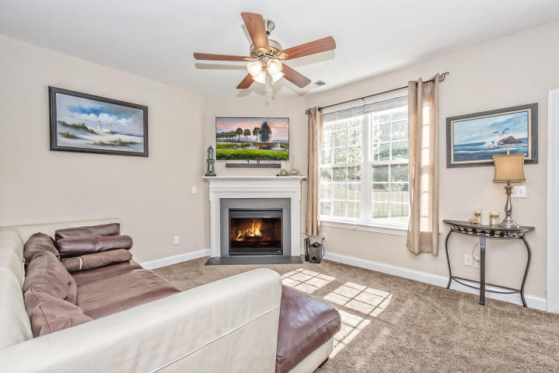
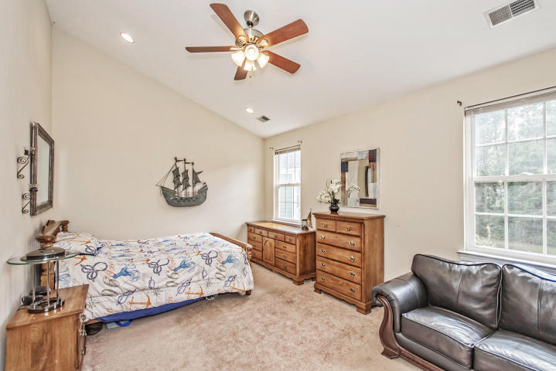
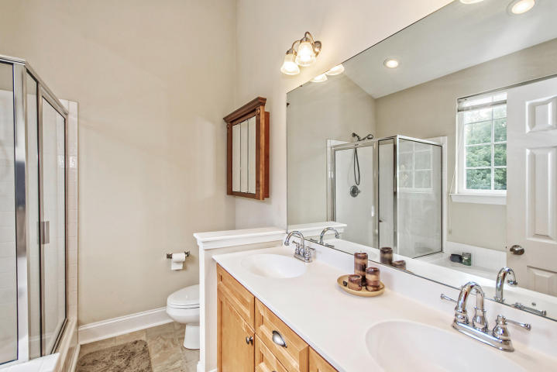
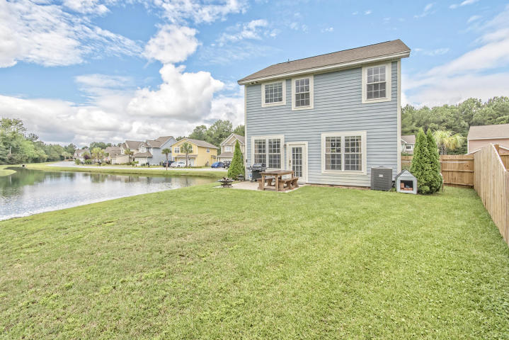
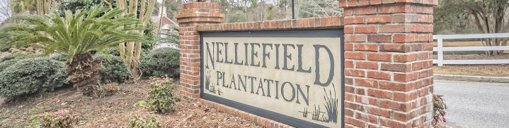

BETTER THAN NEW!
323 Cypress Walk Way Nelliefield Plantation ~ MLS# 16024941 ~ $274,900
3 Bedrooms ~ 2½ Bathrooms
Move-in ready home on a fully-stocked pond just a "stone's throw" from Mount Pleasant and its world-class, sun-kissed beaches, gourmet dining and terrific shopping opportunities. This home is truly “better than new” because it has all of the advantages of a brand-new home such as a new roof, new HVAC and high-tech features like a tankless hot water heater but, as opposed to the barren landscaping and noisy surrounding construction associated with new homes, this home has lush landscaping, quiet surroundings and a fully-stocked pond teaming with fish. The virtual “On Golden Pond" setting for this home is close to the brand-new K-12 Phillip Simmons school that everybody is talking about as well as all of the conveniences that Mount Pleasant has to offer, historic downtown Charleston and the ever-popular Daniel Island. Yes, this can ALL BE YOURS for the VERY BEST BARGAIN in the greater MOUNT PLEASANT area!
Chip Walsh
843-822-4663
chipwalsh@gmail.com
Andi Walsh
843-822-4663
myandigirl@gmail.com
Century 21 Properties Plus | 3301 Salterbeck Ct Suite 100 | Mt. Pleasant, SC 29466

