Slide 1
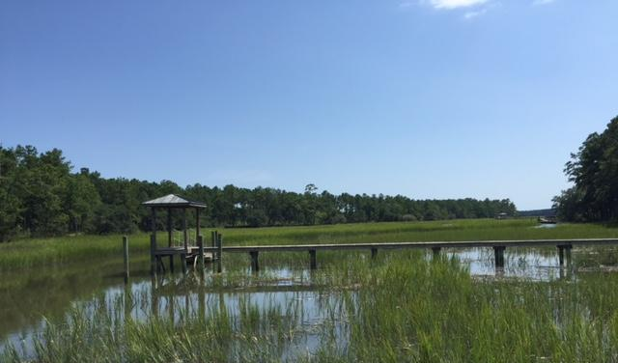
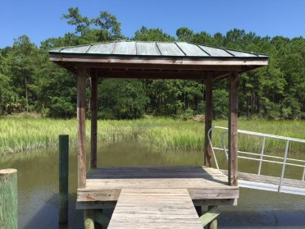
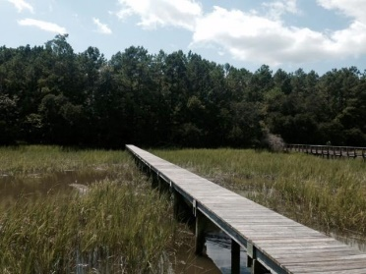
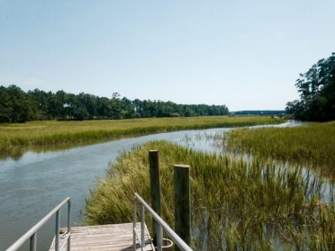
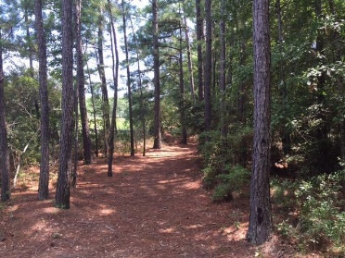
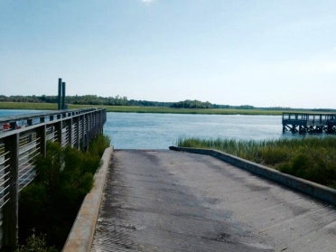


DRINKS ON THE DOCK
(Weather Permitting)
323 Martins Creek Lane
Beresford Hall | Charleston | MLS# 15021204 | $350,000
Join us for a great view & enjoy a beer or wine on the dock
Thursday 9/24/15 ~ 3:30 - 5:30pm
Text 225-921-2111 for gate code
This lot is located right off of Clements Ferry Road in the gated community of Beresford Hall. While extremely private and tranquil, Beresford Hall is minutes away from Daniel Island and Mt. Pleasant. The airport, downtown Charleston and the beach are easily accessible by major highways. Beresford Hall is comprised of 600 acres with only 200 home sites. This tidal creek lot (Martin’s Creek) is over three quarters of an acre on a cul-de-sac, with an existing dock with a covered pier, a floating dock and pilings in place for a boat lift. Enjoy watching birds and wildlife as you fish on your private dock with magnificent views. Have your home on a lot that has water views from the back and wooded green space in the front. The community fishing and crabbing dock is right beside this lot. Walk to a beautiful children's playground with a large dog park nearby. Other amenities include a clubhouse, pool, picnic/green space, four parks, two playgrounds, biking and walking trails, deep water community boat launch, and fire pit. Take a walk towards the community fishing dock to view this beautiful lot. Property is currently taxed at a non-residence rate. Tax rate is significantly reduced when property becomes primary residence.
Donna Landry
Mobile - (225) 921-2111
donna.landry@cbunited.com
Betsy Sarsfield
Mobile - (843) 608-1048
betsysarsfield23@gmail.com
Coldwell Banker United of Charleston | 35 Broad St | Charleston, SC 29401 | www.thebestincharleston.com

