Slide 1
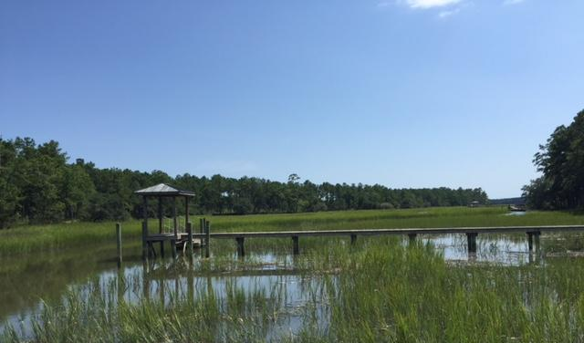
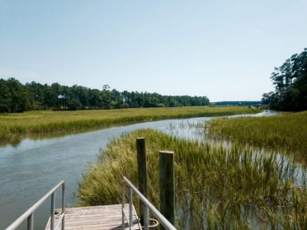
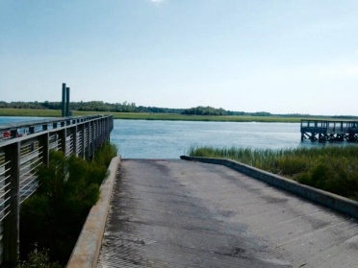
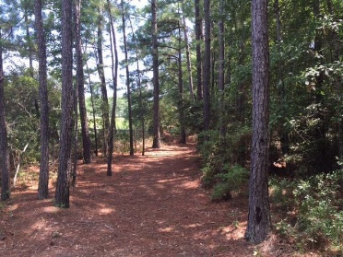

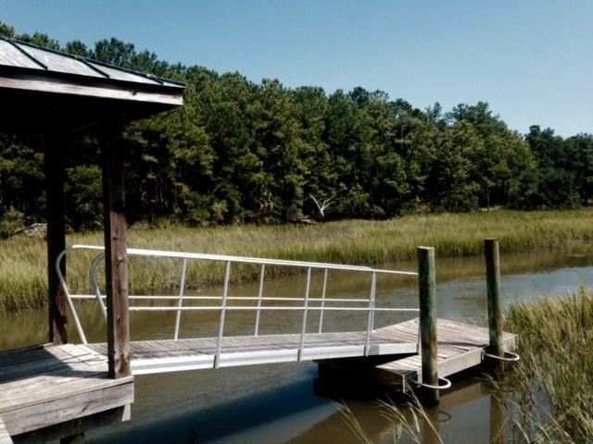
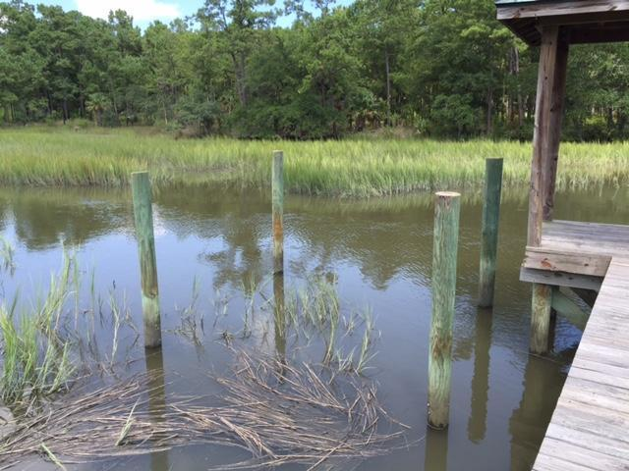
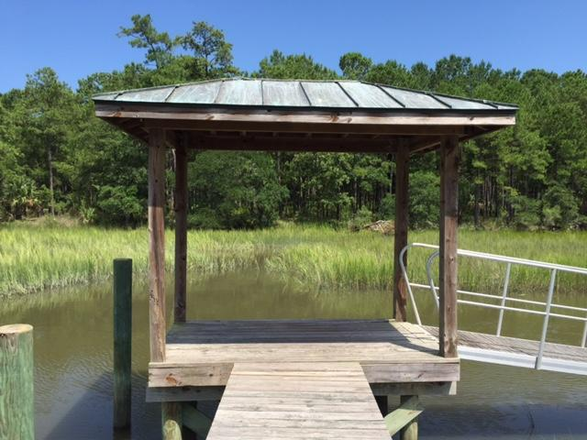
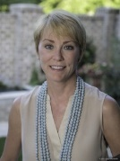
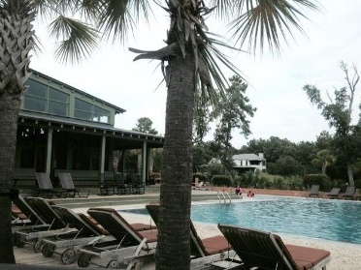

323 Martins Creek Lane Beresford Hall | Charleston | MLS# 16007016 | $320,000
Build Your Dream Home
Gated Beresford Hall Subdivision
Beautiful Martins Creek Lot
Dock in Place
.77 Acres
Only minutes form the new Philip Simmons Elementary & Middle Schools Opening 2016. High School Opening 2017.
Donna Landry
Mobile - (225) 921-2111
donna.landry@cbunited.com
Betsy Sarsfield
Mobile - (843) 608-1048
betsysarsfield23@gmail.com
Coldwell Banker United of Charleston | 35 Broad St | Charleston, SC 29401 | www.thebestincharleston.com

