Slide 1
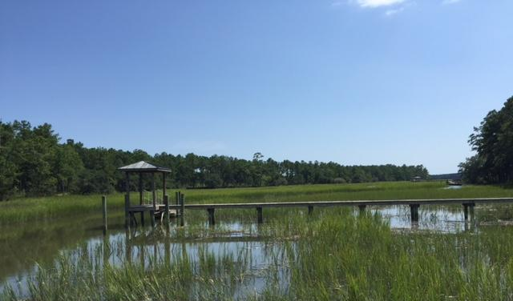
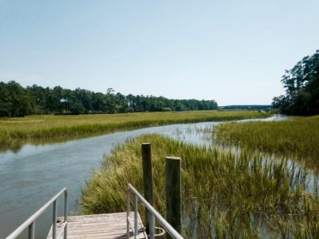
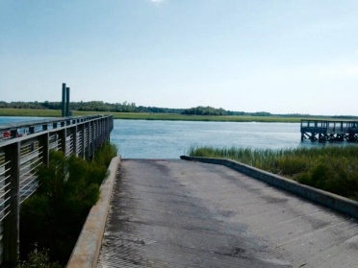
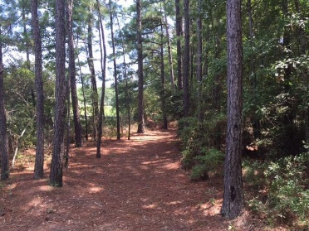

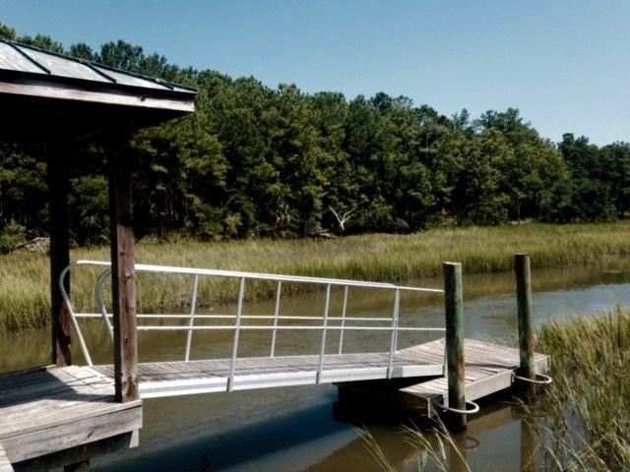
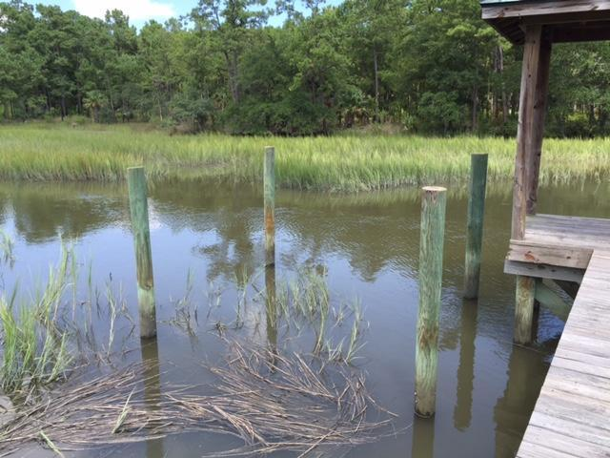
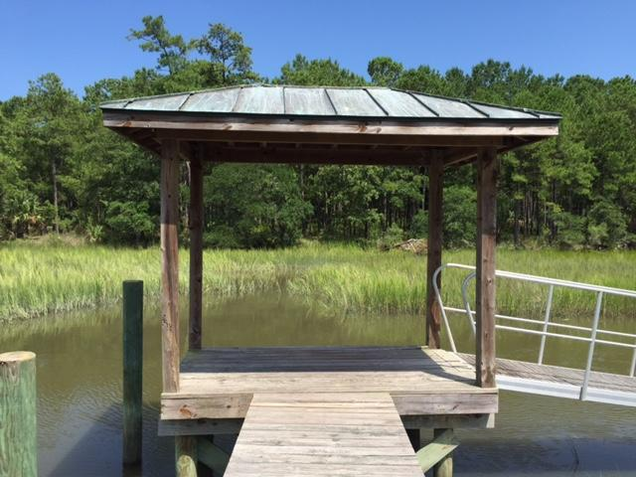
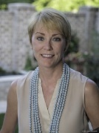
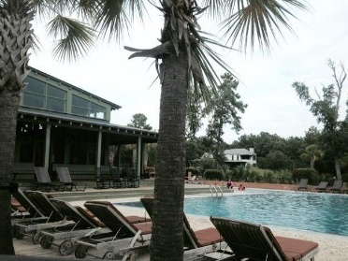

323 Martins Creek Lane Beresford Hall | Charleston | MLS# 15021204 | $350,000
Build Your Dream Home
Hidden Gem
Gated Community
Tidal Creek Lot
Dock in Place
Pier & Floating Dock
Pilings for Boat Lift
Donna Landry
Mobile - (225) 921-2111
donna.landry@cbunited.com
Betsy Sarsfield
Mobile - (843) 608-1048
betsysarsfield23@gmail.com
Coldwell Banker United of Charleston | 35 Broad St | Charleston, SC 29401 | www.thebestincharleston.com

