Slide 1
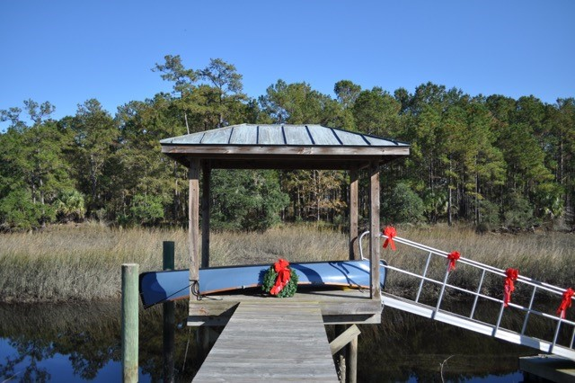
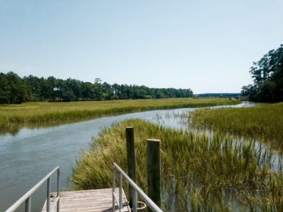
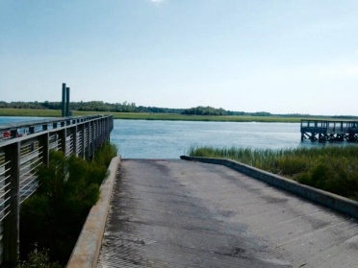
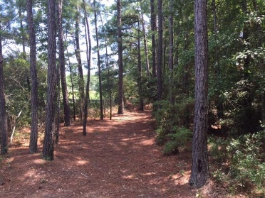
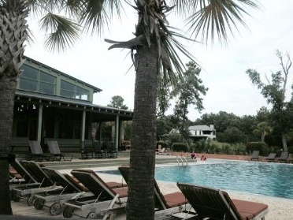
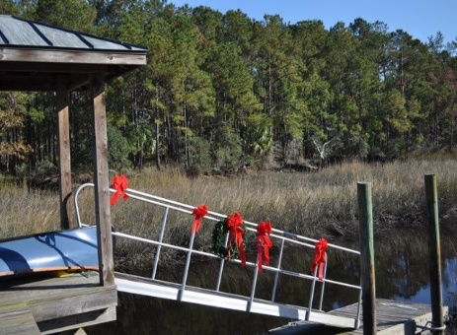
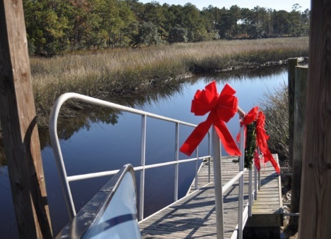


323 Martins Creek Lane Beresford Hall Charleston MLS# 15021204 $338,000
A Dock For All Seasons
Hidden Gem in Gated Beresford Hall
Tidal Creek Lot ~ Dock in Place
Large Lot ~ .77 Acre
Daniel Island School District
Great View ~ Great Price
Donna Landry
Mobile - (225) 921-2111
donna.landry@cbunited.com
Betsy Sarsfield
Mobile - (843) 608-1048
betsysarsfield23@gmail.com
Coldwell Banker United of Charleston | 35 Broad St | Charleston, SC 29401 | www.thebestincharleston.com

