Slide 1
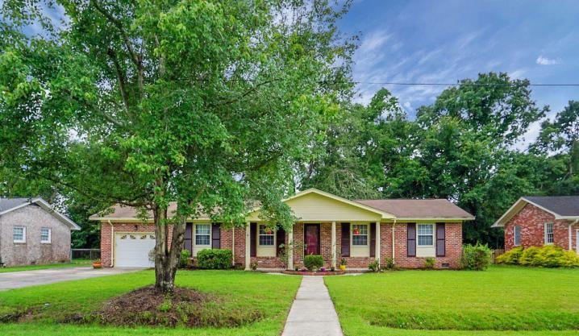
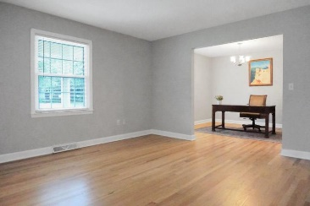
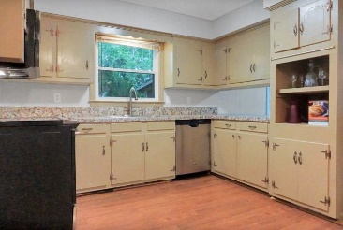
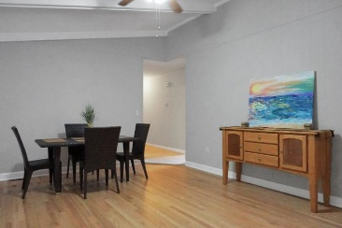
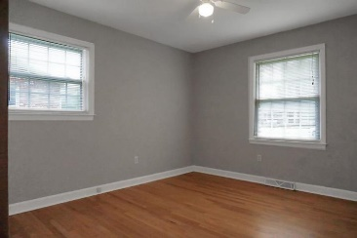
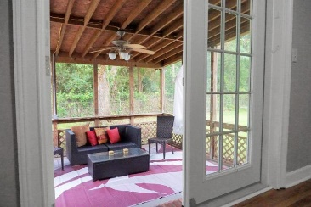
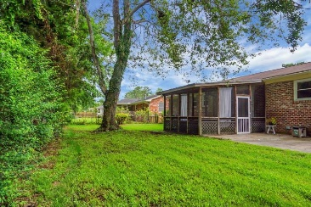

323 Susan Drive
Rotherwood Estates
Charleston, SC 29407
MLS# 20016195
$349,000
West Ashley
Close to Downtown
Reduced $32,000
This updated brick beauty is located in Rotherwood Estates near the Greenway Trail and minutes to downtown.
3 Bedrooms 2 Full Baths, large kitchen, cathedral ceiling dining area and screen porch. Newly refinished hardwood floors, large family room also boasts a flex area that could be used as a home office.
NO HOA! There is plenty of room on the side driveway with double gates so bring that boat/RV along. Flood zone is AE, current owner pays $1211 annually.
Gerri Sandford
(843) 817-8762
gsandford29455@gmail.com
Anchor Line Realty LLC
1619 Samuel Rd
Charleston, SC 29412

