Slide 1
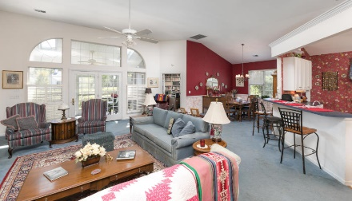
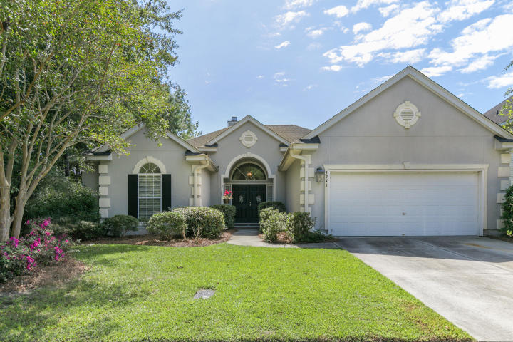
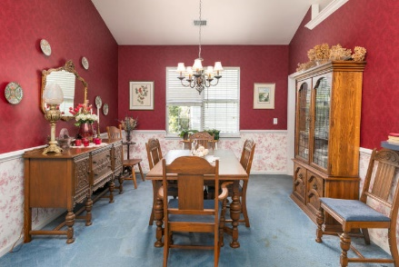
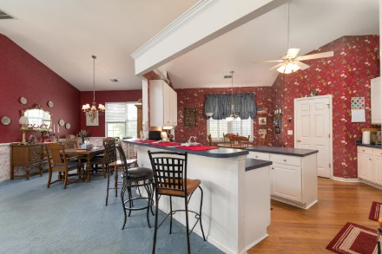
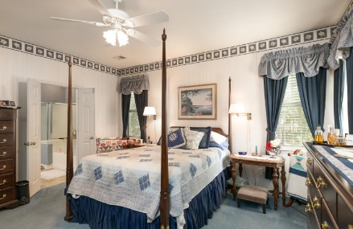
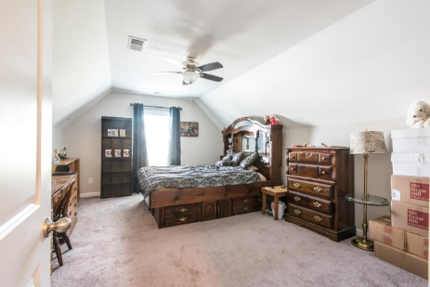
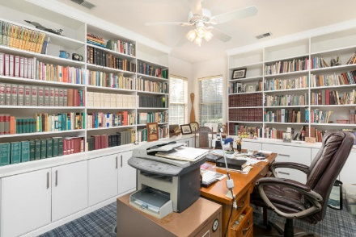
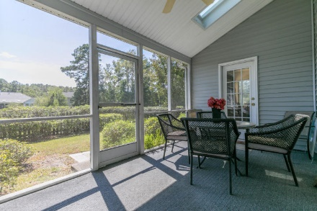
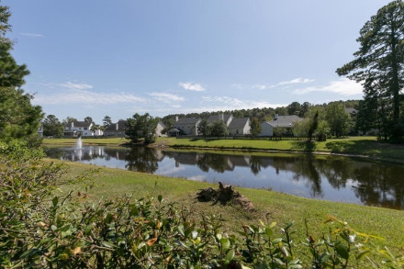


3241 John Bartram Place Park West · Mt Pleasant · MLS# 19026795 · $360,000
Open House Sunday from 2-4
Fabulous In Foxbank...
Sellers Say Sell!
This lovely home is nestled in the heart of Park West and sits on a peaceful pond lot next to a wooded HOA owned pathway so you only have one immediate next door neighbor. This stucco home is a true one story house with an open floor plan. Upon entering the double doors you are enter into the foyer. The open kitchen is enormous with tons and tons of counter space. There is an island and a breakfast area. Off the kitchen is a laundry/utility room that connects to the large two car garage. You can walk through the breakfast area into the spacious formal dining area. Both the dining room and the kitchen are open to the large family room that has built in shelving and a fireplace. Off of the family room is a very well appointed office/study that boasts custom built in shelving with filing cabinets that are also built in to match the shelving. The master bedroom is also of generous size and it sits in the back of the home for a quiet and peaceful setting. There is a large en suite bathroom with a walk-in shower, garden tub and double sink vanity. The master closet space is also grand and is conveniently located just off of the master bathroom. There are two extra bedrooms on the other side of the home to create privacy from the guest area. These two bedrooms are also quite large and share a full bathroom. There is a lovely screened in porch off of the back of the home that overlooks the pond and the fenced in back yard. The location is awesome for Park West as it is in the Foxmoor section which is closer to the entrance off of Highway 17. This home is priced to sell! You can tell there has been lots of love there and it is ready for its new owners.
Carey Nikonchuk
(843) 276-1701 M
cnikonchuk@gmail.com
www.palmettoproperty.net

