Slide 1
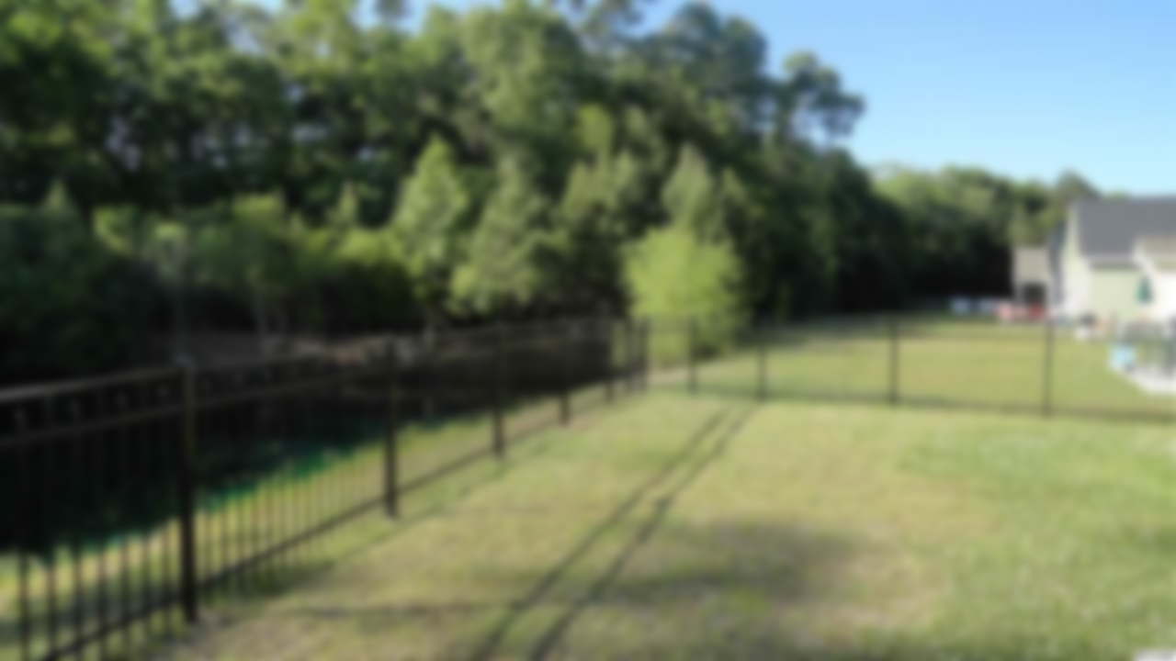
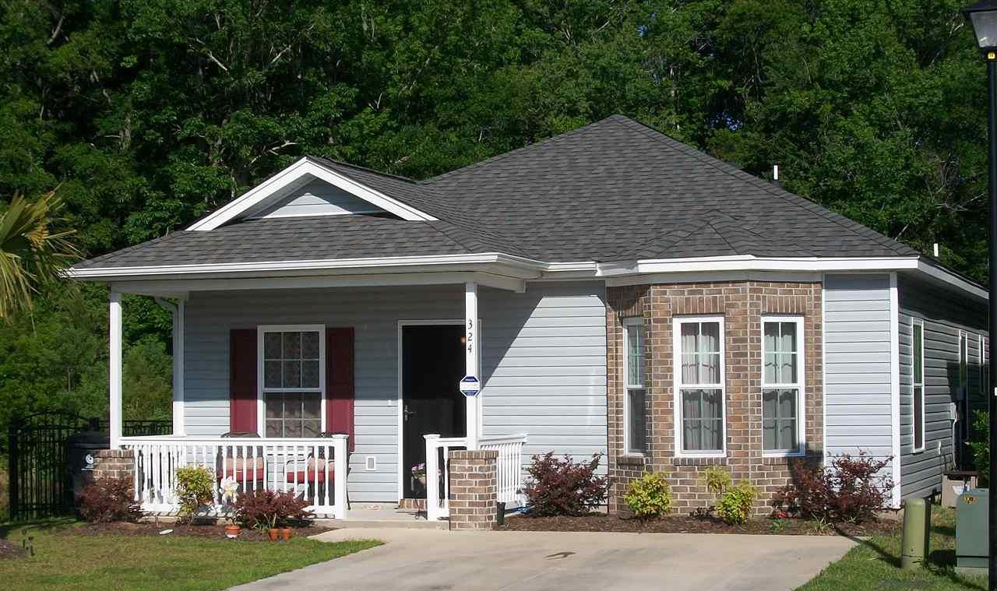
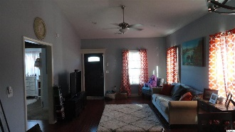
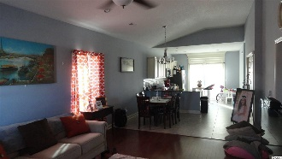
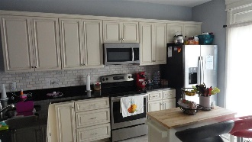
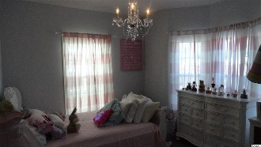
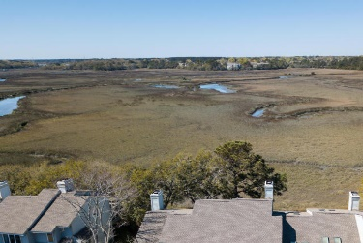


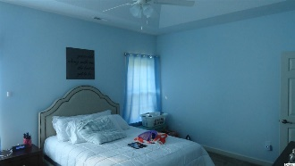

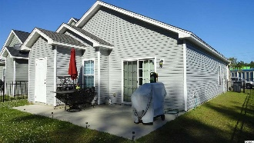
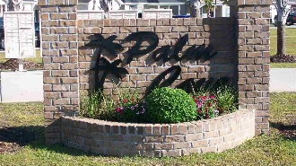
Great Discounted Price for a Great Property in Myrtle Beach!
Seller is offering the Buyer a credit for a home warranty
324 Palm Cove Circle
Palm Cove ~ Myrtle Beach, SC 29588 ~ MLS# 1809264 ~ $167,900
3 BD · 2 BA · 1301-1400 Est. SF Under Roof
Palm Cove is an exciting new home community on Palmetto Point Blvd. just across Hwy 17 Bypass from Withers Preserve and the Market Common area. This great location provides quick access to the beach, Market Common, recreation areas, walking areas, ball fields, Coastal Grand Mall,...and just about any location on the beach,...easy access everywhere! Great open plan with many upgrades as standard,...granite counter tops, stainless steel finish appliances, upgraded wood cabinets with dove tail construction and slam proof construction detail, et cetera. Note also that this particular lot is a premium lot,...oversized and located at the end of Palm Cove Circle,...with just one neighboring property on one side. Sign on property. Easy to See!
The Sun Group
PO Box 2278
Murrells Inlet, SC, 29576
Don Morris
843-543-2272
dimorris7@gmail.com

