Slide 1
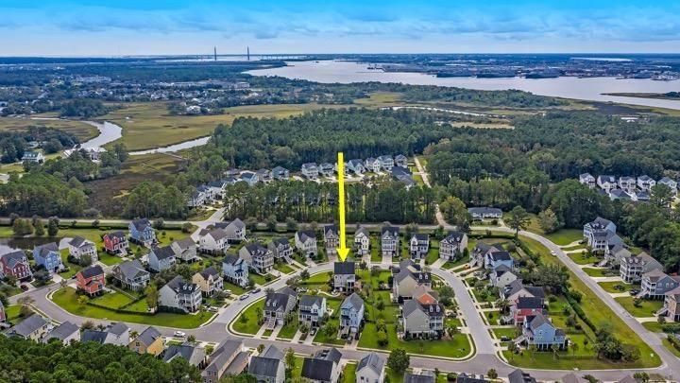

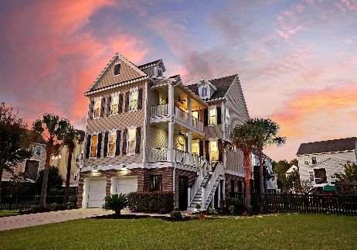
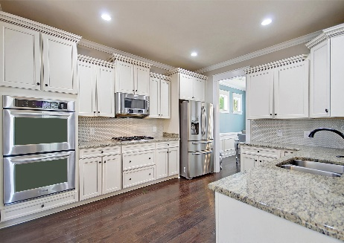
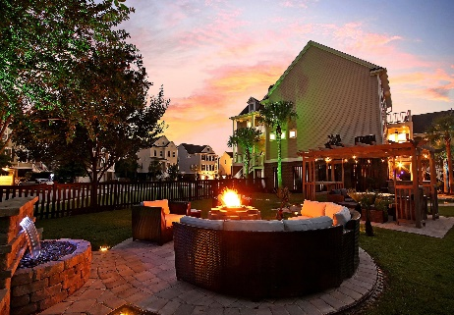
Open House Saturday 12-3
Price Reduced
For Quick Sale
Open House Saturday 12-3
324 Megans Bay Lane
Shellring at St Thomas Island ~ Charleston, SC 29492 ~ MLS# 20030202 ~ $595,900
GORGEOUS home with Resort-Style Backyard Entertaining Oasis! Welcome to Shellring at St. Thomas Island, a secluded, highly coveted community of Charleston Style homes, just a golf cart ride away from the shops, parks and restaurants on Daniel Island! This magnificent, 2-story elevated abode situated on a huge .31 acre lot is MAGAZINE WORTHY with a dramatic front stairway, two extra long driveways, double front porches, designer lighted landscaping and a HUGE, new construction, custom outdoor living and entertainment space -no other home in the neighborhood has anything like it! Greeted by a gas lantern at the front door, step inside and be impressed by gleaming 5" weathered saddle hardwoods throughout the entire first floor. This elegant, stylish home features a gas fireplace in the spacious living room, recessed lighting throughout and built-in ceiling speakers upstairs and down.
The home's open, airy floor plan features high ceilings and is flooded with natural light from a bounty of windows encased in quality plantation shutters throughout. The beautiful state-of-the-art eat-in kitchen is every chef's dream featuring upgraded cabinetry, granite countertops, high-end Kitchen Aid stainless appliances including a gas range and double ovens. Soft-close drawers and a stunning coin tile backsplash complete this elegant, functional kitchen. The laundry room and large pantry are conveniently located right off the kitchen.
The owner's suite is privately tucked away on the main floor, replete with two walk-in closets and a spa-like ensuite with soaking tub and walk-in glass shower with rainfall head.
Upstairs you'll find a huge bonus space with custom built-in cabinetry and shelving, perfect as a gathering room, den, or hang out space. Additionally, there are three roomy bedrooms, two full baths and the perfect, spacious office with a glass paned door and sliding privacy panel which looks out into the loft when open, or can be closed off for total privacy.
The home boasts multiple porches, two on the front, one in the back that is screened in, and an exterior upper deck for sunning. There is a huge 3+ car garage reinforced with heavy plastic preventing rain, pollen, dust or dirt from entering the space and ample storage for tools, lawn equipment, a workout area, bikes, a small boat or a golf cart.
Saving the best for last, the owners spared no expense with the addition of a new fabulous outdoor space that truly sets this home apart from any other! The large, corner fenced-in yard features a built-in outdoor kitchen, pavered hardscaping throughout the grounds, a custom pergola seating area and cozy gas fire pit space backed by a soothing waterfall. There is also a solar powered custom light system which can be adjusted to choice of white or a soothing cool tone which tops off this amazing outdoor entertaining space!
Shellring's amenity center has a beach-entry pool, an oyster pavilion with a huge fireplace, Viking Grill and plentiful seating on the marsh for friendly neighborhood or social gatherings. With just a bike or golf cart ride to Downtown Daniel Island for shopping, dining, parks and trails, Shellring at St. Thomas Island is an amazing investment without the Daniel Island price. This neighborhood is easily accessible to Mt. Pleasant, Downtown, North Charleston, I-526 and I-26. Make an appointment for a private tour today and make this your very own dream home!
Book your showing today!
Amanda Shannon amanda@mattoneillteam.com 843-437-1318

