Slide 1

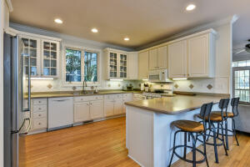
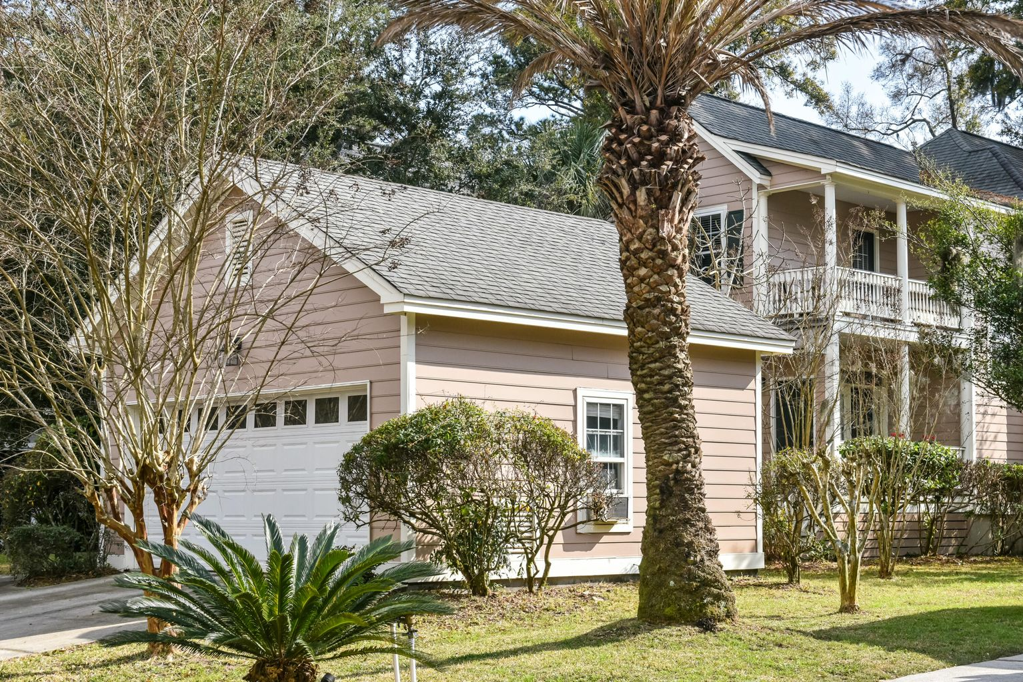
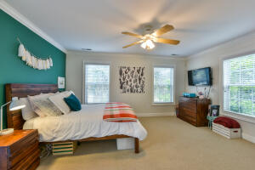
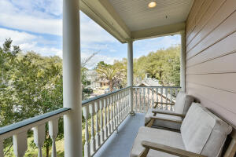
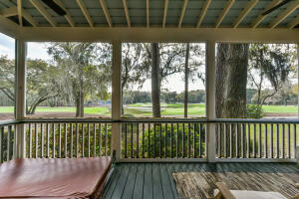
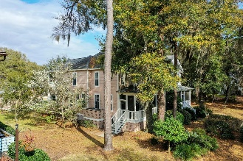

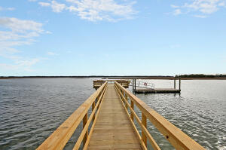
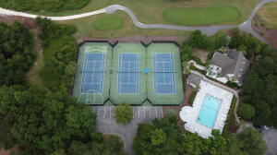


Just Listed!
This Charleston single house exudes Lowcountry charm with its double covered piazzas and soft pastel color. It is located in Johnstowne in lovely, gated Kiawah River Estates. Johnstowne is a stamped brick street with gas lamps at the entrance. Here, life slows down so that you can fully enjoy your surroundings. You will love relaxing on the screened porch overlooking the lagoon and green of the 14th hole of Kiawah Island Golf Resort's Oak Point Golf Course. You can soak in the hot tub here, watch the amazing wildlife, and enjoy the southern breeze and wonderful afternoon light. Downstairs in the home you will enjoy oak flooring and 2 large living areas; one just inside the entrance door and the other with a fireplace and built-ins at the back of the home. In between is a large kitchen and dining area and a powder room. The kitchen has plentiful cabinets & solid surface countertops with bar seating.
Upstairs are 3 large bedrooms and 2 full baths with granite countertops. The master suite is on the back overlooking the golf course. Enjoy low taxes, low POA fees, and NO flood insurance requirement. There is a 2-car garage plus an additional off street parking area.
As an owner here you will have access to a clubhouse with fitness center, community pool, dock & park, and tennis/pickleball courts. Optional membership in Kiawah Island Governor's Club is available for access to 10 miles of pristine beach and amenities. Bohicket Marina and Freshfield's Village shopping area extremely close for your shopping and dining needs.
3251 Johnstowne Street
Kiawah River Estates | Johns Island, SC 29455
MLS# 22006155 | $799,000
Highlights:
Traditional Charleston Single
Screened Porch with Hot Tub
2200 S.F. 3BR/2.5BR
Detached 2-Car Garage
Sits on a Lagoon on #14 of Oak Point Golf Course
Gas Fireplace and Built-Ins
Gated Community
Neighborhood Pool, Tennis Courts, Dock, Clubhouse w/Fitness Center
Option to join the Kiawah Island Governor's Club
Lee Lindler
Cell (843) 637-0803 | lee@akersellis.com
Akers Ellis Real Estate LLC | 3730 Bohicket Road, Suite 5 | Johns Island, SC 29455
akersellis.com

