Slide 1

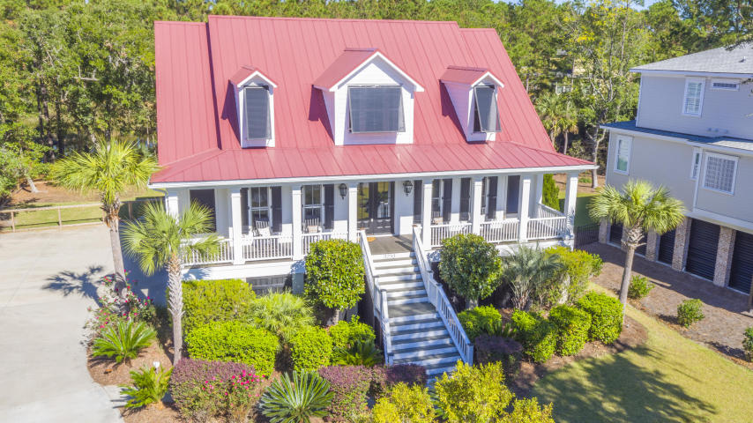
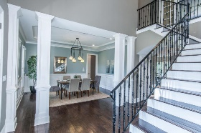
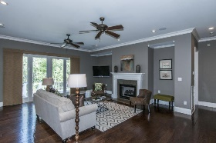
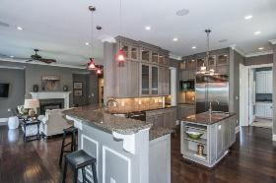
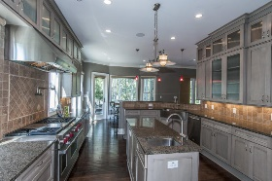
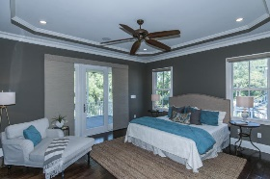
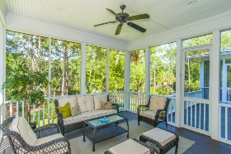
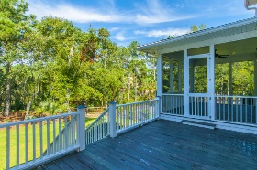
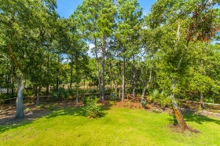
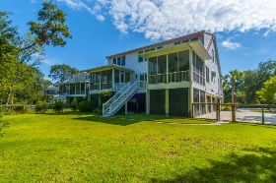
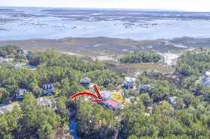


Hamlin Plantation
Open House Saturday
February 18th, 1-3pm
3253 Sand Marsh Lane
Mount Pleasant | MLS# 16026141 | $988,750
One of a kind, custom built home in The Sound at Hamlin Plantation. Set on almost a half acre, 3253 Sand Marsh is located on a quiet cul-de-sac with private marsh views. The large wraparound front porch with gas lanterns gives way to an open floor plan with hardwood flooring throughout. The two story foyer is flanked by an office with french doors and a formal dining room with custom lighting. The kitchen boasts a Sub Zero refrigerator, Wolf Stove/Ovens/Hood/Microwave, 2 sinks, island, wet bar, and Viking wine cooler. The master suite on the first floor features a private screened porch, and the master bathroom is loaded with all the bells and whistles! Enjoy the heated tile floor, steam shower, his and her vanities and walk-in closets, a TV and much more! The laundry room with granite counter tops, half bathroom, and expansive back porch with two separate screened areas make-up the remainder of the first floor. Upstairs, there are three additional bedrooms with en suite bathrooms, granite counter tops, and shower/tub combos. Media room is also located on the 2nd floor along with a second laundry area. A mahogany elevator with built-in phone services all three floors including access to the 3 car garage that spans the footprint of the home. In the garage, be sure to check out the outdoor shower and custom dog friendly area. Significant safety features include custom hurricane shutters on the front and metal protection inserts around the doors and windows. A built-in generator is connected to natural gas and has its own breaker box, transfer switch, and runs automatically when the power goes out. This home is twenty minutes from downtown Charleston and 7 to 10 minutes to the local beaches and golf courses. Community amenities are a 30 second walk away and include an extensive system of lakes, tennis courts, club house, community pool with water slide, work out room, walking trails, and boat storage area. The home has protected wetlands behind it meaning no one can build behind it for ultimate back yard privacy!
Lauren Courcoux
Mobile - (843) 224-8613
lauren.courcoux@carolinaone.com
www.laurendelucacourcoux.com
Carolina One Real Estate | 2713 Highway 17 North | Mt Pleasant, SC 29466

