Slide 1
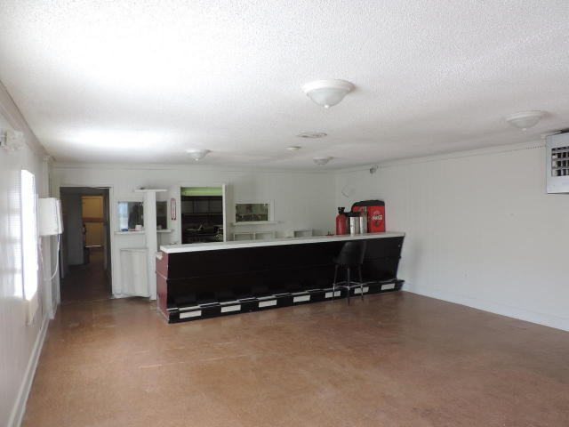
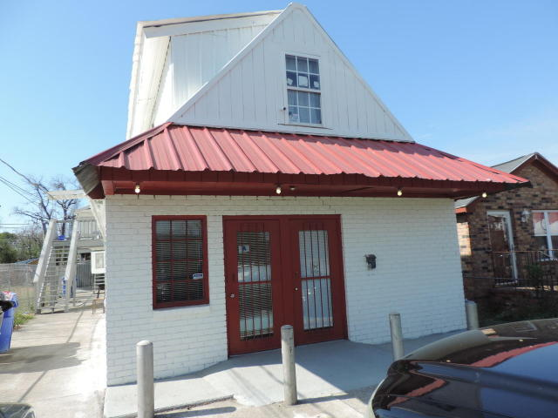
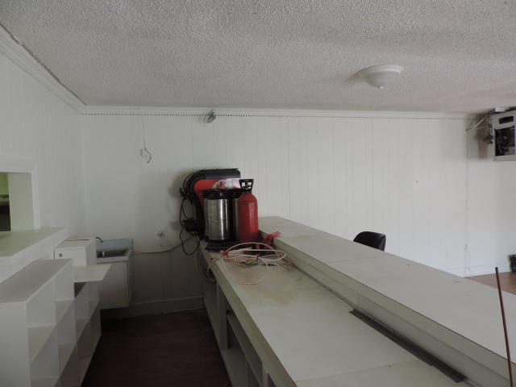
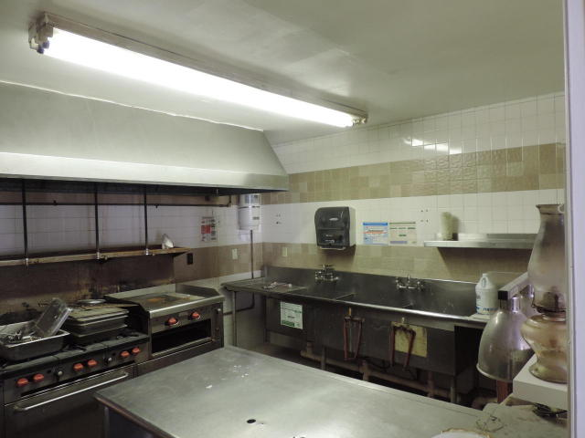
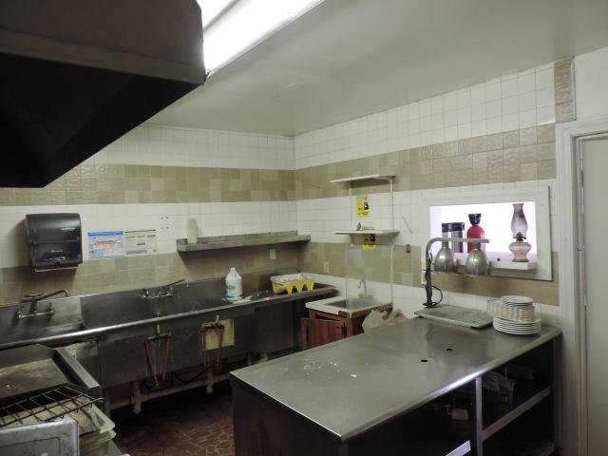


***PRICE REDUCTION***
3255 Meeting Street Road
North Charleston, SC 29405 · MLS# 17008861 · $249,000
Michael Dew
O (843) 870-7000
M (843) 870-7000
michaeledew@gmail.com
www.michaeldewrealestate.com
Great Business/Investment opportunity. Fully equipped restaurant on 1st floor with kitchen and storage or possible additional rental unit. 3 residential rental units upstairs. 2 are currently rented on month to month basis. One unit needs renovation. Only 3 miles from down town.
Unit 1: SqFt: 2,058; Baths: 3
Unit 2: SqFt: 450; Bedrooms: 1; Baths: 1
Unit 3: SqFt: 450; Bedrooms: 1; Baths: 1
Unit 4: SqFt: 450; Bedrooms: 1; Baths: 1
AgentOwned Charleston Group
902 Savannah Hwy
Charleston, SC 29407
Real Estate ● Mortgage Insurance ● Business Brokerage

