Slide 1
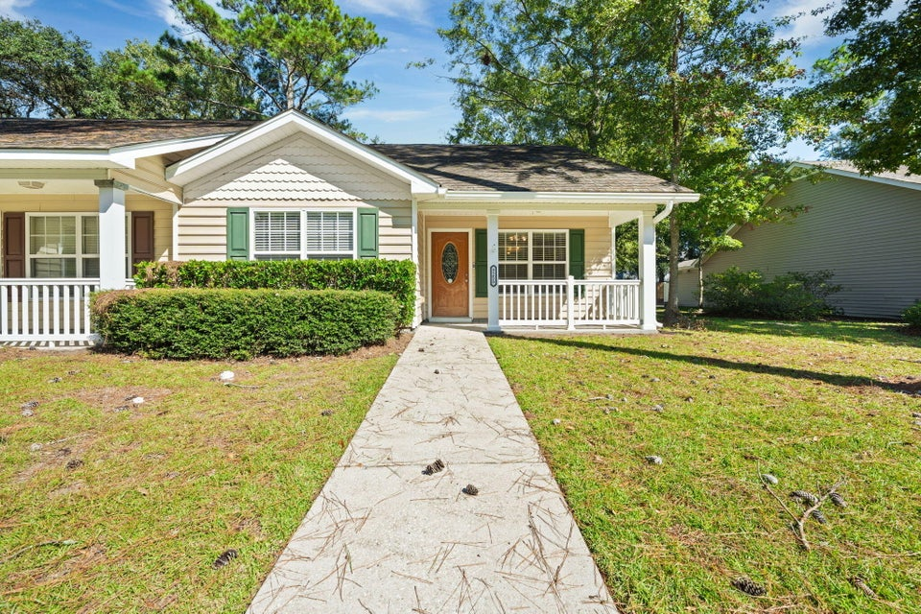
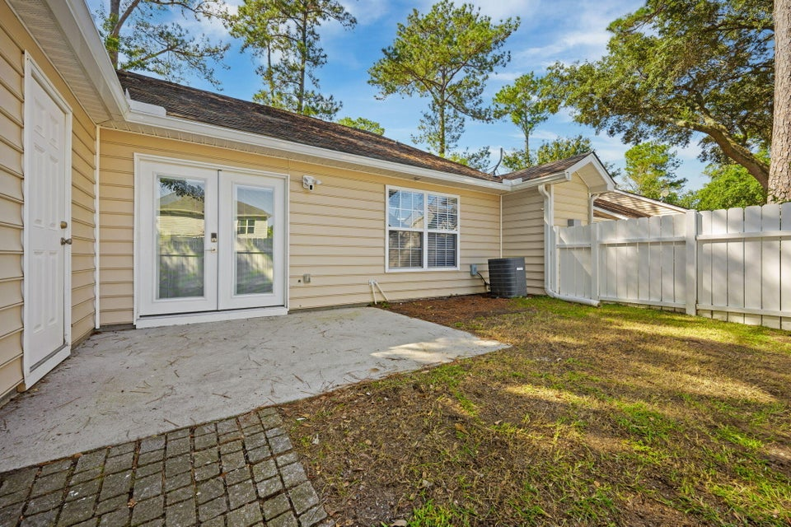
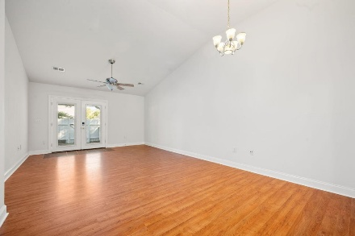
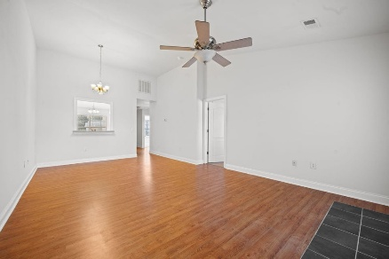
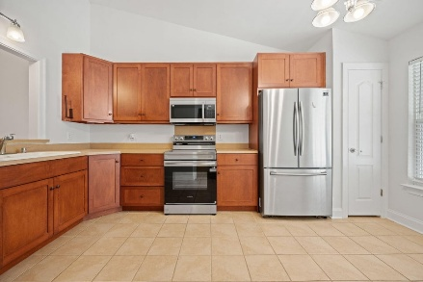
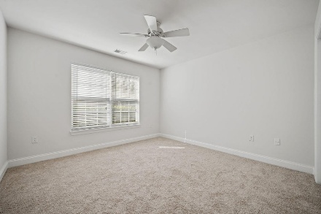
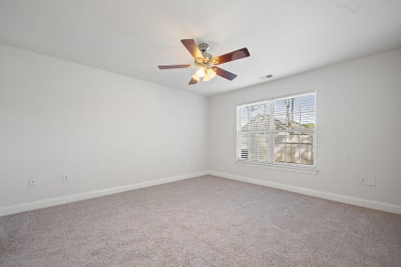
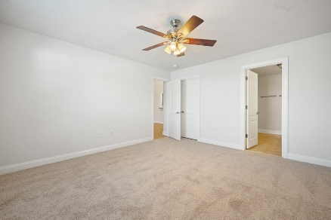
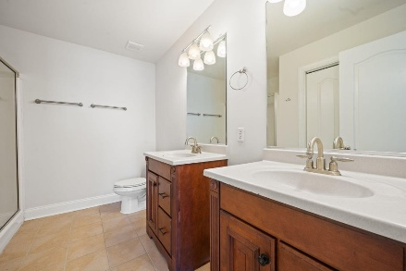
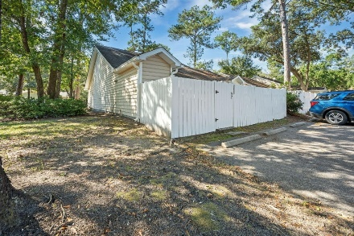


3255 Walter Drive
Village Gardens Move-in Ready End-Unit Townhome
Johns Island, SC 29455
MLS# 25028518 | $360,000
Welcome home to this beautifully updated two-bedroom, two-bathroom end-unit townhome, perfectly situated on the highly sought-after Johns Island. Step inside to find hardwood floors, tile, brand-new carpet and fresh paint throughout. The kitchen features new stainless steel appliances, ample cabinetry, and a bright open layout for comfort. A washer and dryer convey, making this home completely move-in ready. Relax and unwind in your private, fenced backyard, offering a peaceful time for morning coffee or evening cookouts. Located just minutes from popular restaurants, shops, and breweries along Maybank Highway. It's also just a short drive to Kiawah, Seabrook, James Island, and Downtown Charleston.
Come see this gem in person to appreciate all it has to offer.
Kelly Rozier
(843) 209-3129
kellywrozier@gmail.com
Brand Name Real Estate
4 Carriage Lane Suite 106
Charleston, SC 29407

