Slide 1
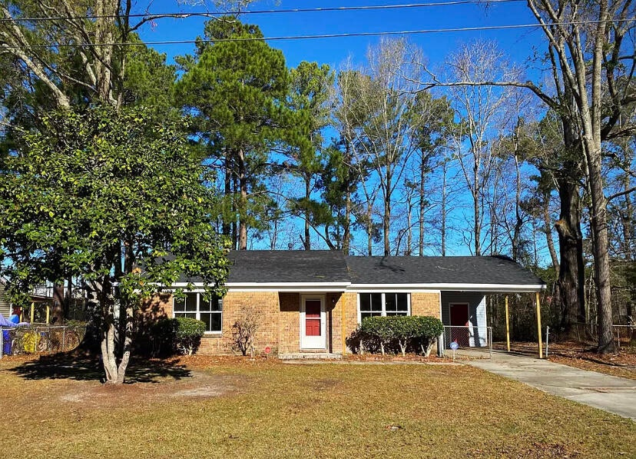
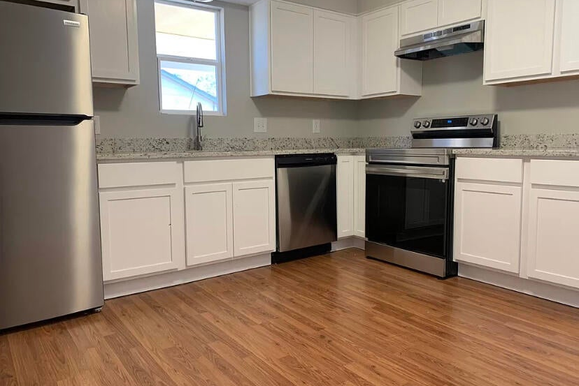
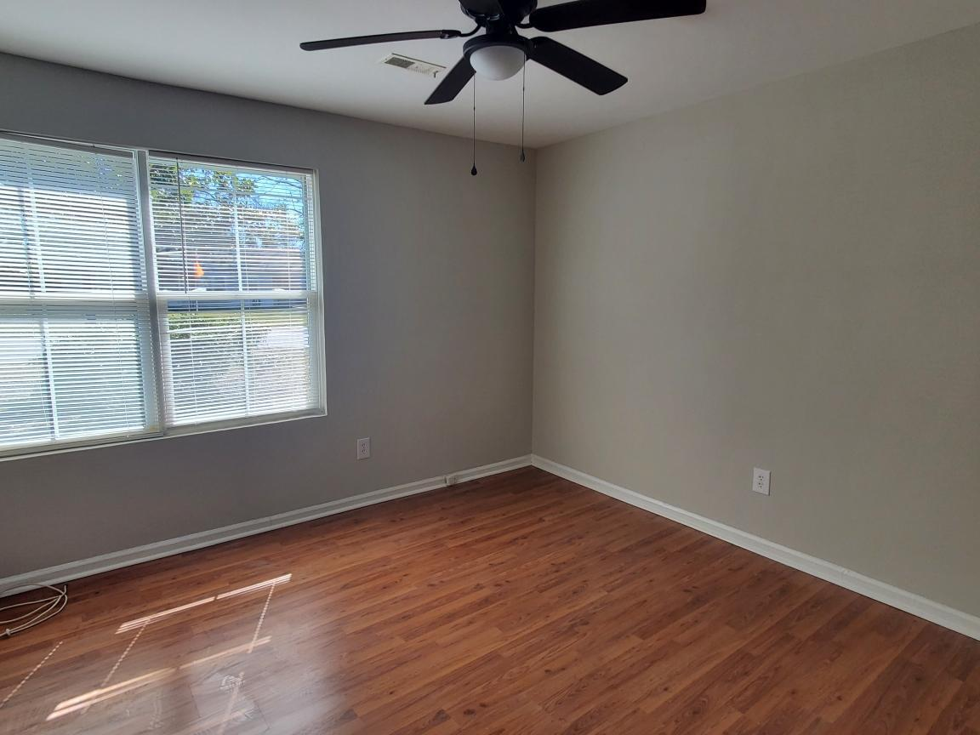
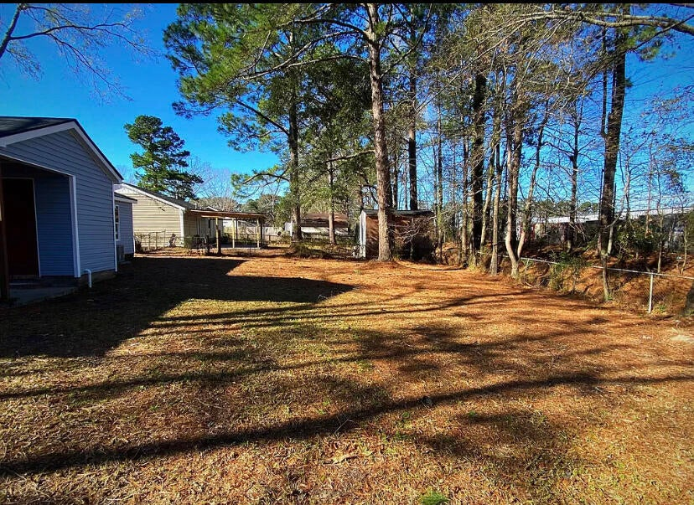
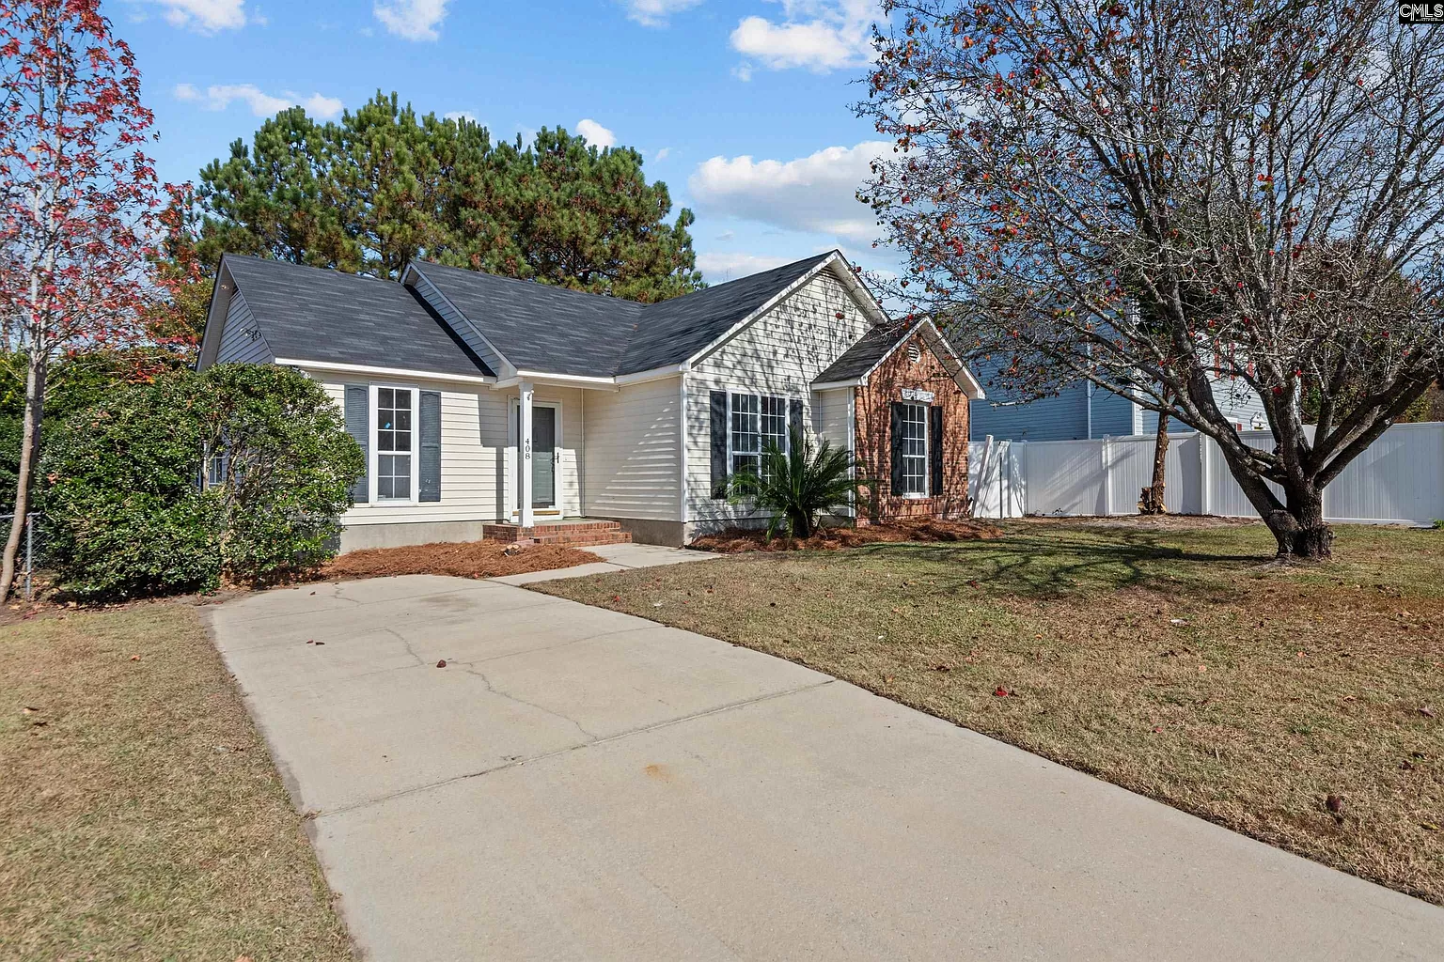




YOUR BEST VALUE WITH UNBEATABLE PRICE
3256 Vinewood Place
Pepperhill | N Charleston, SC 29420
MLS# 24004751 | $245,000
Susan Stanley
843-323-5573
susancstanley@gmail.com
1,040 SF
3 BEDS
1 BATH

