Slide 1
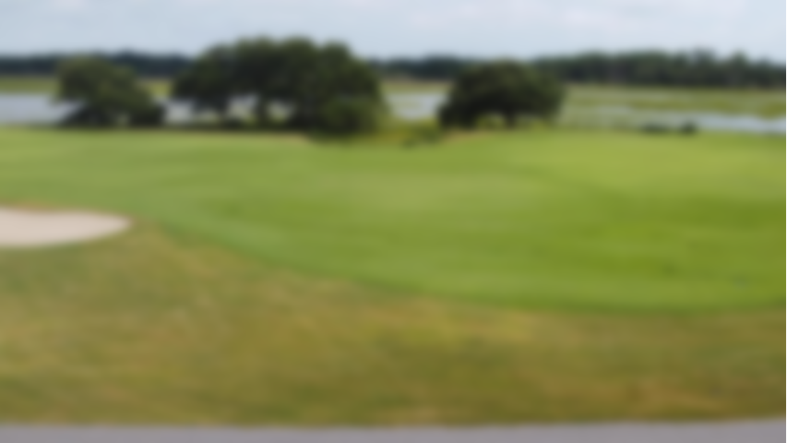
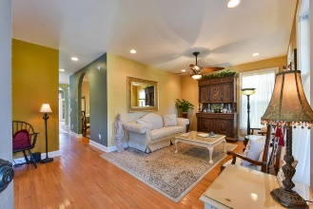
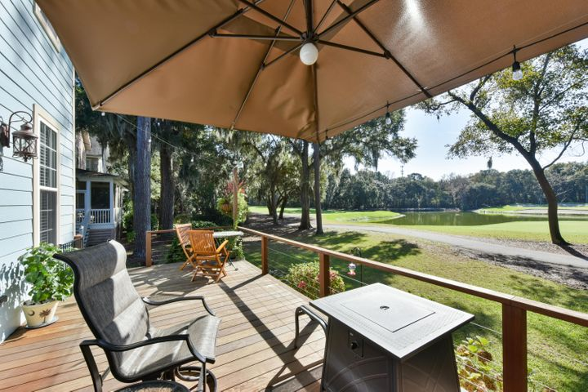
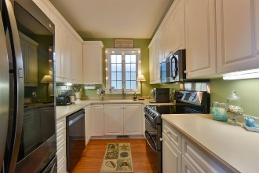
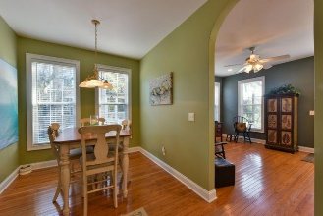
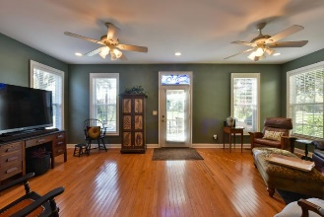
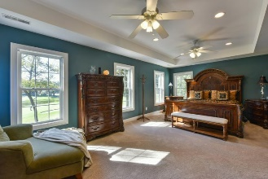
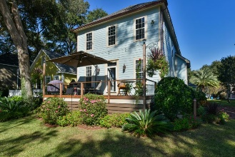
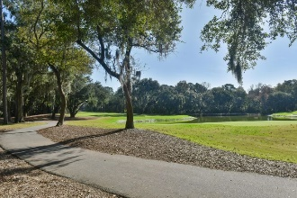
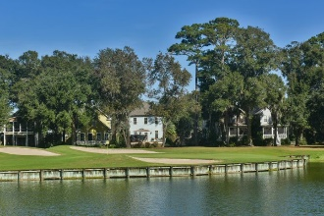


Lagoon View Lowcountry Gem
3257 Johnstowne Street
Kiawah River Estates | Johns Island, SC 29455
MLS# 20031812 | $555,900
Immaculate Lowcountry home with lots of bells and whistles on Kiawah Island Golf Resort's Oak Point Golf Course with a beautiful lagoon view. This home is low maintenance and energy efficient with its cement fiber board siding, new roof, 2 new Trane high-efficiency HVAC systems, and new high-end stainless steel kitchen appliances featuring a clear door refrigerator that makes craft ice. And it's a short walk to the community pool, clubhouse, and tennis courts. Johnstowne Street has an old Charleston feel with its red stamped brick roadway and traditional styled architecture, and cooper accents from the gutters with pineapple rain chains, and pineapple newel post ornaments welcome you to this lovely abode. At night you set the mood with multicolor LED Wifi exterior lighting located under the railings. The yard lights light up the beautiful palm trees in the fully irrigated yard. The full front porch and the rear deck give you great options for your outdoor chill time. The exterior decking and railing on the front porch, the rear deck, and the privacy shutter are all beautiful Ipe, and stainless steel cables keep the view wide open.
There are too many details to list here…check out the listing to read more!
Take a virtual tour: https://my.matterport.com/show/?m=9SaZQ1nTD3n
Lee Lindler Cell (843) 637-0803 | lee@akersellis.com
Akers Ellis Real Estate LLC | 3730 Bohicket Road, Suite 5 | Johns Island, SC 29455 akersellis.com

