Slide 1
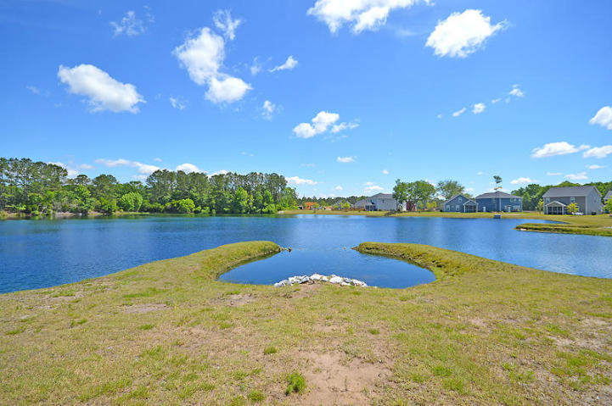
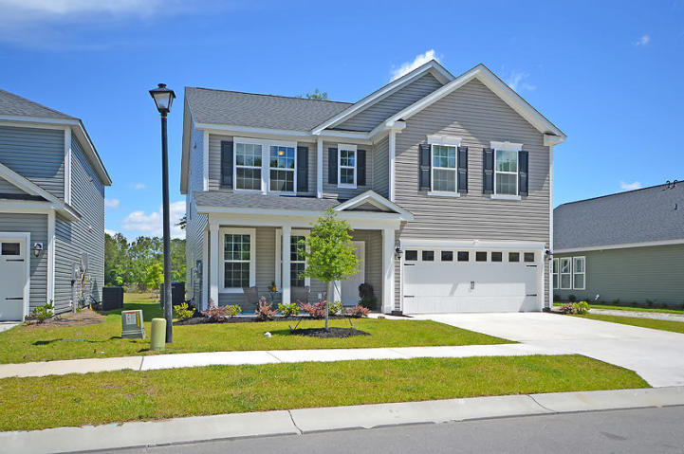
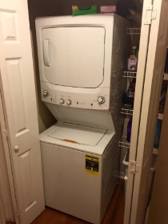
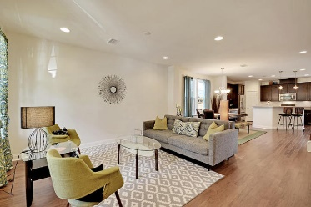
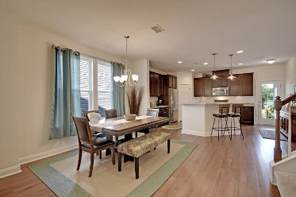
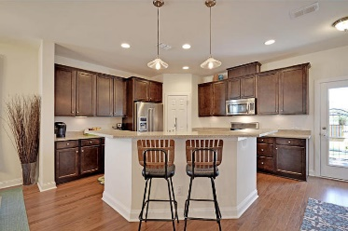
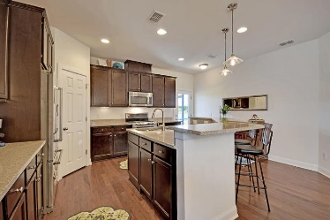

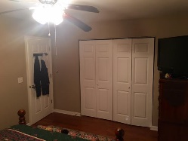
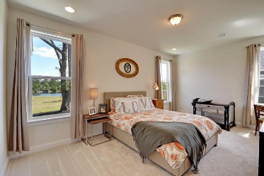
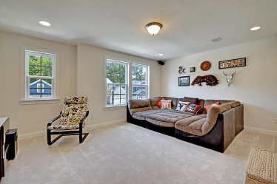
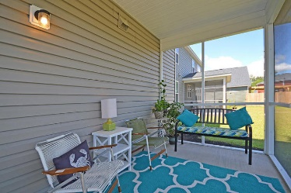
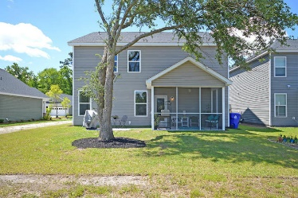


3258 Hartwell Street Maybank Village Johns Island, SC 29455 MLS# 16013082 $329,975
~ Priced to Move ~ Motivated Seller ~
2015 home available NOW! Why wait?! Gently lived in almost new home in Maybank Village. Premium Lot, every room from the back has a great view of the water, and better privacy than most other lots in the neighborhood. Large upgraded kitchen with top of the line fridge, double oven, granite countertops, under cabinet lighting and tons of storage. Huge island perfect for entertaining with your open concept main floor. Hardwood throughout kitchen, living room, and dining room. Master bedroom on the main floor has large bathroom en suite. His and hers walk in closets. Largest bedroom could be a second master. Media room with 5.1 Dolby Surround Sound. All bathrooms large with plenty of storage. Secondary bedrooms great size with walk in closets. Screened in porch to enjoy the pond view.
Joshua Pono
(619) 384-8163
pono@ponosrealestate.com
www.ponosrealestate.com
AgentOwned Realty Co. Premier Group, Inc. | 824 Johnnie Dodds Blvd | Mt Pleasant, SC 29464

