Slide 1
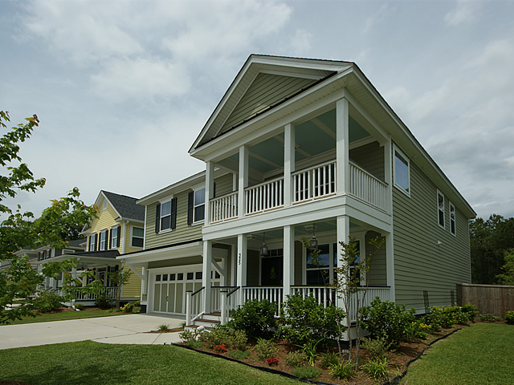
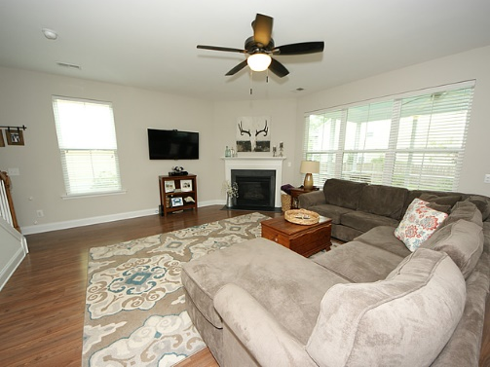
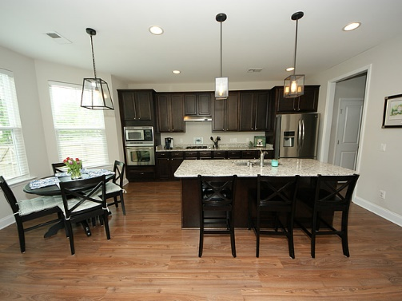
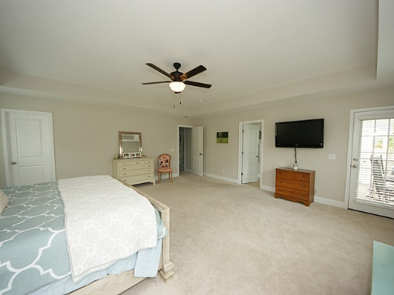
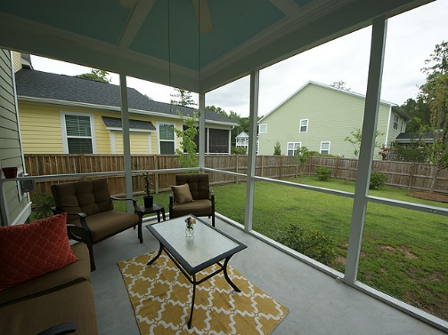


Branch Creek Open House Saturday from 11-1! 325 Brick Kiln | Summerville, SC 29483 | MLS# 16012719 | $279,000
137 Beaufain Street
MLS# 15000837 - $1,150,000
Beautiful 2-story home in popular neighborhood of Branch Creek! Upon entering you will notice formal dining room with coffered ceiling. Large kitchen with granite countertops, stainless steel appliances and built-in sound system. Eat-in kitchen and bar-top area as a bonus! Open to spacious living area with gas fireplace! Screened-in porch leads to fenced backyard perfect for entertaining. Upstairs you will find a loft with french doors perfect for kids playroom or office space. HUGE master with tray ceiling and double walk-in closets, complete with balcony porch is perfect for relaxing. Master bath boasts double sinks, garden tub & stand-up shower. Two additional bedrooms upstairs as well as large laundry room. You don't want to miss out on this one!
Check out the virtual tour for more pix!
Melissa Britt Thierfelder, MRP melissabritt@remax.net
Office: 843-442-8787 | Cell: 843.725.8016
www.melissabritt.remax-carolina.com
RE/MAX Elite | 91 Broad St | Charleston, SC 29401

