Slide 1
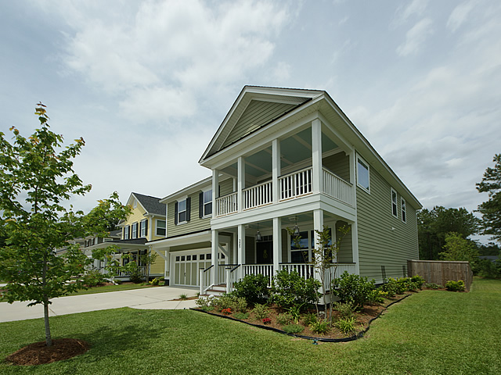
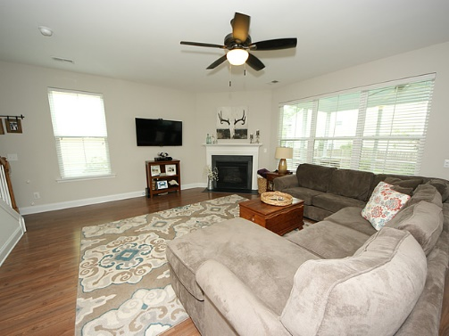
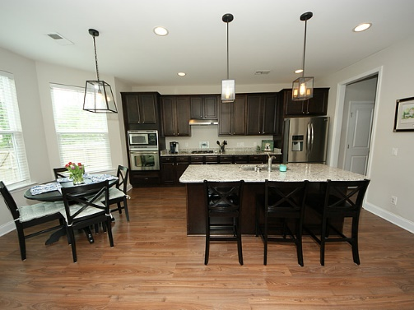
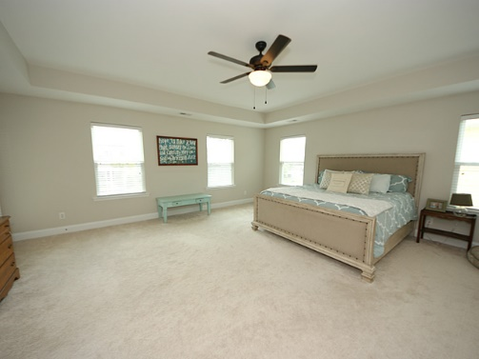
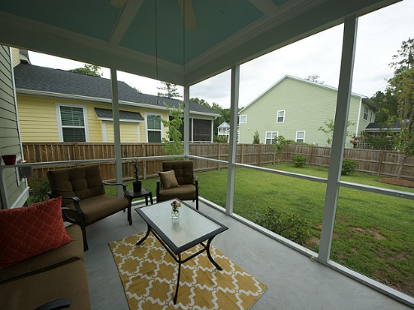


Price Reduced in Branch Creek! 325 Brick Kiln | Summerville, SC 29483 | MLS# 16012719 | $282,000
Beautiful 2-story home in popular neighborhood of Branch Creek! Upon entering you will notice formal dining room with coffered ceiling. Large kitchen with granite countertops, stainless steel appliances and built-in sound system. Eat-in kitchen and bar-top area as a bonus! Open to spacious living area with gas fireplace! Screened-in porch leads to fenced backyard perfect for entertaining. Upstairs you will find a loft with French doors perfect for kids playroom or office space. HUGE master with tray ceiling and double walk-in closets, complete with balcony porch is perfect for relaxing. Master bath boasts double sinks, garden tub & stand-up shower. Two additional bedrooms upstairs as well as large laundry room. You don't want to miss out on this one!
$1,000 Bonus
if ratified by 8/30
Check out the virtual tour for more pix!
Melissa Britt Thierfelder, MRP melissabritt@remax.net
Office: 843-442-8787 | Cell: 843.725.8016
www.melissabritt.remax-carolina.com
RE/MAX Elite | 91 Broad St | Charleston, SC 29401

