Slide 1
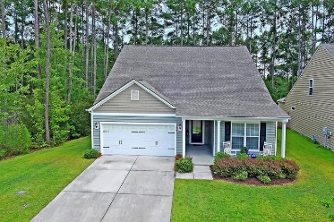
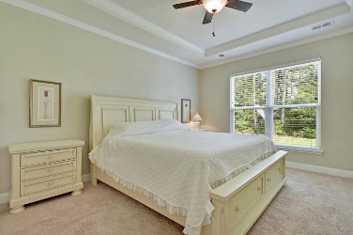
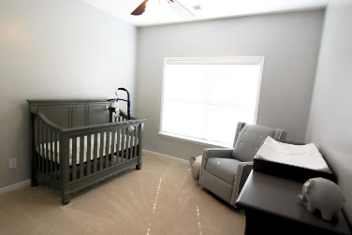
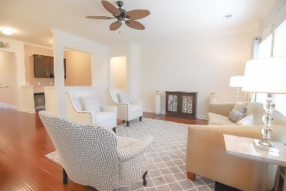
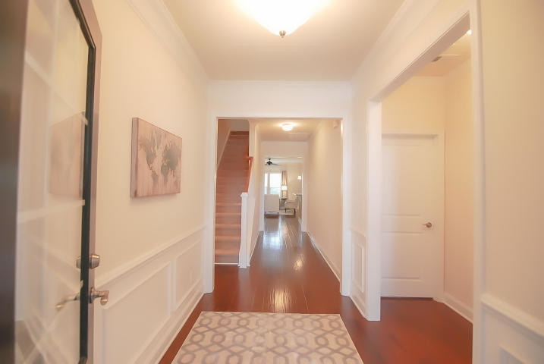
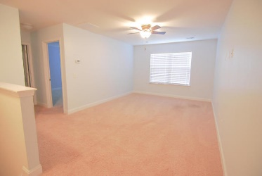
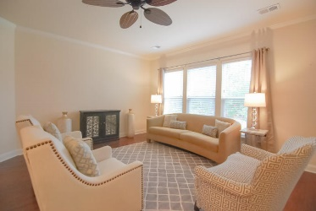
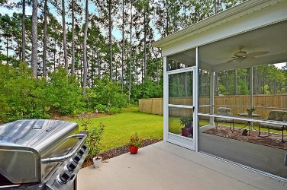
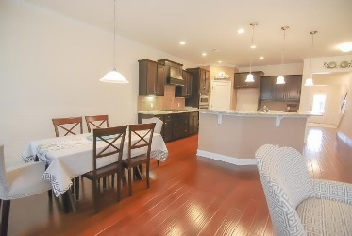
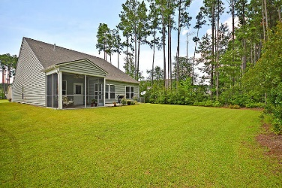



325 Decatur Drive Cane Bay Plantation Summerville, SC 29486 MLS# 19021061 | $319,500
Open House Jan 18th
10:00a-12:00p
$100 GIFT
CARD DRAWING*
MOVE-IN READY newer construction only five years old and still under warranty! This tree-lined homesite is one of a kind in Cane Bay. This type of privacy is hard to find in the community, and the home has every upgrade one could dream of. The grand foyer sets the tone and includes extensive hardwood flooring as well as trim detail: crown molding, chair rail and picture frame molding. The great room is perfect for entertaining and enjoying with family. The kitchen is upgraded throughout and includes upgraded cabinets with crown molding and hardware, gourmet stainless steel appliances with a five-burner gas cooktop, wall oven, microwave and dishwasher. The raised bartop also has pendant lighting in addition to the recessed can lighting in the kitchen. The dining area is quite spacious and open to the family room, as well as the home office, all of which have gleaming hardwood flooring and lovely crown molding. The first floor master suite has a tray ceiling with crown molding, deluxe master bath with double sinks and raised vanity with granite counter tops, 5' custom tiled shower with a seat and dual showerheads including rainfall head, separate water closet, two linen closets and an enormous walk-in closet. You will also find two other bedrooms, a full bathroom with double sinks and a walk-in linen closet, laundry room (with upper and lower cabinets plus a laundry sink) and mud area on the first floor. Upstairs, there's a huge loft, the fourth bedroom, another full bathroom and plenty of closet space. The views are stunning from the screen porch and the patio where there's a gas connection for your grill! The THREE car garage is perfect for extra storage, a workshop, mancave etc. The benches and upper organizational racks will be left for the new owners to enjoy. There is also a sink in the garage. Cane Bay's amenities are unrivaled, and the community is self contained with top rated schools, shopping, restaurants, grocery store, medical facilities and more. TAKE ADVANTAGE OF TODAY'S RATES - DON'T WAIT TO BUILD!
Beth Moore
M (843) 532-4892
bmoore@carolinaone.com
Meg H. Kandik
M (843) 814-5137 | O (843) 603-4659
Meg@HolyCityRE.com | www.holycityre.com
Bennett Construction & Realty | 792 Folly Rd | Charleston, SC 29412

