Slide 1
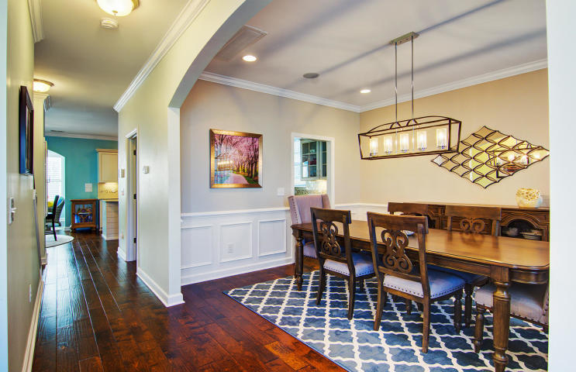
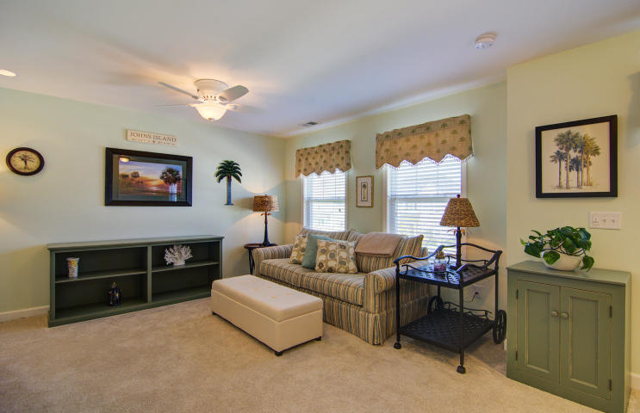
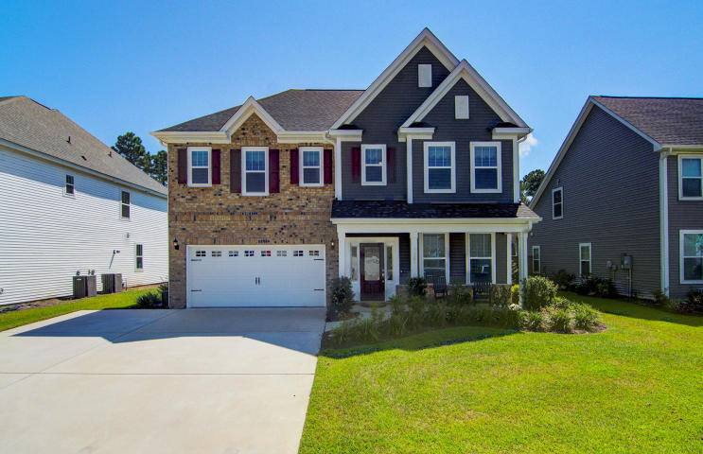
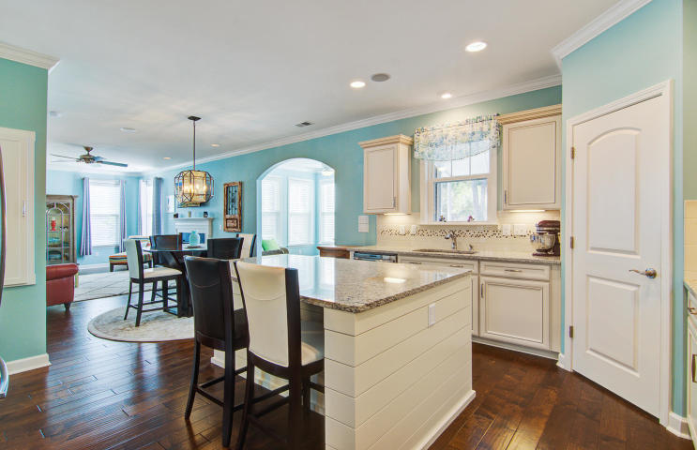
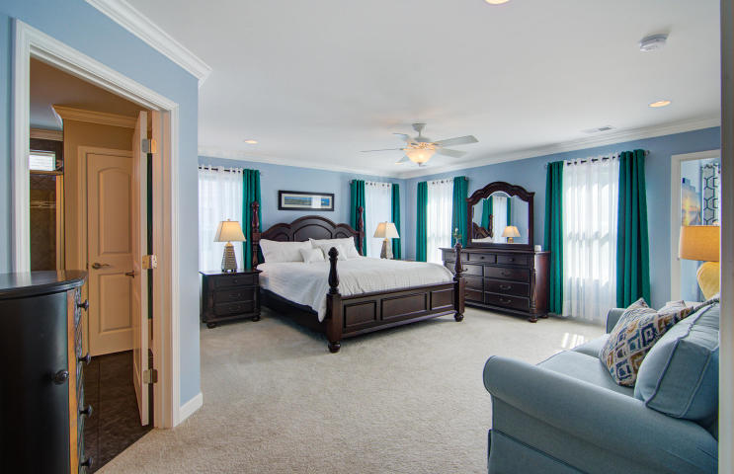
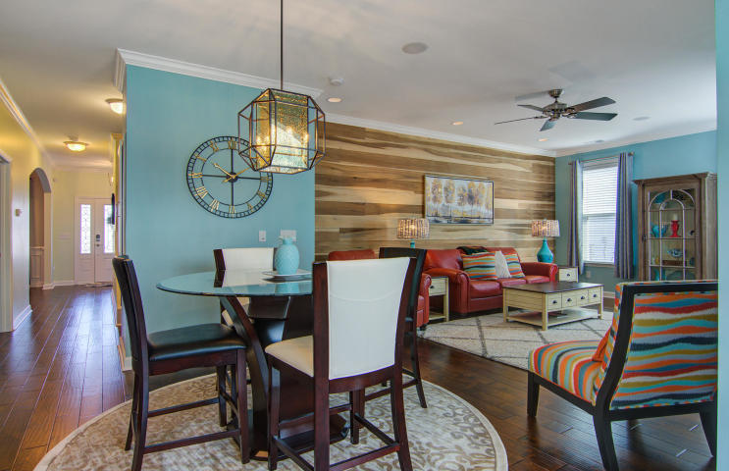
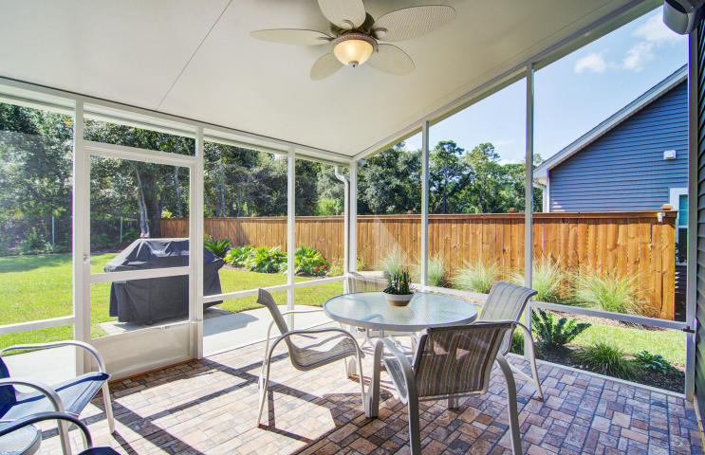
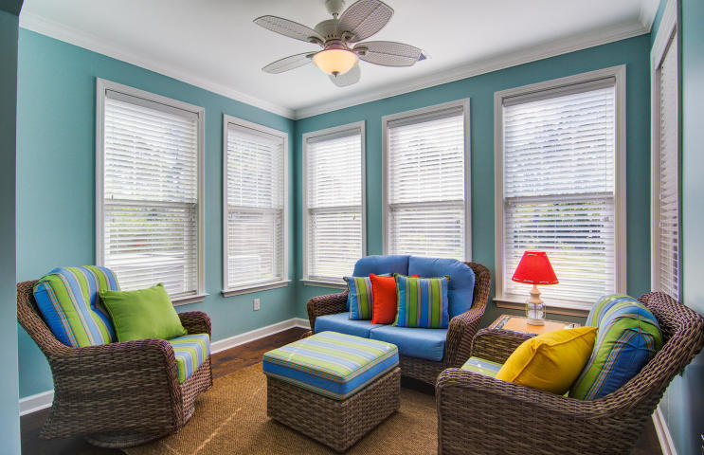
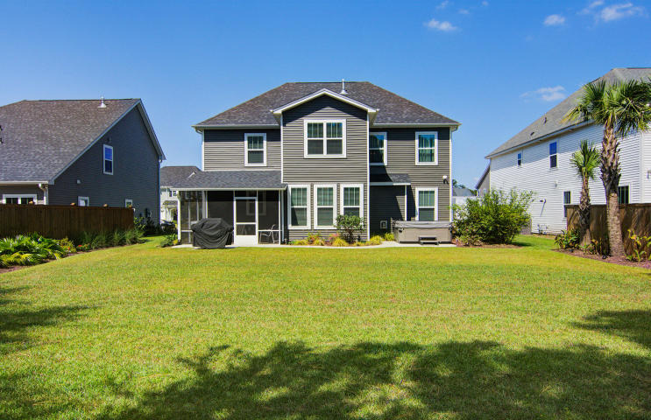


New Listing on Johns Island!! Won't last long...ACT TODAY!!
3263 Arrow Arum Drive
Fenwick Woods
Johns Island, SC 29455
MLS# 18026171 ~ $389,900
This stunning home can be summed up with three simple words: BETTER THAN NEW! If you love the idea of new construction but don't have the time, patience or bravery to have a new home built, then look no further! The moment you step inside 3263 Arrow Arum Drive you will think you entered a model home! Two years young, this home shows no signs of wear and tear (current owners have no children or pets). The home features a significant level of tasteful builder upgrades throughout. The gleaming hardwood floors throughout the main level make a fantastic first impression upon entry. The kitchen was planned with the chef of the family in mind. The gas cook top and double wall ovens make meal prep for family and guests a joy! The kitchen has been outfitted with stainless steel appliances, gorgeous upgraded granite, upgraded cabinets and a pretty tile backsplash. The huge pantry is an added bonus and the large center island is perfect for casual meals and while entertaining since everyone gathers in the kitchen! There is a butler's pantry which provides even more room for storage and makes a great beverage station when entertaining. The open concept floor plan is featured in this home, yet there is a separate formal dining room for those special meals and on holidays. The current owners took advantage of the opportunity to have a sunroom and additional sitting room above added to their home during the planning phase. The result is the suite of all master suites! As you venture upstairs and head to the master suite on the rear of the home, you will be wildly impressed! The master bedroom is stunning- large enough to easily accommodate a king bedroom suite plus sitting area. Attached is a separate sitting room currently used as a home office and exercise room! It overlooks the picturesque back yard. The elegant master bath features gorgeous granite counters and double sinks, upgraded cabinetry, and the deluxe oversized shower option with twin linen closets. A sprawling walk in closet with built in shelving is tremendous in size and storage. A rare bonus in this home is the fact that the laundry room connects directly to the master closet for extreme convenience! This is a thoughtfully designed home! Also upstairs are the two guest bedrooms each with its own walk in closet. The guest bath is fully upgraded with granite counters and dual sinks as well as tile floors. A bonus room upstairs offers endless possibilities for a second living room, a home office, a game room, hobby room or any other need or desire you can imagine. This bonus room could easily covert to a 4th bedroom. There have been numerous enhancements to the home after the current owners moved in. The entire first floor has crown molding as does the master suite. Judges panels grace the formal dining room adding to its beauty. In the family room the striking poplar shiplap wall adds tremendous charm. Shiplap was also added to the kitchen island. The addition of the screened porch provided outdoor living opportunities. As you walk the grounds, you cannot help but appreciate the extensive professional landscape design that has been implemented. There are pops of color year round and a huge variety of plantings that add privacy where needed and beauty everywhere! This is a standout yard for certain, and an irrigation system was installed, too. A winding walkway connects the new screened porch to the large patio. Privacy fences ensure your time in the back yard will be enjoyable. You will be hard pressed to find a home this large and as beautifully upgraded and enhanced at this price point, so don't delay in making your appointment to schedule a tour! 3D Walk thru tour: https://my.matterport.com/show/?m=4C6Fk1tZEny
Ellen O'Neil
Broker/Owner, ABR, e-PRO, CNE
Charleston Realtor of Distinction
(843) 300-8530
www.EllenONeilProperties.com

