Slide 1
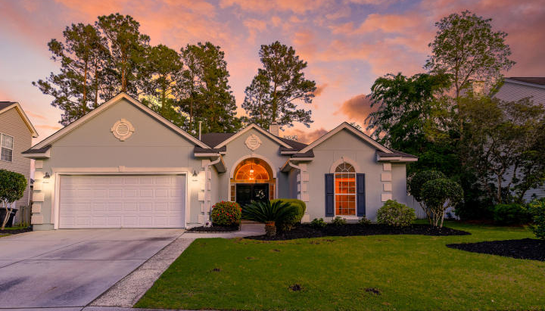

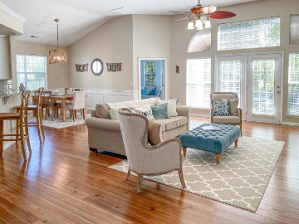
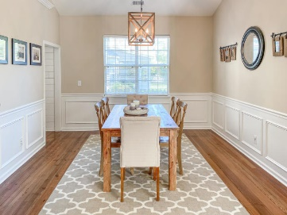
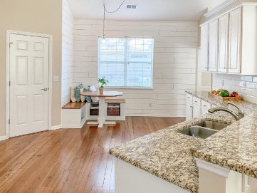
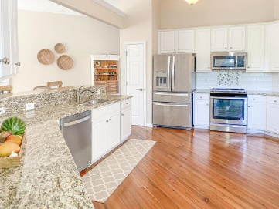
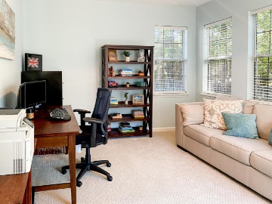
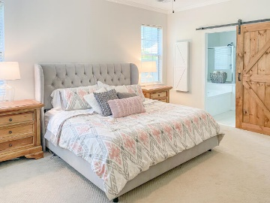
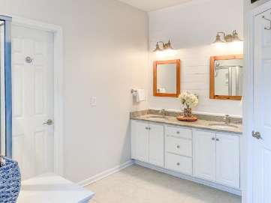
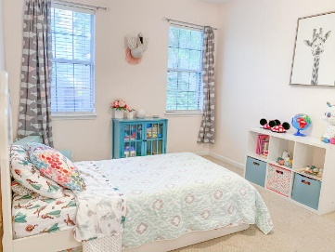
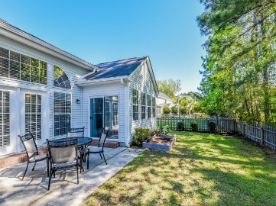
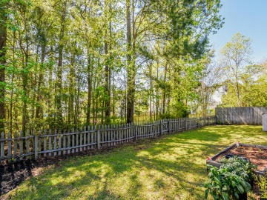
Great Downtown Investment Opportunity
Recently Updated One Story Living
3267 John Bartram Place Park West ~ Mount Pleasant, SC 29466 ~ MLS# 20009566 ~ $415,000
Hurricane impact resistant windows and doors
Smart home technology
Shiplap, vaulted ceiling in the breakfast room
Coffered ceiling, fireplace and custom built-ins in the living room
Master bedroom on main floor has two oversized walk-in closets with custom built-ins
Master bathroom has dual vanities with electronically equipped storage towers, heated floors, oversized walk-in shower and soaking tub
Separate dining room with custom trim work
Media Room/Home Office/Playroom on second floor with deck overlooking the golf course
Laundry room with extra storage, hanging rack and built-in ironing board
High efficiency HVAC systems with multiple zones (Warranty transferable to new owner)
One story living at it's finest! This charming home located in the Foxmoor neighborhood in Park West, is a short drive from historic downtown Charleston, the beaches and the airport. Recently updated, this home is perfect for buyers who are looking for easy living. The open floor plan features a coastal kitchen with stainless appliances, an eat-in area, a separate dining room and counter seating. The large family room with fireplace is perfect for entertaining. The first floor master bedroom has shiplap detail, a large walk-in closet with custom built-ins, and a barn door into the master bath. Owner's bath has dual vanities, shower and tub. In addition to the 3 bedrooms, there is a 4th room that would be ideal for a home office, playroom, den or home gym. This home is full of natural light and features heart of pine flooring throughout the main living areas. The fenced-in backyard features a large patio area, perfect for grilling and year round enjoyment. Recent updates to the home include: new appliances, granite countertops and tile backsplash in kitchen, new HVAC and water heater, new light fixtures, garage door openers/key pad, smart home technology (Nest thermostat and Ring doorbell) and new paint throughout the entire home. Convenient to schools, pools, parks, sports fields, tennis courts and shopping -- bike, golf cart or walk to everything you need in this fabulous neighborhood. This home has too many upgrades and features to list and must be seen to fully appreciate its location and layout!
Book your viewing today!
Paige Rhodes 843-830-3281 paige@mattoneillteam.com
Ben Laaper 843-642-3546
ben@mattoneillteam.com

