Slide 1
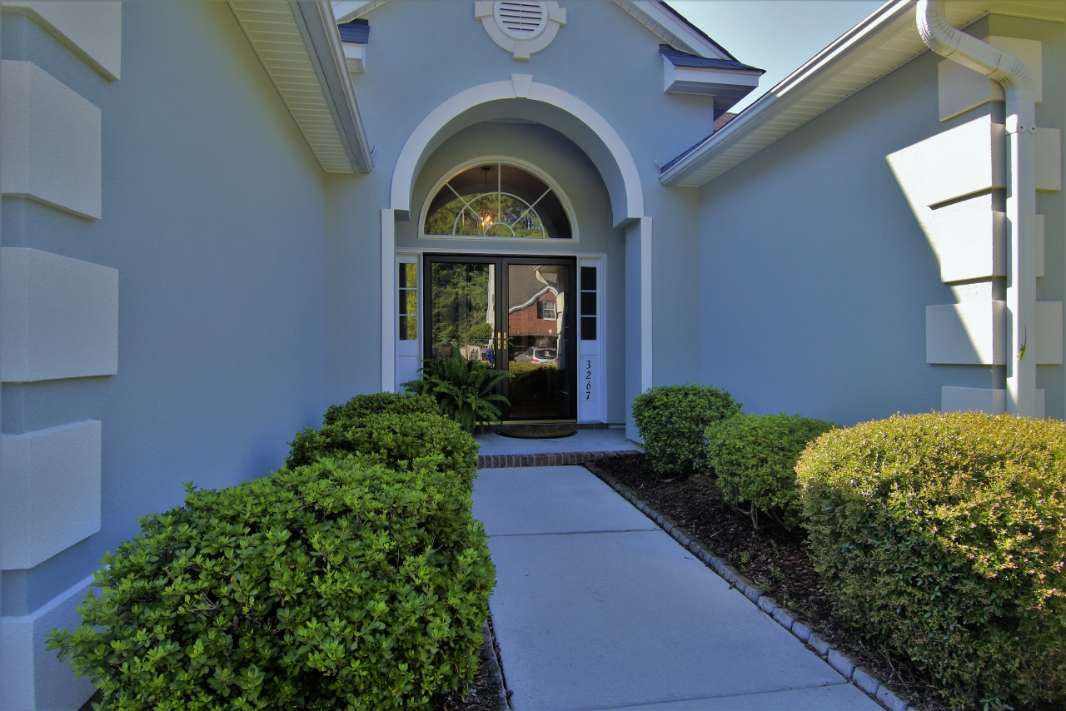
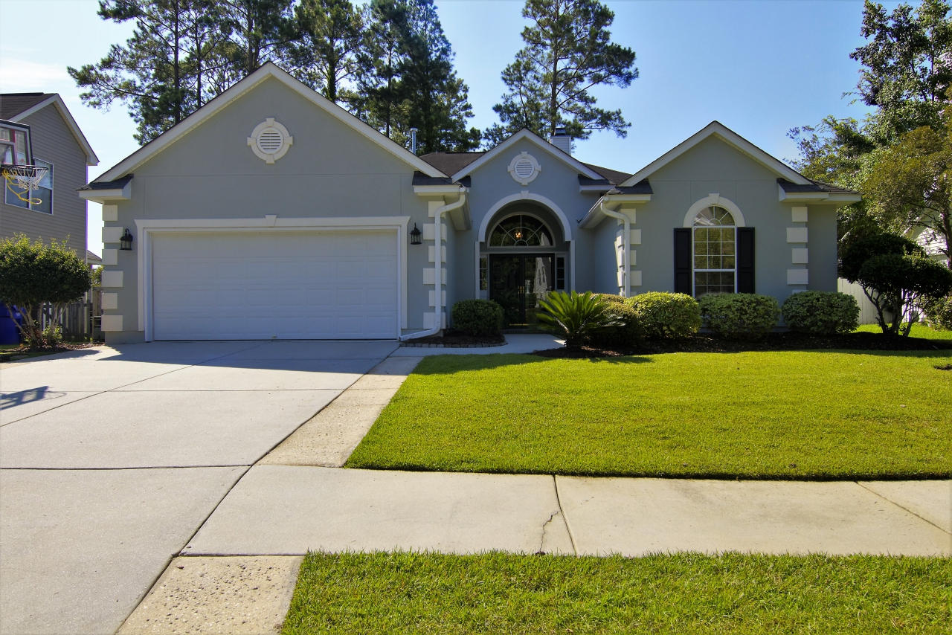
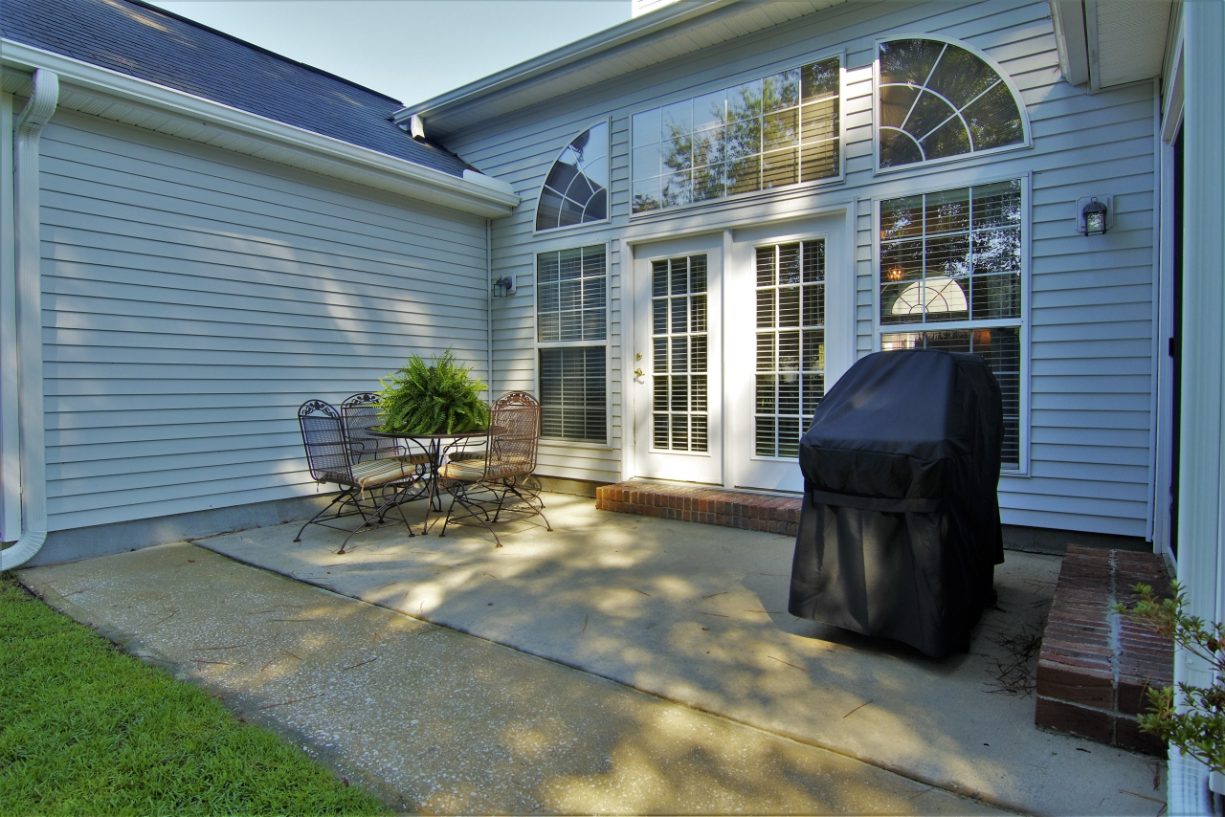
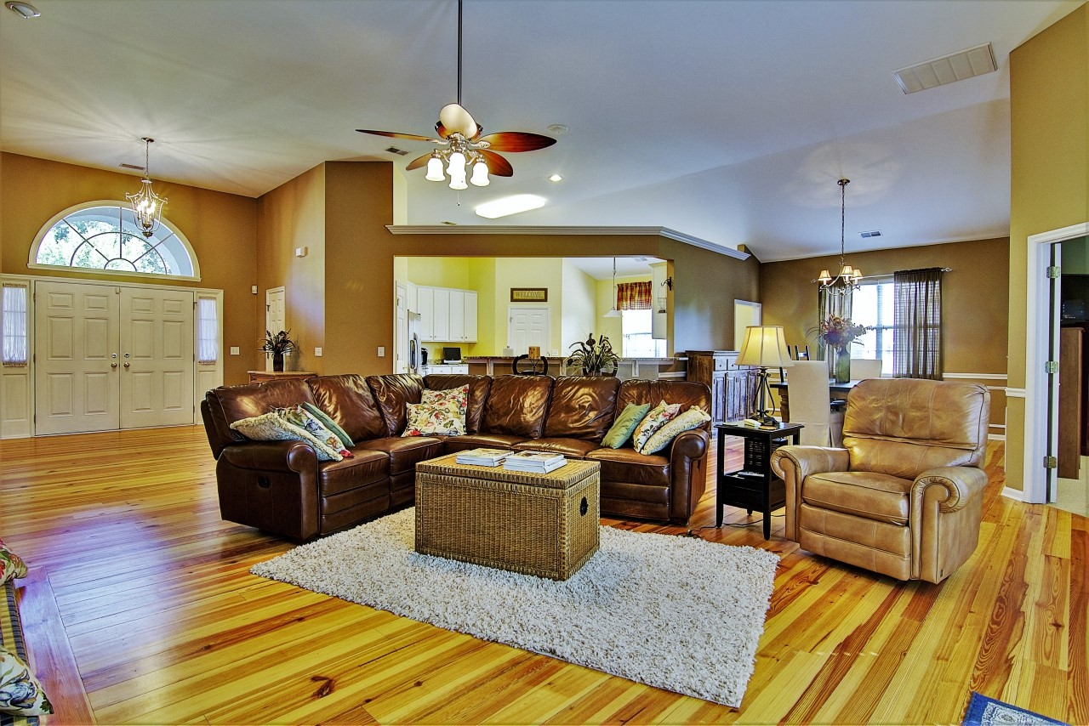
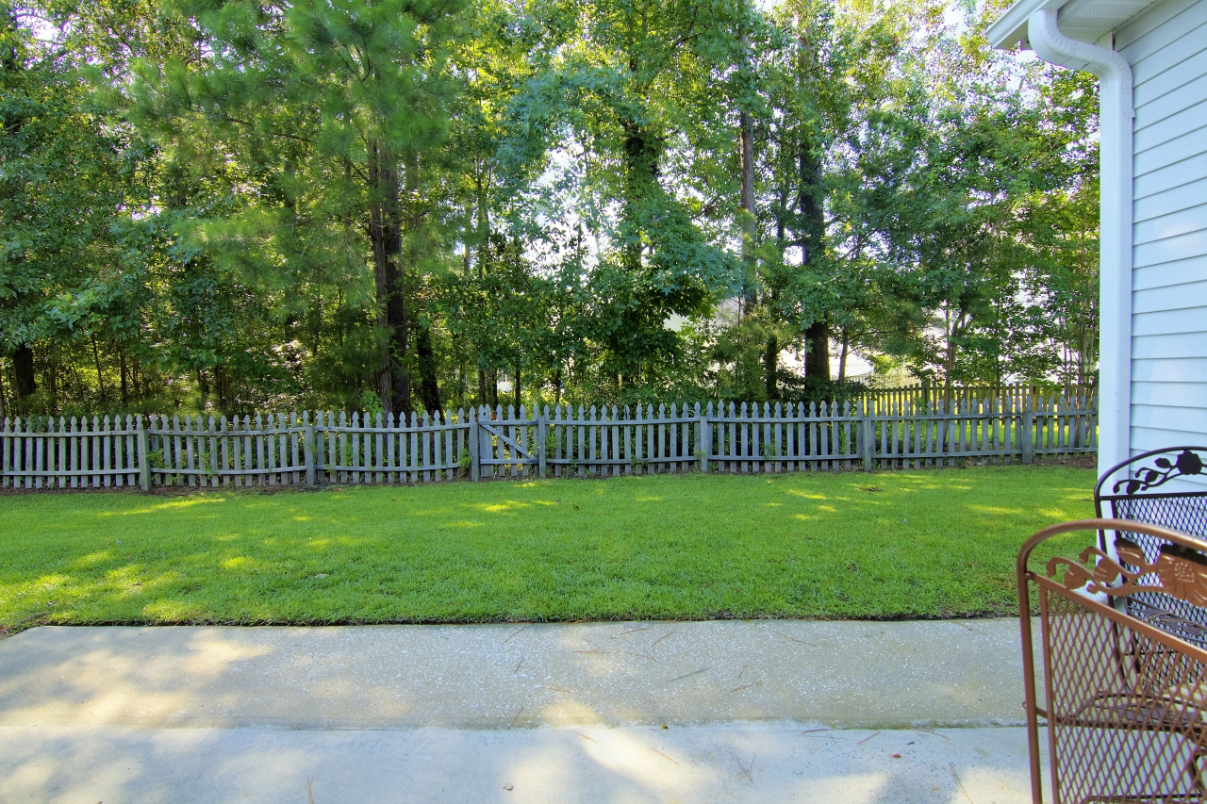
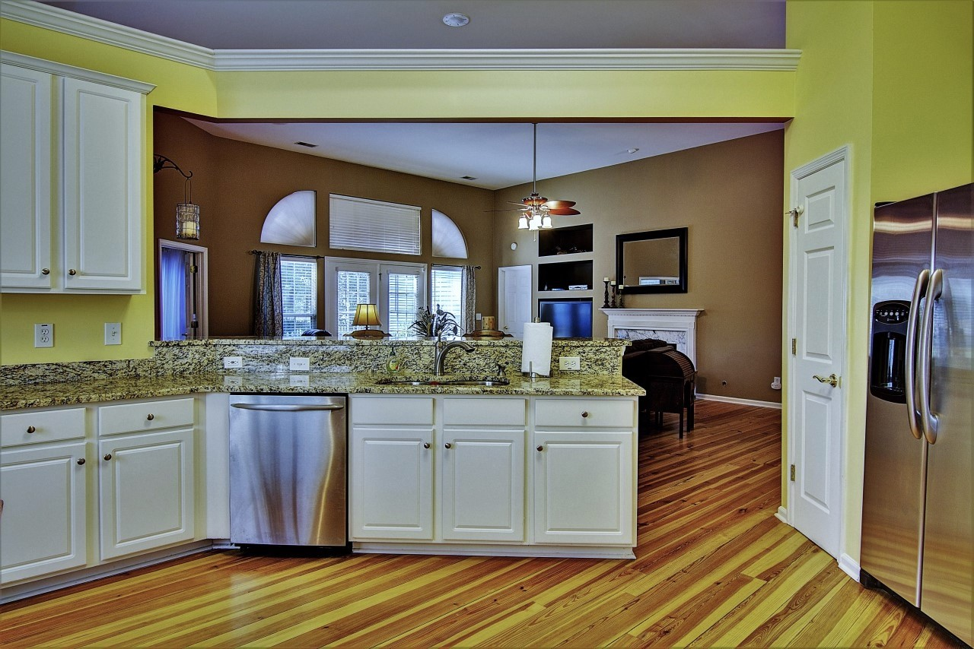
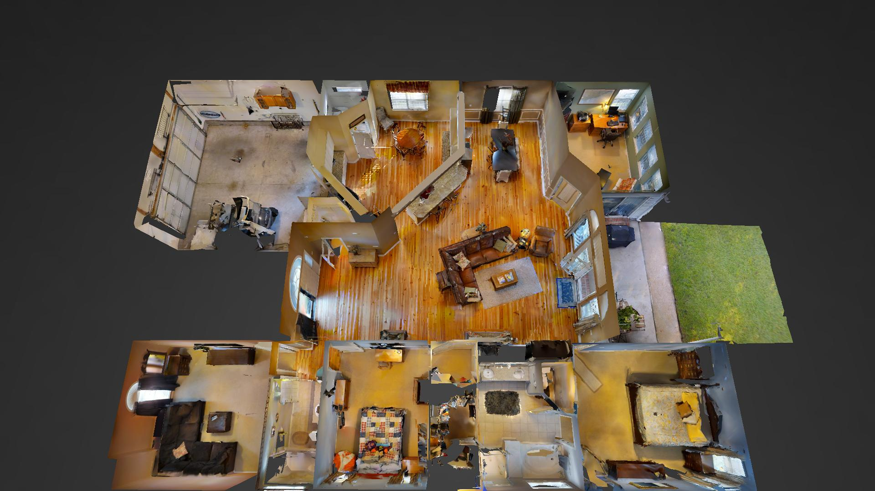
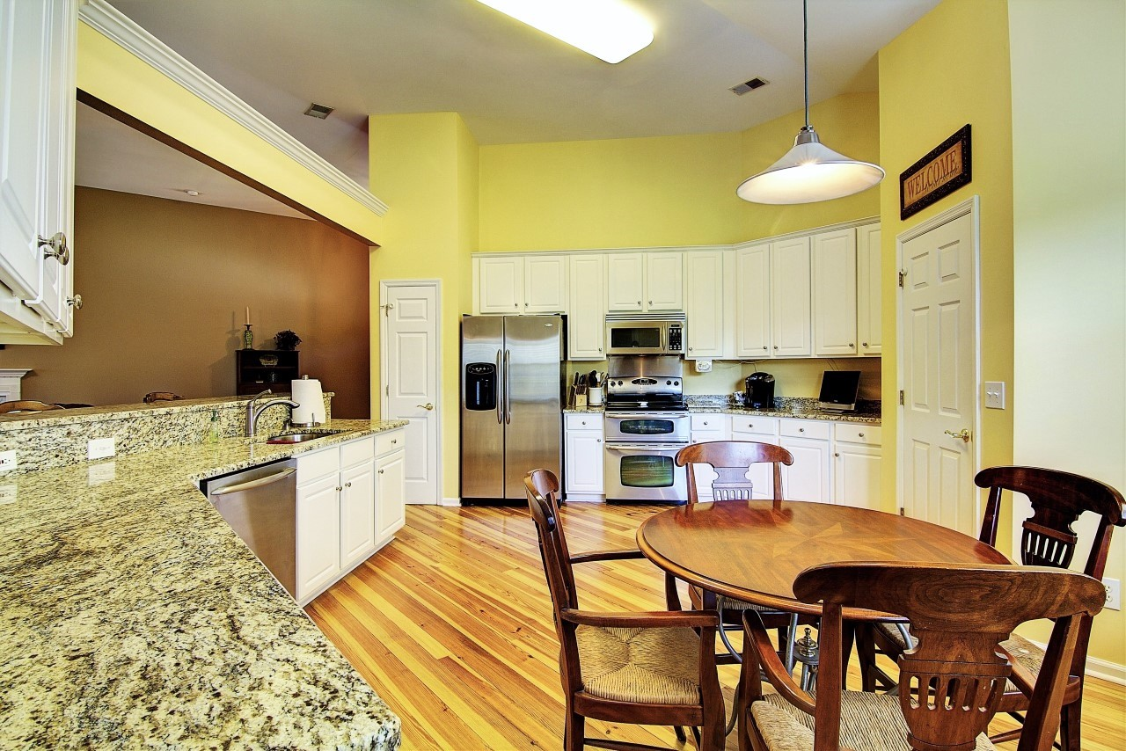
New Listing!
Perfect Park West Ranch
3267 John Bartram Place
Mount Pleasant, SC 29466
MLS# 16019684 ~ $395,000
This new listing is the perfect ranch! It has a fantastic open floor plan which is perfect for families or entertaining. This home is truly one level living at its finest! There are tasteful finishes throughout, including heart pine flooring, granite in the kitchens and baths, and stainless steel appliances, all of which convey. A designated office or hobby room is located on the rear of the home in addition to the three bedrooms making this a fantastic option for someone who works out of the home or for a family who wishes to have a play room for the children! It is an easy bike ride to the Park West Amenity Center and to the Award Winning Park West Schools and Mt. Pleasant Recreation Department. Three bedrooms, plus an office move in ready and under $400,000 in Park West - check this one out!
Ellen O'Neil
Broker/Owner
Ellen O'Neil Realty
ABR, e-PRO, CNE
Charleston Realtor of Distinction
(843)300-8530
http://EllenONeilRealty.com

