Slide 1
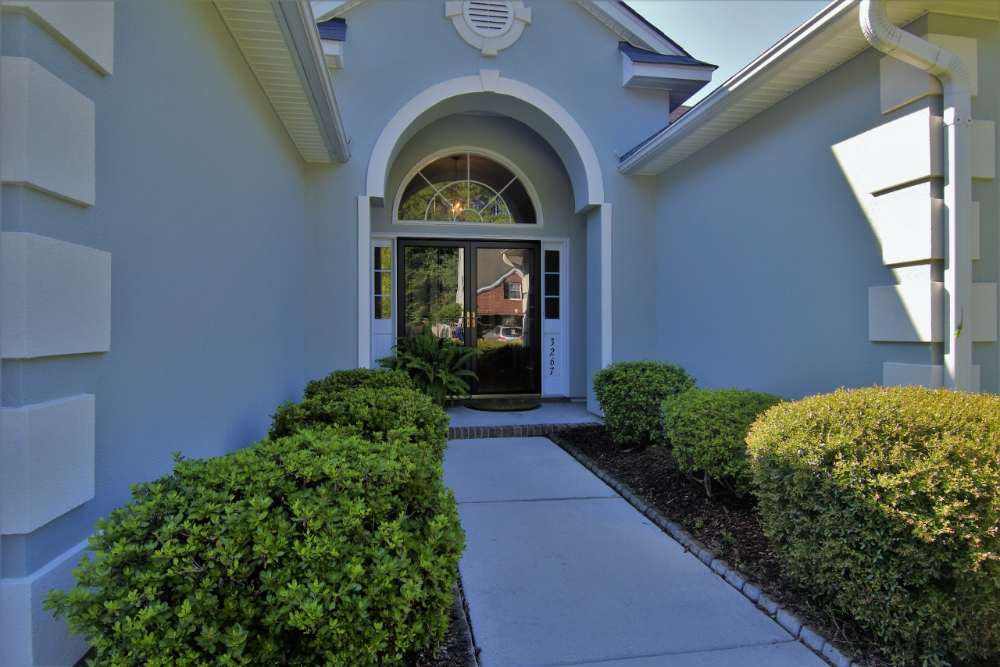
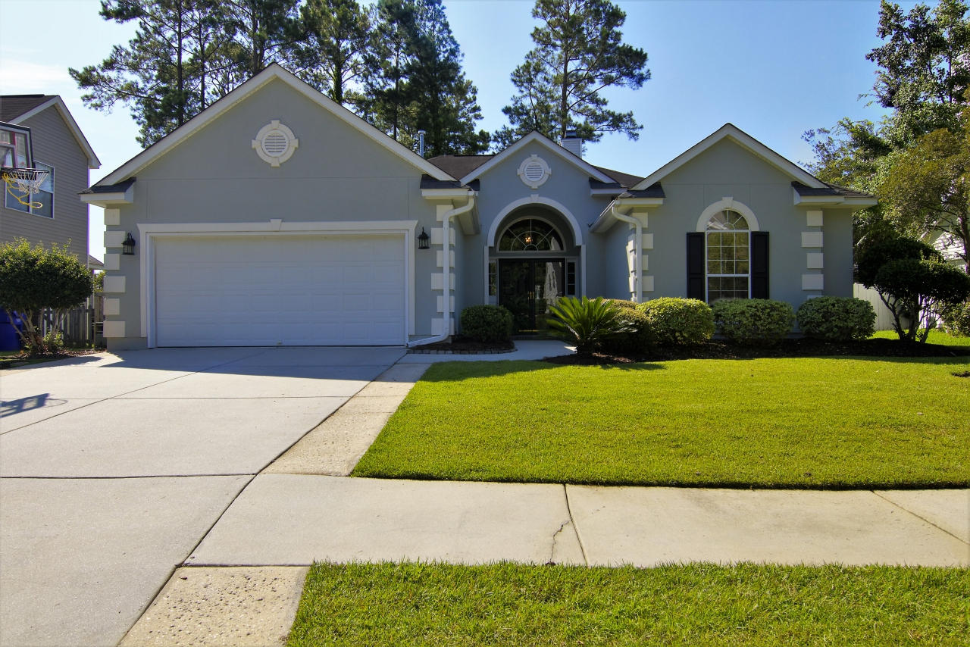
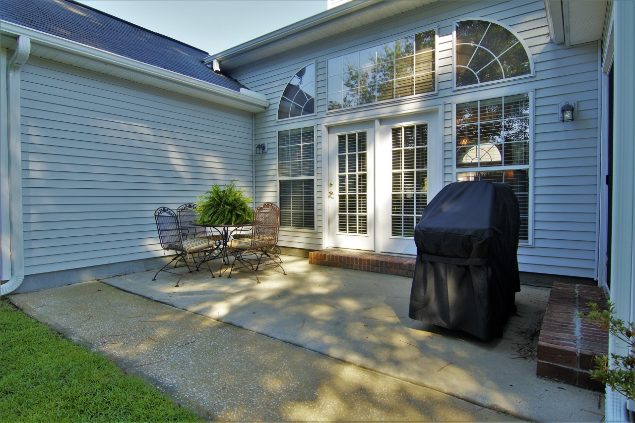
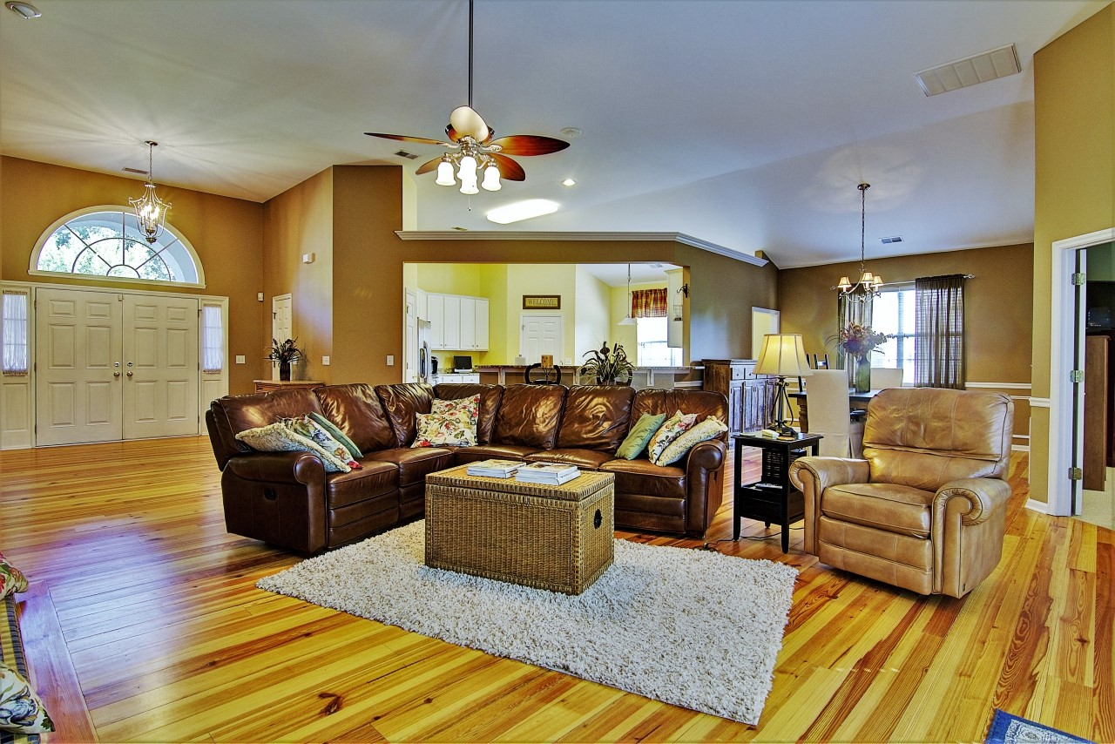
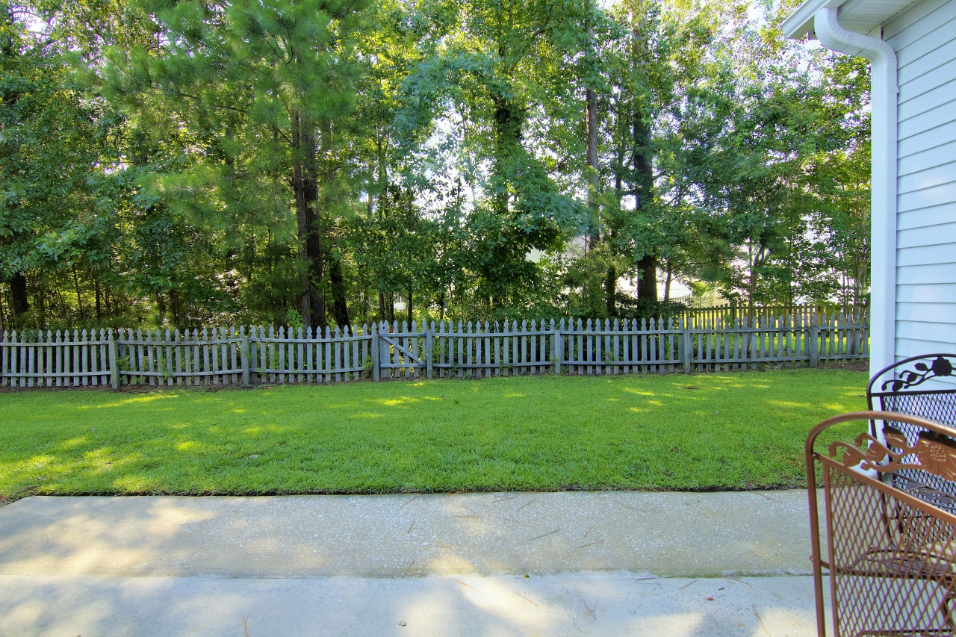
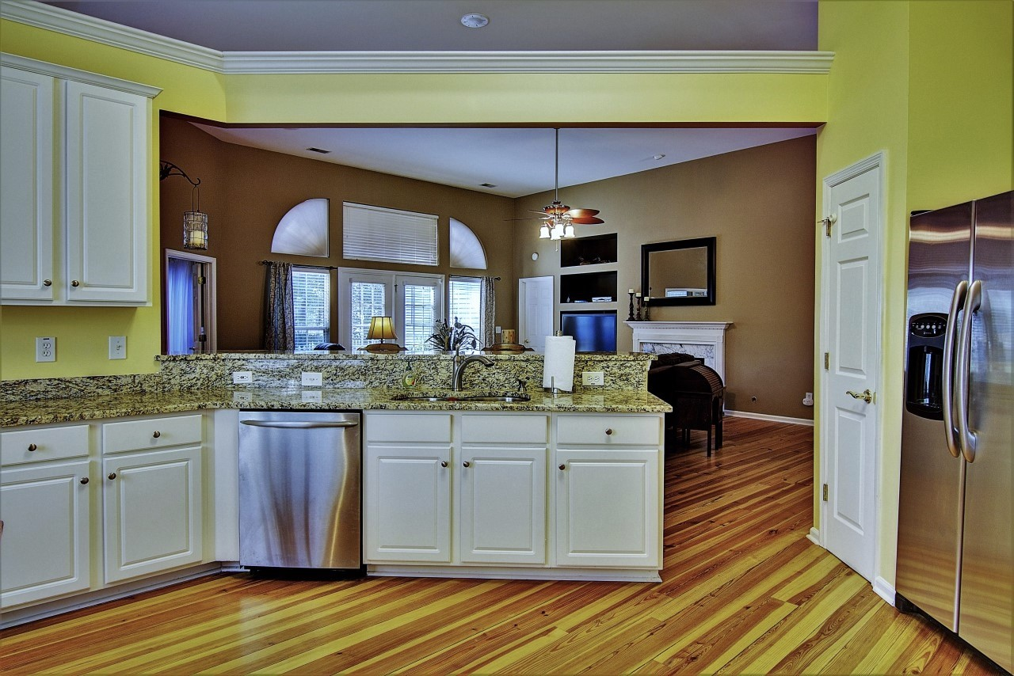
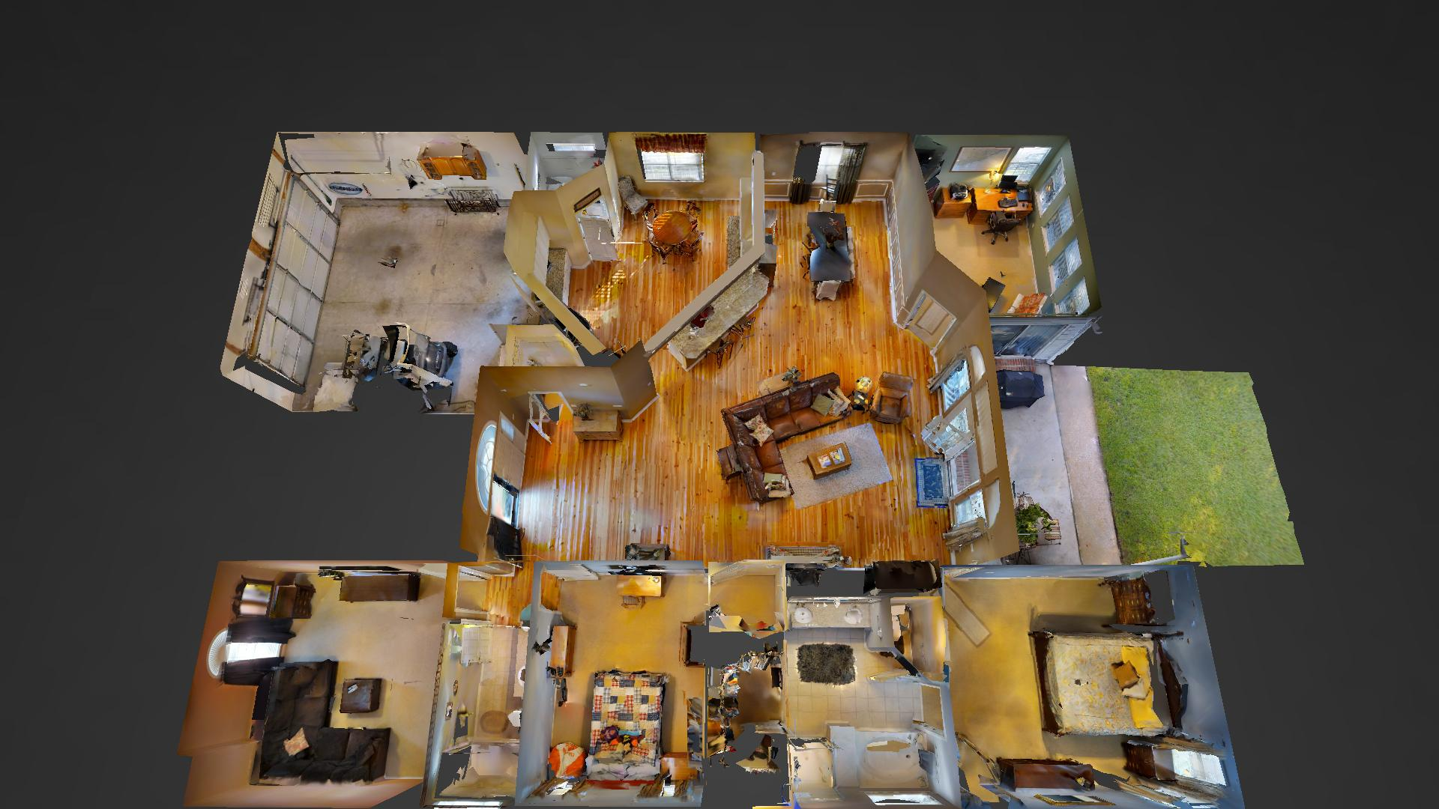
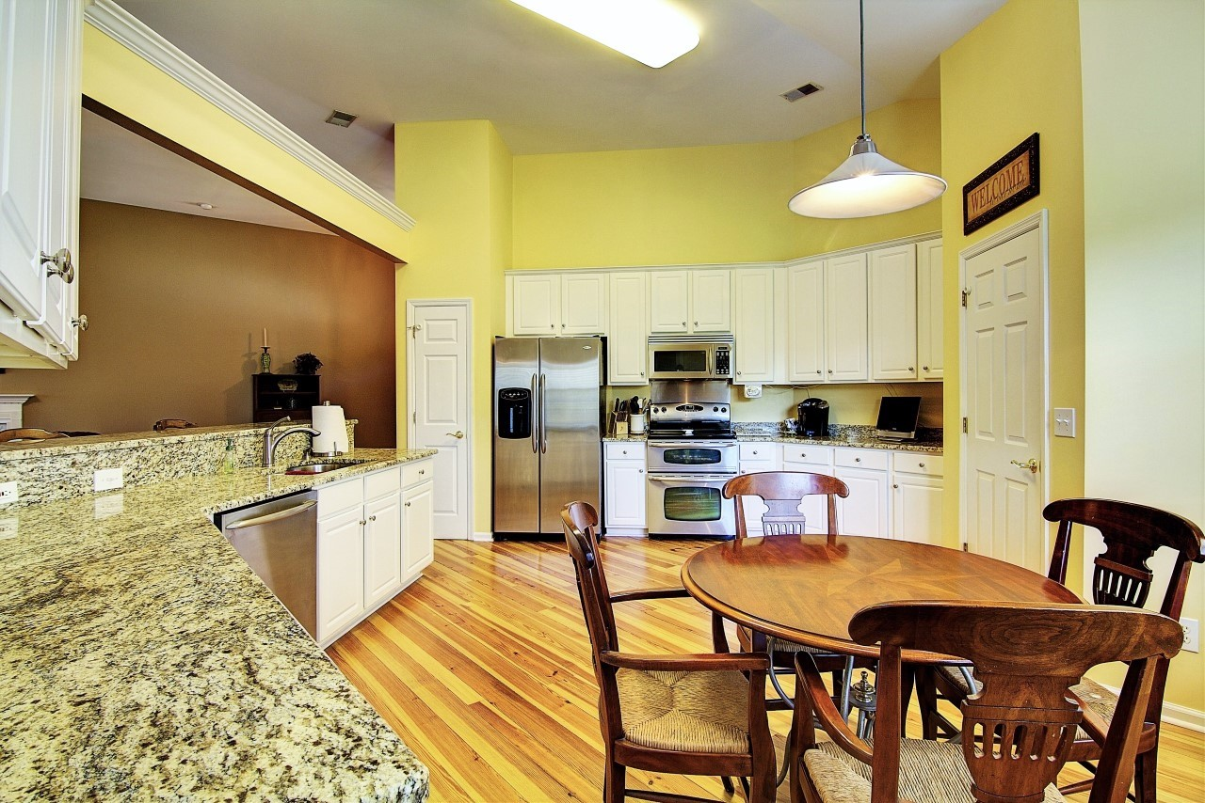
Perfect Park West Ranch
Price Reduced!
3267 John Bartram Place
Mount Pleasant, SC 29466
MLS# 16019684 ~ $382,500
The price has been reduced on this move in ready ranch with a fantastic open floor plan. This house is in the Foxmoor neighborhood of Park West in Mt. Pleasant. The value is UNBEATABLE priced at less than $172 per square foot! There are currently 29 ranch style homes for sale in the area and this is the second lowest price per square foot! Bring your clients on a tour- notice the attractive heart pine flooring and other upgrades like granite counters and stainless steel appliances. This popular open floor plan is perfect for those who entertain, retirees, and families alike. This home is literally in the heart of Park West with an easy bike ride to the award winning schools, park and recreation department, and amenity center. Check out this home today!
Ellen O'Neil
Broker/Owner
Ellen O'Neil Realty
ABR, e-PRO, CNE
Charleston Realtor of Distinction
(843)300-8530
http://EllenONeilRealty.com

