Slide 1
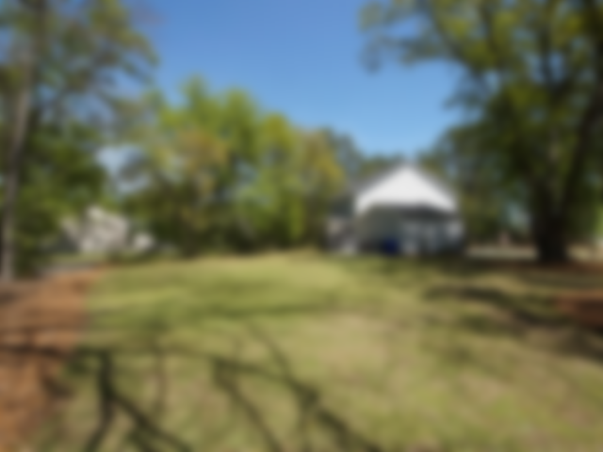
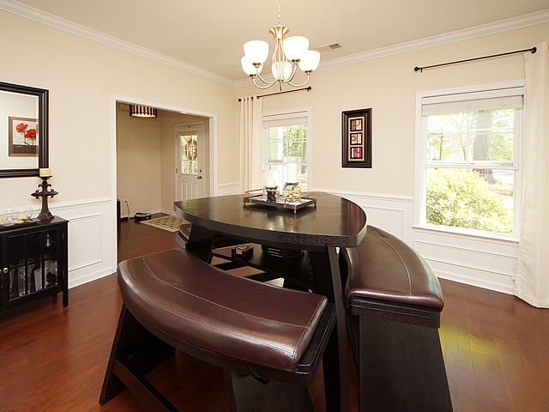
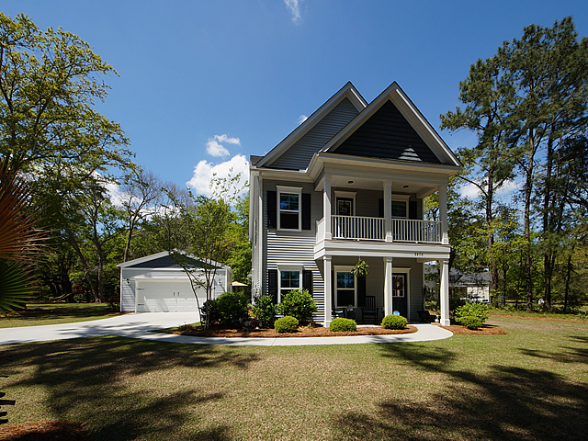
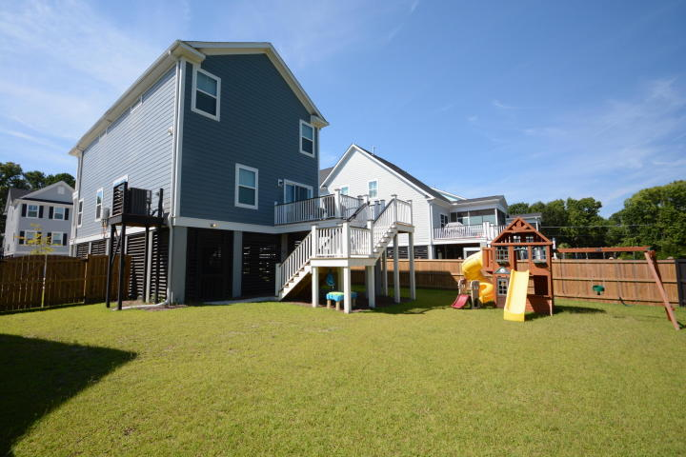
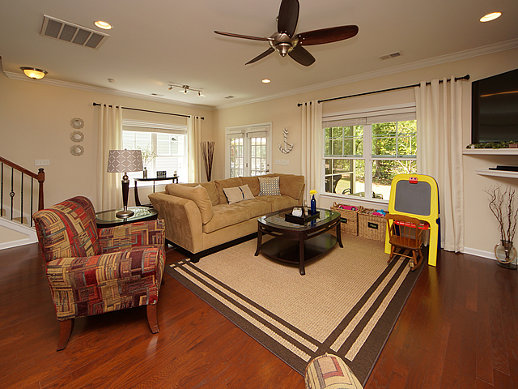
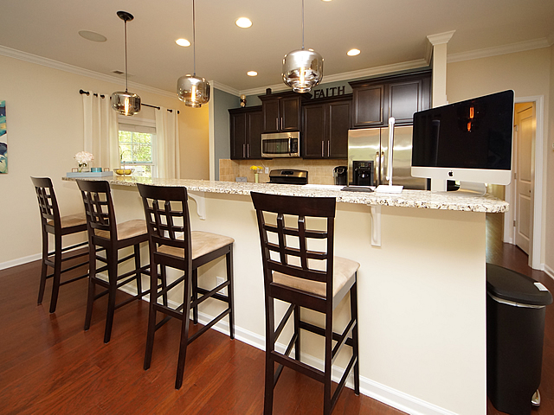
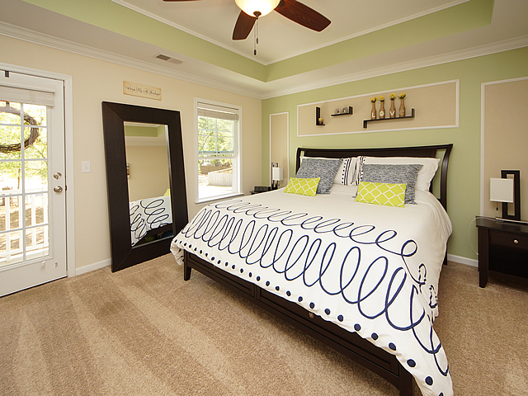
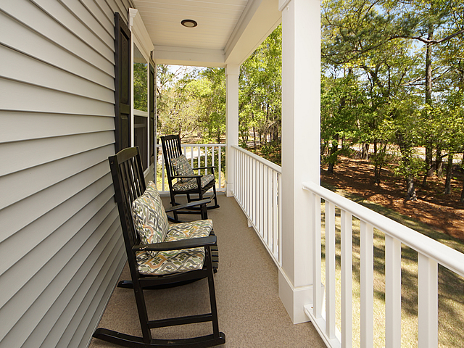
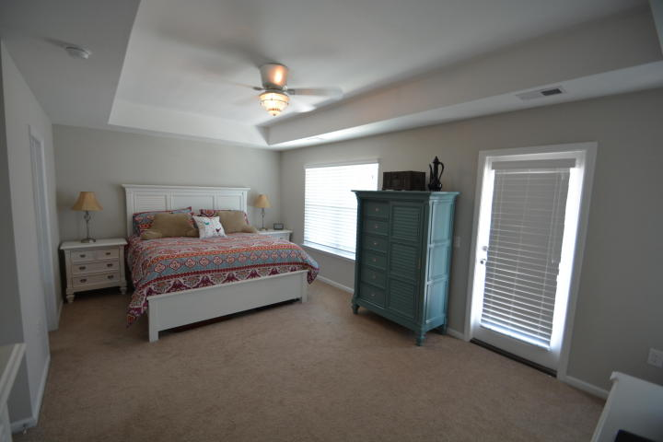
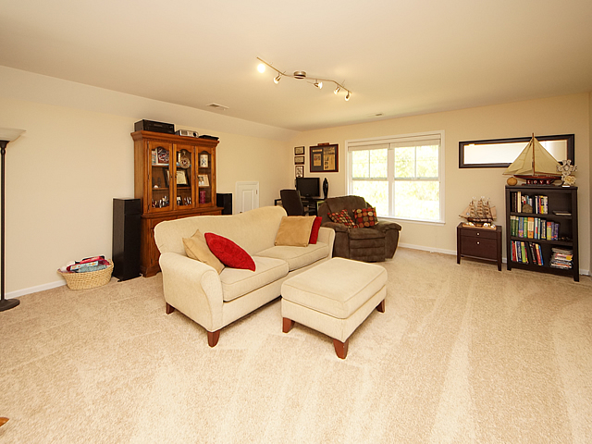
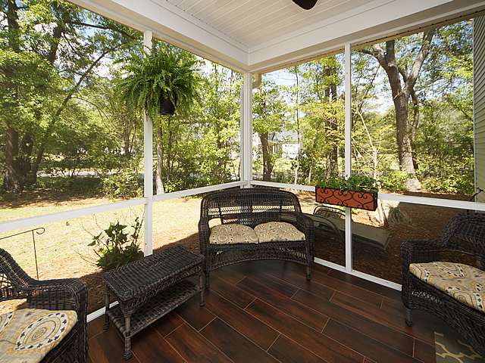
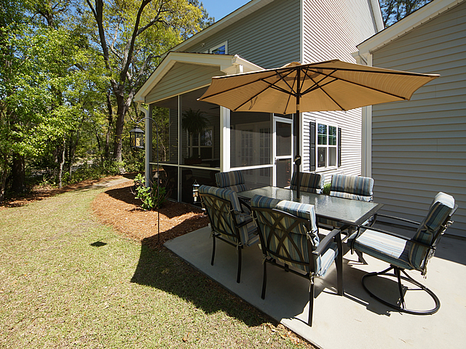
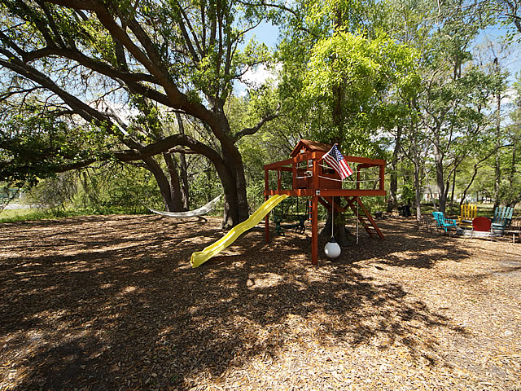
Huge Lot, Grand Oak Trees, Perfect Home!
3272 Comsee Lane
Brownswood Farms ~ Johns Island, SC 29455
MLS# 18010663 ~ $375,000
RARE OPPORTUNITY to own one of the best maintained "Charleston single" homes you will find with amazing features on almost an ACRE with some of the most amazing grand oaks the lowcountry has to offer! This home looks better than most brand new homes. When visiting this home you will feel as if you are in an estate lot community with the privacy it offers, yet you are just minutes from the boat ramp, grocery stores and downtown Charleston and the 2 most popular beaches, Folly Beach and Kiawah Island, are just a short drive away. The huge downstairs and upstairs front porches really set the tone for Southern Charm and wait until you see the interior of this home in person...you'll be amazed! Granite counters, window treatments, high ceilings, garden tub, wet bar...it will go quickly!
Johnny Crosby
(843) 270-9407
jcrosby@propertyadvisorsinc.com
www.charlestonhomeproviders.com
Brand Name Real Estate
4 Carriage Lane Suite 106
Charleston, SC 29407
Michael Albenesius
(843) 343-5870
m.albenesius@gmail.com

