Slide 1
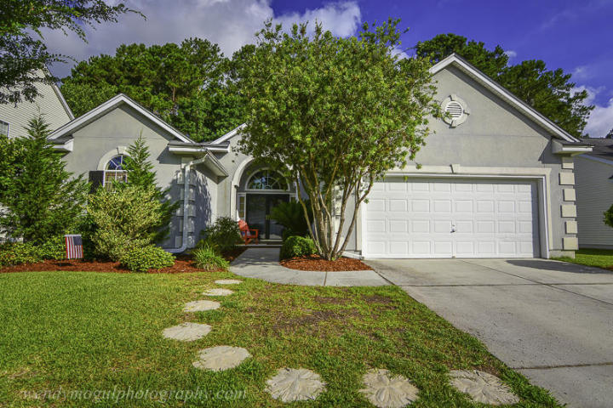
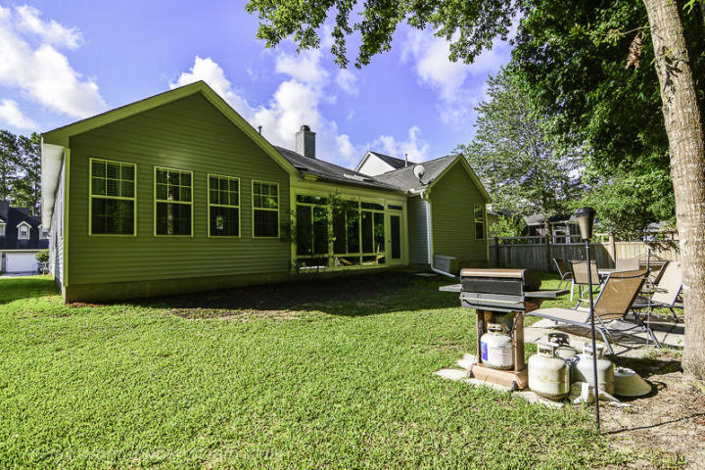
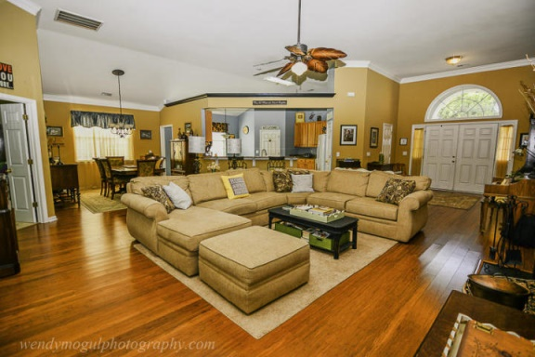
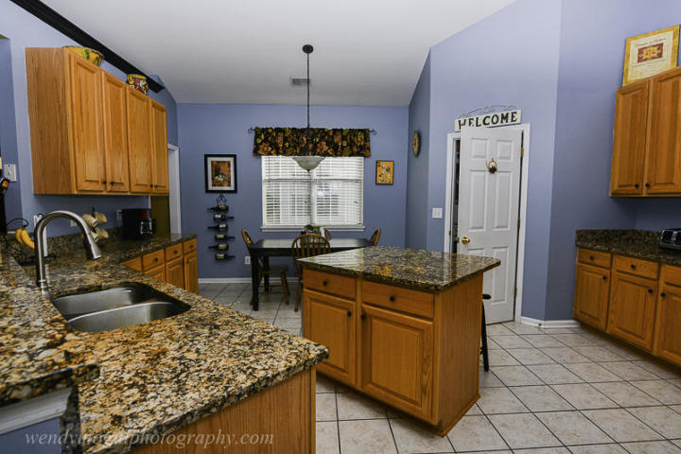
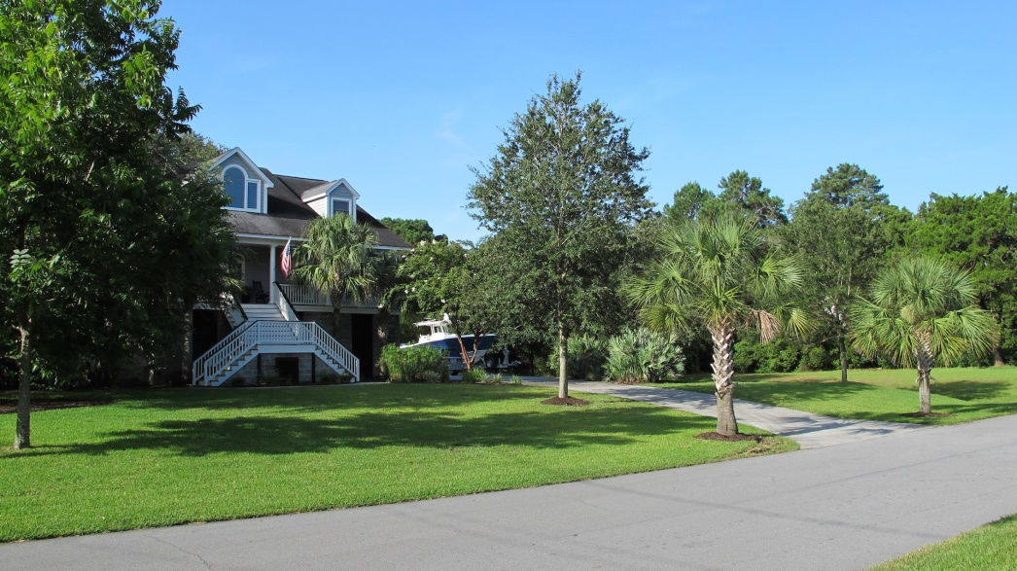
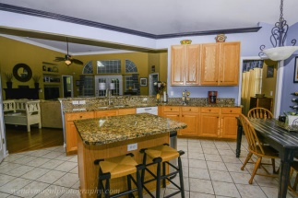
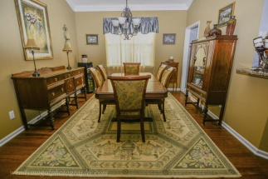
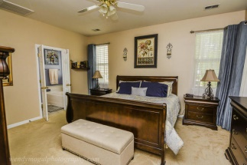
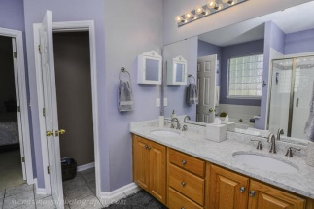
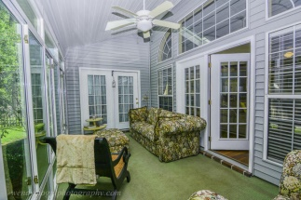
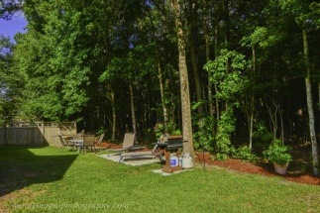

~ New Listing - Perfect Park West Ranch ~
3278 John Bartram Pl
Mount Pleasant
MLS# 15014603
$379,900
Price Reduced
This is the one you have been waiting for! The home has excellent curb appeal, and it is the very popular Delaware floor plan. As you enter this attractive ranch style home, you are immediately impressed with the open floor plan and meticulous condition! Numerous upgrades stand out as you enter the home. There are engineered hardwood floors throughout the living area and custom crown molding as well. The eat in kitchen boasts tile floors and beautiful granite countertops. The back porch has been enclosed with windows allowing you the opportunity to enjoy this sitting area (which overlooks a private, wooded back yard) year round. It is immediately evident that the current owners have put great care into planning all the upgrades and enhancements to this property so you won’t have to! You will love the versatility offered in this home's floor plan. There is a study or home office overlooking the back yard adjacent to the porch which is currently being used as a fourth bedroom (though there is no closet in the room). The master bedroom also overlooks the backyard. You will be mighty impressed with the recently completed master bath renovation! The new custom tiled shower is spacious and elegant. Tile floors and quartz countertops add to the luxurious feel in the master bath. A large walk in closet loaded with shelving provides ample storage space for the owners. The two guest bedrooms are bright and sunny and they share another full bath between them. The carpets in the bedrooms are in great condition, having been installed within the past few years. The AC is only 3 years old! The back yard is wonderfully private. There are woods behind the home creating a peaceful and serene setting for enjoying time in the yard. Both the home and the yard have been beautifully maintained. You will not have to do a thing other than unpack your boxes and enjoy living in this beautiful home! Foxmoor is a popular community within Park West. Residents of Park West enjoy fantastic amenities (two pools, a playground, an outdoor kitchen, tennis courts, and miles of walking and jogging trails). Award winning schools are located in the Park West school complex (grades pre-K through eight) and the local public high school is a short drive from Park West. One of the town's outstanding recreation departments is also located within the community as well as a dog park. In addition, shops, restaurants and a variety of businesses are located in the neighborhood so residents can enjoy the added convenience. Due to Foxmoor's ideal location, it is an easy bike ride or walk to the amenities center, the Mt. Pleasant Recreation Department, dog park and even the school complex! This gorgeous home and fantastic community is a winning combination! Don't wait to schedule your tour.
Ellen O'Neil
843-300-8530
ekoneil@sbcglobal.net
www.southernlivingre.com
Southern Living Real Estate
2249 Salt Wind Way, Mt. Pleasant, SC 29466

