Slide 1
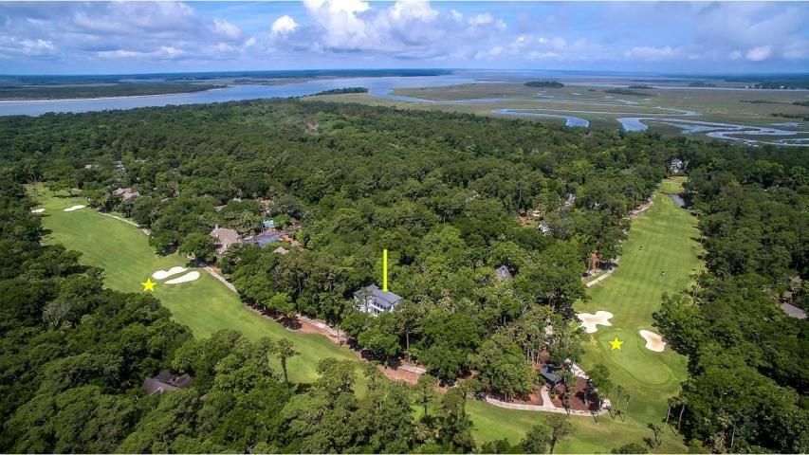

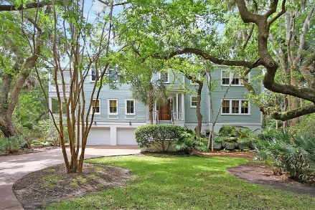
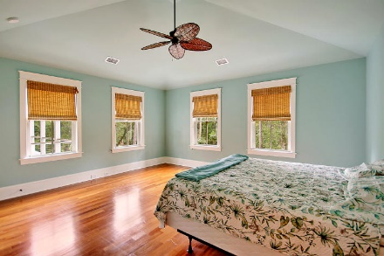
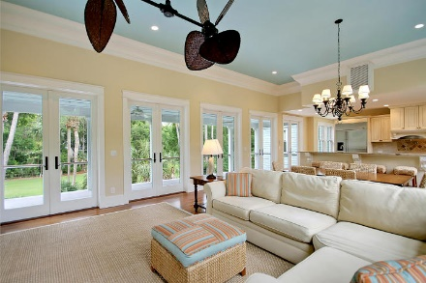
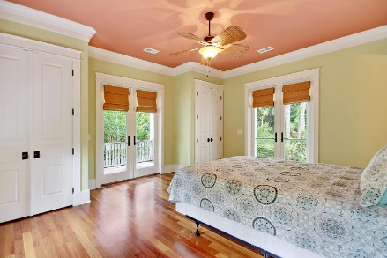
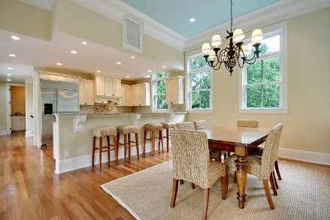
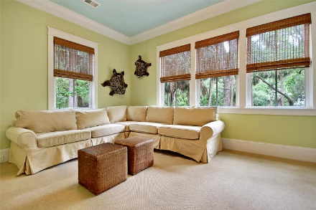
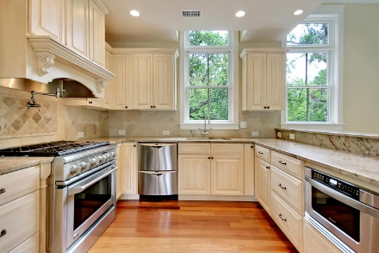
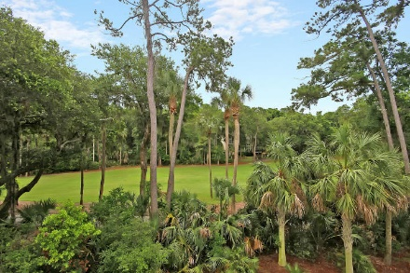
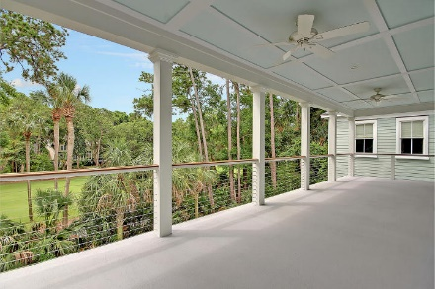
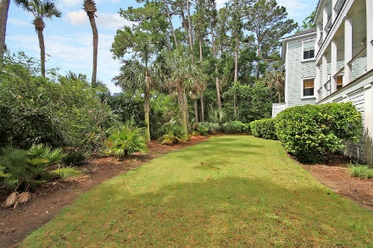

Parkshore Marshfront
Price Reduced
3278 Privateer Creek Road
Seabrook Island, SC 29455 ~ MLS# 18016084 ~ $955,000
Discover your very own piece of paradise with this stunning, custom home on Seabrook Island that backs to the golf course. The reverse floor plan has an elevator to take you from the spacious, two car garage with additional storage all the way up to the third level. A side porch on each level and a deck and balcony all look out to the private, heavily wooded backyard and golf course, making for amazing outdoor living. The open floor plan boasts Brazilian teak hardwood floors, a gourmet kitchen with breakfast bar area and a tropical ceiling fan that helps make every day feel like vacation. The owner's retreat feature a cathedral ceiling, two custom closets and a luxurious, relaxing jetted tub and high end walk-in shower in the en-suite full bath. Come begin your island lifestyle today!
Additional features include:
Kitchen has granite counters, high end SS appliances, gas range with an instant hot water pot filler and two sinks
Beautiful wood work design in the flooring of the foyer
Gathering area on the bedroom level has a wet bar and access to the deck
Exotic, durable Brazilian teak floors
State of the art, HVAC units with air quality system
Exceptional workmanship and construction
2 exterior Japanese hot water heaters
Close by to the beach, clubhouse, golfing and pools
Book your showing today!
Missy Reid Missy@MattOneillTeam.com (864) 934-5447

