Slide 1
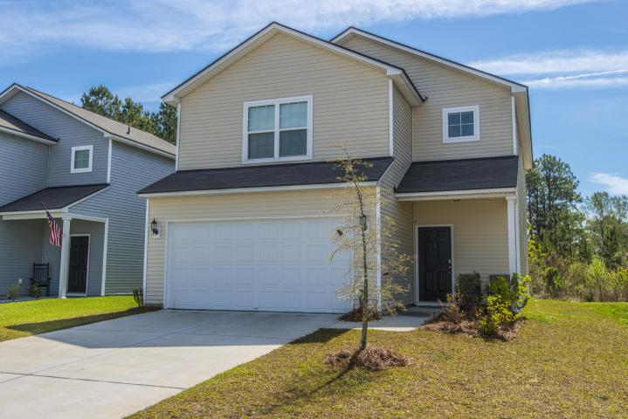
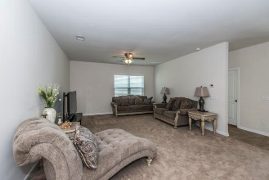
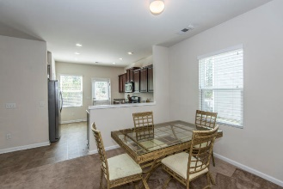
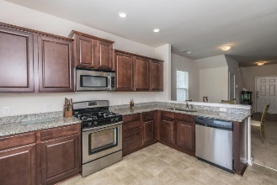
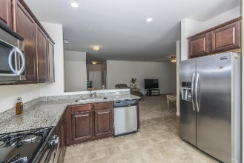
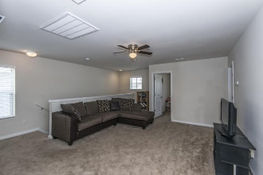
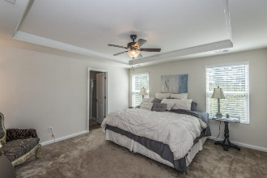
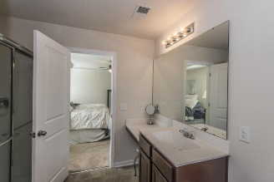
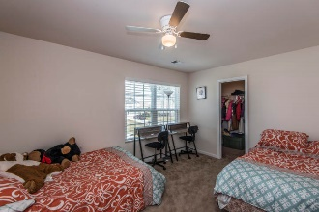
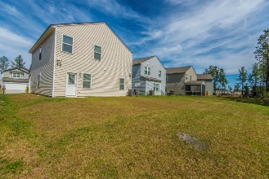
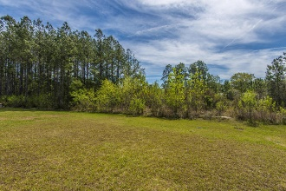


327 Cantley Court Summerville :: MLS# 18008717 :: $225,000
Welcome Home to Cane Bay Plantation!
This beautiful home features a large open floorplan that welcomes you as you enter the front door. The family room offers plenty of space for entertaining or just relaxing around the TV. The dining room sits off the kitchen and offers plenty of room for guests. Granite counter tops gleam throughout the kitchen with plenty of cabinets and a large pantry with plenty of storage. The 1st floor also has a convenient study and half bath that could easily be converted into a 4th bedroom if needed. Upstairs is the real treat with a huge loft perfect for lounging and is surrounded by 2 guest bedrooms and guest bathroom, the laundry room and Master Bedroom with on-suite bathroom.
Stuart DeVault
(843) 754-1769
stuart@carolinaone.com
www.stuartdevault.com
Carolina One Real Estate
2713 Highway 17 North
Mt. Pleasant, SC 29466

