Slide 1
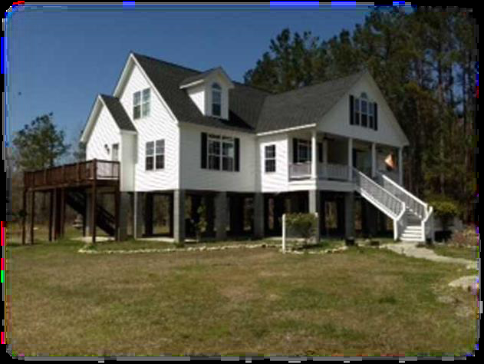
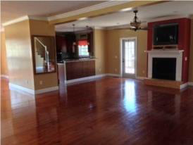
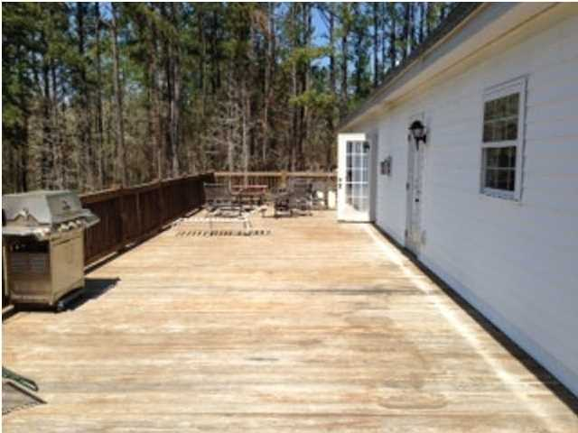
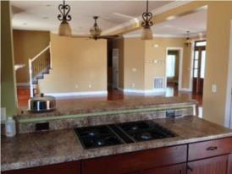
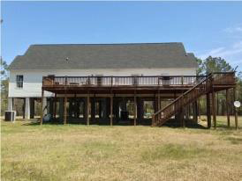
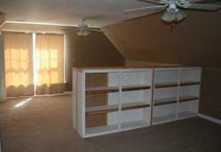
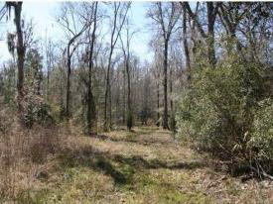


327 DOUBLE CHURCHES RD
RUFFIN, SC 29475 ~ MLS# 1421920
REDUCED TO $279,000
4 BEDROOMS | 3½ BATHS | 3,600 SQ FT
Great Home + Shop on 5 Acres Wooded Land
Perfect for Hunting!
What an incredible price for what you can get!!! This can be your refuge in the nature or the HUNTING retreat you were looking for. There is a beautiful house built in 2009 with 3,600 sq. ft. and great amenities! Don't miss on this opportunity! Located within 15 minutes of Walterboro and Interstate 95, off Highway 21 in the quiet town of Ruffin, you can enjoy the country life style and be close to town as well. The acreage includes an open area around the home and sheds as well as mature hardwood bottom land offering an ideal habitat for deer and turkey. When you walk in the home through the front door you are greeted with a bright open great room and kitchen featuring stainless steel appliances and gleaming hardwood floors. The main floor has an open floor plan with two bedrooms including a large master suite with two large bedrooms upstairs which you could easily reconfigure to provide two additional bedrooms. There's also a huge deck overlooking the back yard that would be perfect for watching all of the wildlife. This home has a concrete bottom floor, great for parking which could be enclosed for total of three floors. There is a 6,000 + sq. ft. wood and tin storage shed with some open and enclosed areas as well as an office/recreational room. This place offers everything: wonderful home, hunting retreat, horse farm, lots of storage. There is an option to buy the whole property with 32 acres plus a HUGE 60x100 enclosed steel building with cement slab that is set up equivalent to a commercial mechanic shop which includes a full car jack for $369,000. It can be your primary residence or your refuge in the middle of nature.
PRICED TO SELL FAST!!!
Daniel Carabus
843-793-9265 M
dcarabus@carolinaone.com
www.danielcarabus.com
Carolina One Real Estate
195 W Coleman Blvd
Mt Pleasant, SC 29464

