Slide 1
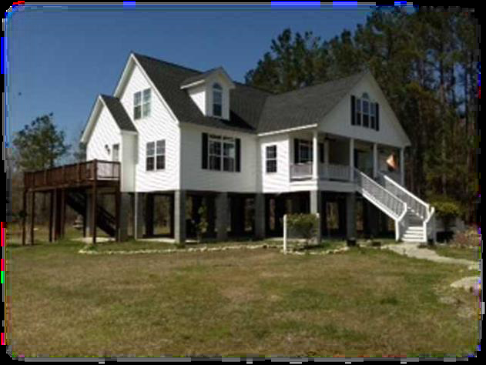
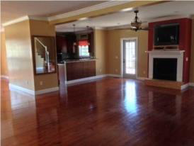
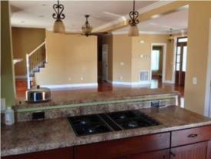
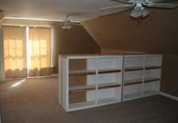
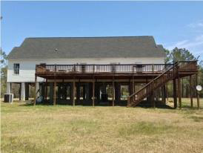
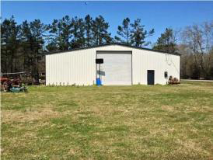
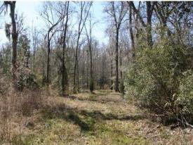

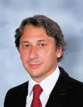
327 Double Churchs Rd
Ruffin, SC
MLS# 1408450
Reduced to $389,000
4 Bedrooms | 3½ Baths | 3,600 Sq Ft
THIS IS THE HUNTING RETREAT YOU WERE LOOKING FOR!
PRICED TO SELL, IT WILL NOT LAST!!!
PRICE REDUCED by $10,000.00. This is the HUNTING retreat you were looking for! Don't miss on this OPPORTUNITY to own your hunting retreat that sits on 32 acres + a beautiful 3,600 sq ft home! Seller is MOTIVATED! The property was appraised to $545,000.00 in December 2012. It is the hunter and outdoor lover dream to own a great home nestled on 32 acres teaming with wildlife! Located within 15 minutes of Walterboro and Interstate 95, off Highway 21 in the quiet town of Ruffin, you can enjoy the country life style and be close to town as well. The acreage includes an open area around the home and sheds as well as mature hardwood bottom land offering an ideal habitat for deer and turkey. When you walk through the front door you are greeted with a bright open great room and kitchen featuring stainless steel appliances and gleaming hardwood floors. The main floor has an open floor plan with two bedrooms including a large master suite with two large bedrooms upstairs which you could easily reconfigure to provide two additional bedrooms. There's also a huge deck over looking the back yard that would be perfect for watching all of the wildlife. This home has a concrete bottom floor, great for parking which could be enclosed for total of three floors, In addition the property also includes two large sheds, one is a HUGE 60x100 enclosed steel building with cement slab that is set up equivalent to a commercial mechanic shop which includes a full car jack. The another is + 6,000 sq ft wood and tin storage shed with some open and enclosed areas as well as an office/recreational room. This place offers you just everything: wonderful home, hunting retreat, horse farm, huge storage/mechanic shop. There may an option to divide part of the land with the house with an acceptable offer. It can be your primary residence or your refuge in the middle of nature. PRICED TO SELL!!!
Daniel Carabus
843-793-9265 M
dcarabus@carolinaone.com
www.danielcarabus.com
Carolina One Real Estate
195 W Coleman Blvd
Mt Pleasant, SC 29464

