Slide 1
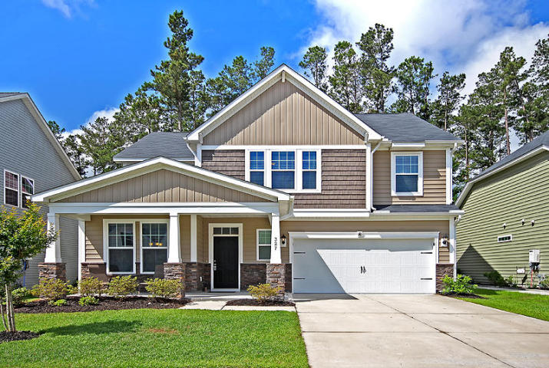
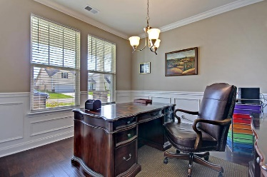
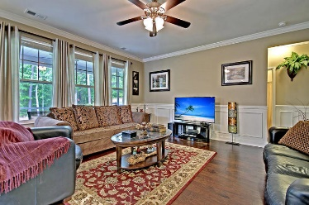
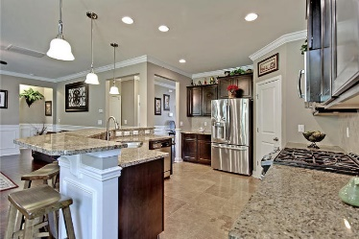
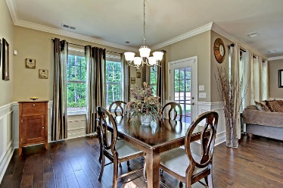
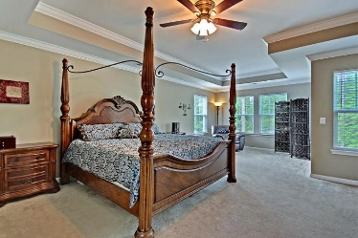
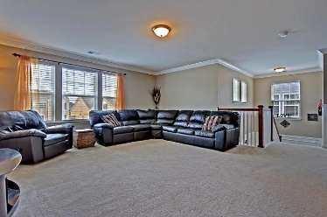
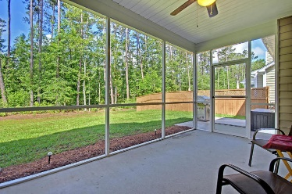
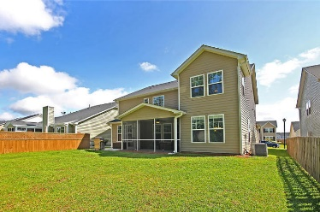

327 Spectrum Road
Cane Bay Plantation · Summerville
MLS# 18014799 · $300,000
Gorgeous Listing
Reduced $15,000
Better Than New
BEAUTIFUL 4 bedroom 3 full bath home on a private lot that backs to a wooded walking trail! The home has wonderful street appeal and a fantastic full front porch that is perfect for a cup of coffee in the mornings or visiting with neighbors. Entering the foyer you are greeted with GORGEOUS hand scraped hardwood floors that extend from the office to the living area, wainscoting, custom heavy crown molding, and an abundance of natural light. To the left is an office/flex room with glass French doors for privacy. Continuing into the open floor plan home is the oversized family room with a row of windows, that is open to the chef's gourmet kitchen with granite counter tops, 42" cabinets, stainless steel appliances, gas cooktop, pantry, breakfast bar that sits 6, 18" square travertine tile an eat-in dining area. The first floor also has a large bedroom with bath great for guests or parents. Upstairs is a HUGE loft that could be an office, second living area, media room, or play room. The expansive master bedroom has a separate sitting area and a spa-like ensuite bath with dual sinks, separate shower, relaxing soaking tub and walk-in closet. Two additional bedrooms upstairs share a bath! There is a large laundry room upstairs. The sizable screened-in porch opens to a private backyard that backs to a walking trail. There is a patio for grilling and entertaining. Magnolia at Cane Bay Plantation in Summerville is a wonderfully landscaped community with schools, walking trails and a community pool! The neighborhood is close to local shopping and grocery stores and is a short drive to downtown Charleston with 5-star restaurants, world class shopping and iconic history as well as a short drive to the beaches, the airport, Boeing and Daniel Island. Come take a look because you will not find another home that offers as much as this one!
Stan Huff
843-670-2835
stan.huff@agentowned.com
Jill Marcacci
843-297-5590
jill@agentowned.com
www.agentownedrealty.com
AgentOwned Realty Co. Preferred Group, Inc. | 824 Johnnie Dodds Blvd | Mt Pleasant, SC 29464

