Slide 1
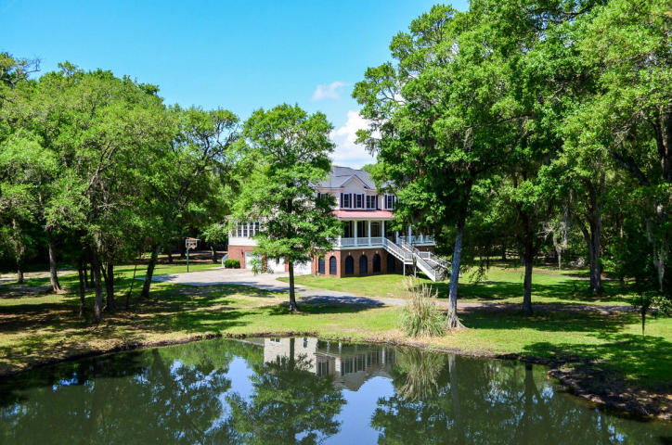
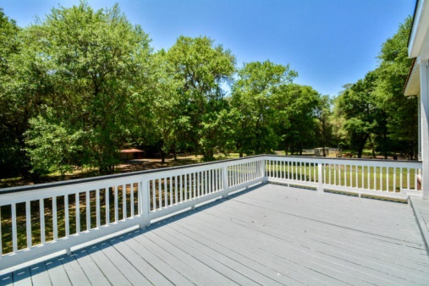
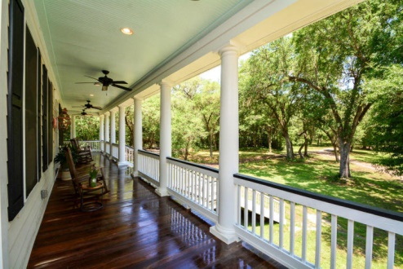
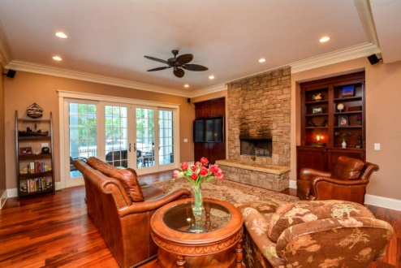
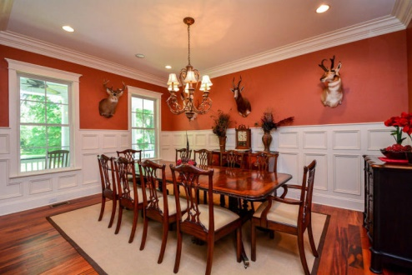
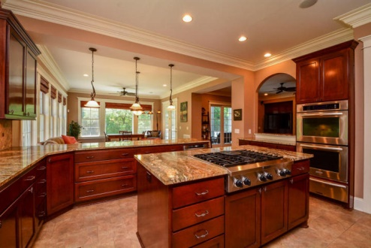
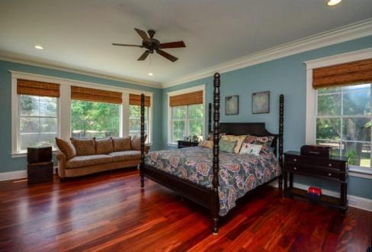
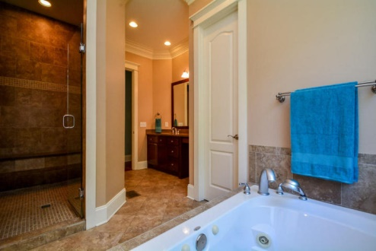
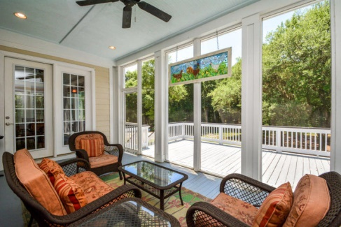
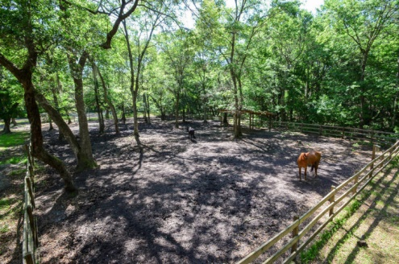

Johns Island Stunner!
Price Reduced!
3283 Black Swamp Road
Johns Island, SC 29455 ~ MLS# 15013310 ~ $1,150,000
This 5 bedroom, 3.5 bath, 5,810 square foot home sits on 14 acres of beautiful land. Enjoy the quiet and privacy this home provides with the amenities of a large, updated home. The house features a wraparound front porch lined with white columns and outfitted with 4 ceiling fans—ideal for sipping your morning coffee on a rocking chair while taking in the view of the beautiful pond surrounded by oaks and magnolia trees covered in Spanish moss. Entering inside, you’re greeted with gorgeous Brazilian hardwood flooring, 10-foot ceilings, and large windows allowing lots of natural light to fill the home. The entryway leads into the great room boasting gorgeous built-in wood shelving, an impressive floor to ceiling stone fireplace, and large French doors opening up to the screened-in back porch. The kitchen is sure to please any chef with its granite countertops, detailed backsplash, stainless steel appliances, a gas stovetop on the large center island, and gorgeous wood cabinets and light fixtures. The casual dining area is a beautiful space surrounded by windows providing a great view of the property. The spacious formal dining room features detailed crown molding and a beautiful light fixture. The large master suite will impress opening out onto the screened porch, great closet space, and a large spa-style bathroom. The property is truly your own private getaway with pear, persimmon, peach, fig trees and blueberry bushes, a fenced-in area with run-in shed for horses, a barn and workshop with 2 exterior stalls, a chicken house, as well as a stocked and aerated pond with a variety of fish. Other benefits include enjoying the quiet of country living while only being a short distance from Kiawah Beach, Folly Beach, James Island, and downtown Charleston.
Call to view this dream home today!
Shane Spurling shane@mattoneillteam.com 843-640-9448

