Slide 1
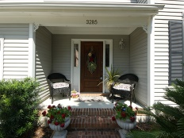
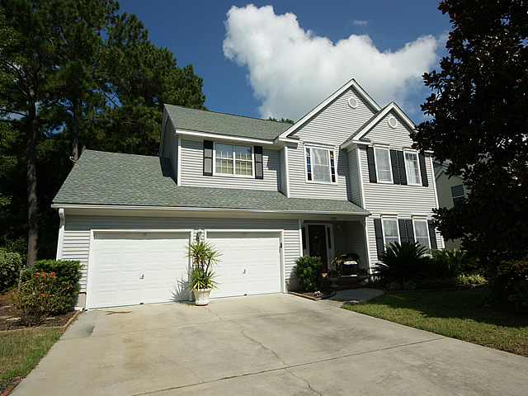
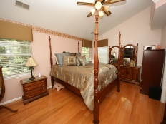
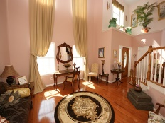
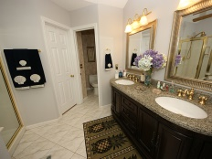
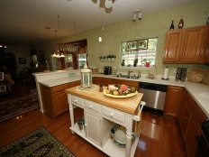
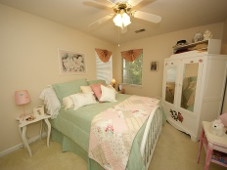
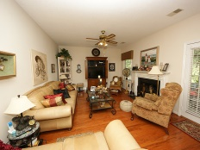
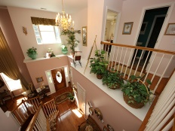
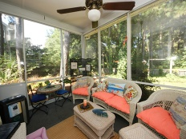
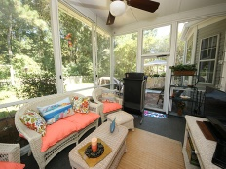
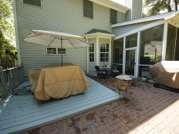
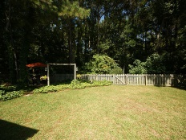
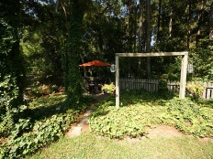
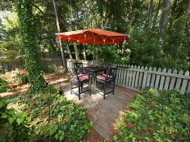
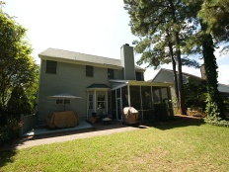


3285 Heathland Way Charleston National ~ Mount Pleasant ~ MLS# 15014773 ~ $387,000
Lowest Priced Single Family Home in Charleston National
This lovely 2 story single family home features 4 bedrooms and 2 1/2 bathrooms. From the welcoming front porch you step right into the sunny two-story foyer. Once inside, continue on into the formal living room/dining room to your right. The living room is also open to the second story and lends to the open and bright feeling of the home. The eat in kitchen is straight ahead and open to the family room...perfect for entertaining! The kitchen includes stainless steel appliances and a bar height counter for casual eating. The family room features a cozy gas fireplace and provides access to the enclosed screen porch and back patio. This area has all weather sliders making it usable year round! Rounding out the downstairs is the freshly remodeled laundry room and half bath. Hardwood flooring runs throughout the entire downstairs and continues upstairs in the master bedroom and adjoining study. The master offers a vaulted ceiling and private bath with garden tub and separate shower as well as a walk in closet. You will also find 2 additional bedrooms which share a large bath. The garage is oversized with a high ceiling and easily accommodates 2 cars as well room for lots of shelving and storage. Out back is a very private and well maintained yard. A wooded buffer creates a serene setting for outdoor entertaining on your porch, patio or rear eating area! You will also notice security film on the windows for hurricane/sun damage. Roof, HVAC, and water heater have been recently replaced. Don't miss your chance to own this meticulously maintained home in a premiere golf community. It offers wonderful amenities including two swimming pools, tennis courts, a workout facility, and play park. Charleston National HOA dues are $375.00/yr and there is a mandatory social membership of $43.50/month that includes pool and tennis. Gym privileges are $11.50/pp per month. Charleston National is conveniently located a mile from Wando High School and the new Roper Mt. Pleasant Hospital. Shopping, restaurants, and professional offices are nearby. You are only a short drive to the beach and historic downtown Charleston.
Melodie Smith (843) 408-5067 M
melodie.smith@carolinaone.com www.melodiesmithrealestate.com

