Slide 1

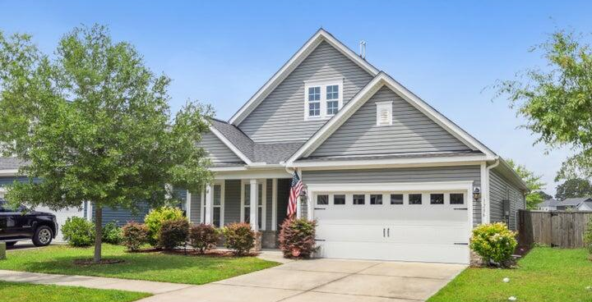

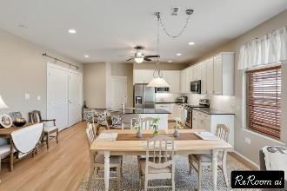
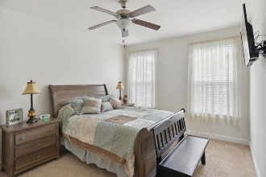
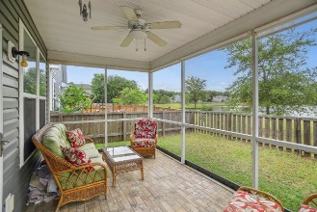
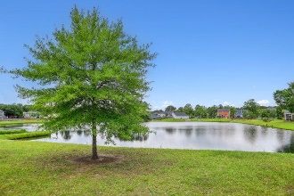

Pam Bass Realtor
843-259-4926
pam@pambassproperties.com
www.pamsellscharleston.com
Seller Offering $8,000 Credit
To Your Buyer
3286 Hartwell Street | Maybank Village | Johns Island | MLS# 24025357 | $548,750
****SELLER IS OFFERING A BUYER CREDIT OF $8,000 WITH AN ACCEPTABLE OFFER BY DECEMBER 31ST. IT CAN BE USED FOR WHATEVER THE BUYER IS WANTING TO USE IT FOR - FLOORING ALLOWANCE, CLOSING COSTS OR TO BUY DOWN THE INTEREST RATE!
Welcome to this stunning 4-bedroom, 3-bathroom one owner residence, offering breathtaking lake views. Enjoy outdoor living on the screened porch, paver patio, and in the fenced yard. As you enter, you're greeted by foyer that leads to a cozy office on your left. To the right, a hallway guides you to two guest bedrooms, a laundry room, and a spacious 2-car garage featuring tile flooring. The kitchen is a chef's paradise, equipped with granite countertops, stainless steel appliances, 42'' birch cabinets, and a gas range. It opens seamlessly into a bright living and dining area, enhanced by a large wall of windows that invite in abundant natural light. The master suite, conveniently located on the main floor, features a generous walk-in closet, an oversized 5' shower, and a private water closet. Head upstairs to discover a massive 4th bedroom/Bonus room complete with its own full bathroom and closet ~ perfect for guests or to have a craft or workout room. This energy-efficient home is Energy Star certified, features durable 30-year architectural shingles, and 9' smooth ceilings on the first floor, all meticulously maintained.
Don't miss the opportunity to make this stunning property your own! Ideally situated near restaurants, just 10 miles from downtown Charleston, and a quick 20-minute drive to Folly Beach. Plus, flood insurance is not required.
VIRTUAL TOUR
EXP Realty LLC | 170 Meeting Street Ste 304 | Charleston, SC 29401

