Slide 1
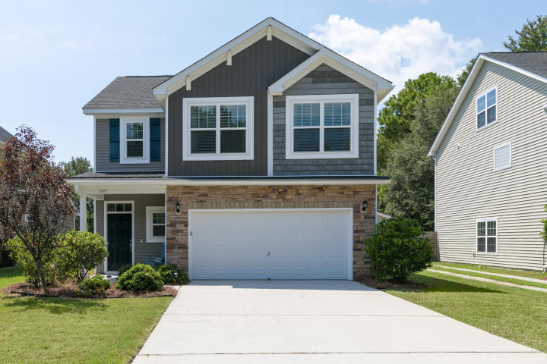
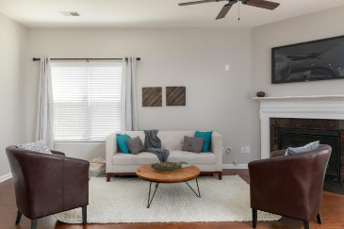
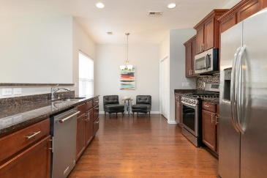
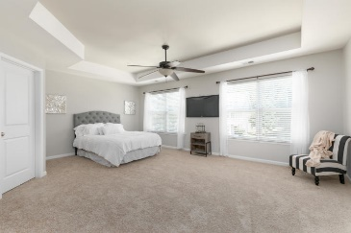
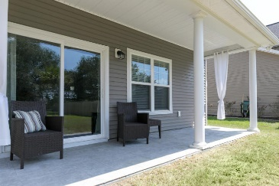
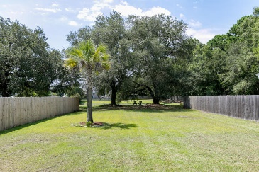
Great Place
Great Price
Great Place…Great Price
3287 Comsee Lane
Brownswood Farms | Johns Island | MLS# 19023461 | $289,900
Like new home! Beautiful hardwoods throughout main floor, granite & stainless appliances including new gas range w/convection & grill features, Kitchenaid dishwasher. Custom glass tile backsplash & expansive breakfast bar. Built-in sound system & Rinnai tankless water heater. Radiant barrier roof sheathing for lower utility bills. Dual-zone heat pump w/programmable thermostats. Gas fireplace & large loft bonus for office or flex space. Huge master w/room for sitting area, tiled upstairs baths & laundry. Relaxing tiled rear covered porch overlooking deep, private lot & pond. Spotless finished garage w/epoxy paint floor. Convenient to shops & Kiawah beaches.
Seller is a licensed SC Real Estate Broker.
Kimberly Rayfield
(843) 494-1494
krayfield2000@yahoo.com
42nd Street Investments, LLC
Charleston, SC 29418

