Slide 1
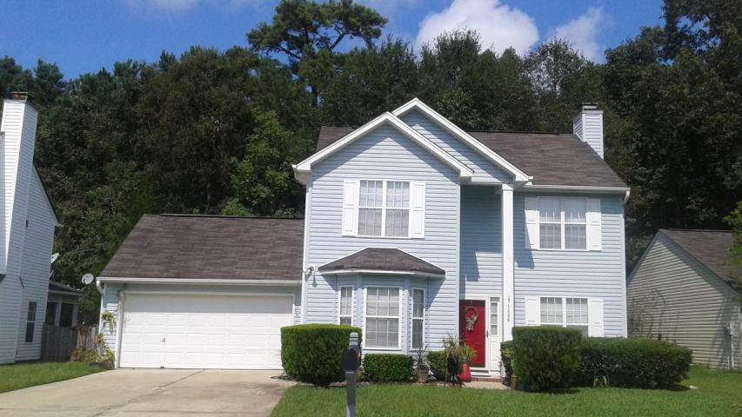


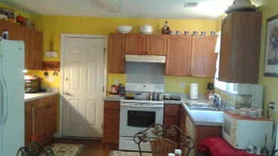
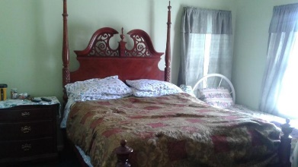
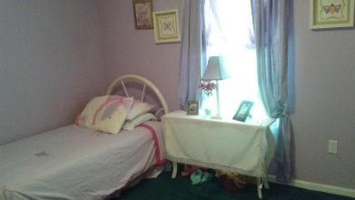


3288 Seaborn Drive
Mount Pleasant
MLS# 16026132
$315,000
Great Deal
in Ivy Hall
Fantastic opportunity with an unbelievable price. This house is in great condition with a nice size eat-in kitchen with a separate formal dining room with bay window. The great room has a fire place for those chilly nights. Upstairs you'll find a spacious master bedroom with a long walk-in closet with a linen closet in the bathroom. Plus two nice size secondary bedrooms. The laundry is conveniently located upstairs close to the bedrooms.
Fenced in and shaded back yard with trees for quality family time. Sellers' are willing to leave the refrigerator and provide a home warranty with acceptable offer. It's a great starter home to get you in Mount Pleasant. Add your touch to match your personality.
Linda Brown
BIC, REALTOR, GRI
Mobile - (843) 343-9147
linda@trinitypropertiesone.com
Trinity Properties of Charleston
846-D Dupont Road
Charleston, SC 29407
www.trinitypropertiesone.com

