Slide 1
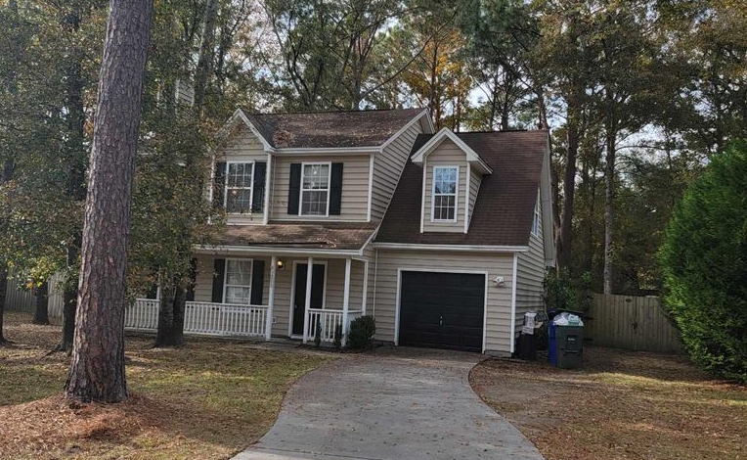
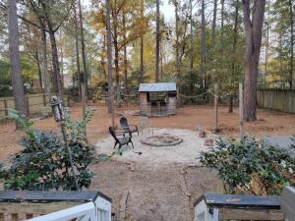
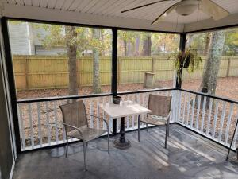
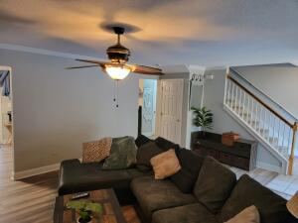
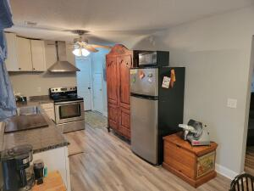
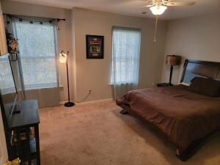
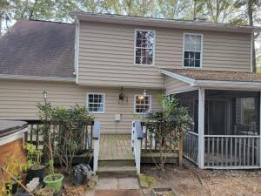


Oyster Roast Open House
3288 Berryhill Road
Cedar Springs
Johns Island, SC 29455
MLS# 21031790
$389,000
CHARLESTON SINGLE STYLE HOME
4 BEDS/2.5 BATHS/LOFT
MASTER BEDROOM DOWN
YARD W/PRIVACY FENCE
HARDIPLANK SIDING
HOME ONLY 2 YEARS OLD
QUARTZ COUNTERTOPS
STAINLESS APPLIANCES
REFRIGERATOR INCLUDED
COVERED PORCH
PERFECT JOHNS ISLAND LOCATION
1 MILE FROM SEVERAL RESTAURANTS/SHOPS
BLINDS AND WASHER/DRYER INCLUDED
LESS THAN 10 MILES TO DOWNTOWN CHARLESTON
12 MILES TO KIAWAH OR FOLLY BEACH
Join me Tuesday from 4-7 for a Happy Hour Oyster Roast with light hor d'oeuvres
Welcome Home to peace & quiet on Johns Island! This home is priced WELL under market to allow room for the next owners to do some upgrades, its going to go quick! The 10k Hot Tub in the backyard Recently Sanitized (12/05/21), ready for cozy nights by the fire in this woodsy oasis! The shed out back is ready to service the next great party! 12/07 the entire home & deck were pressure washed! Deck is ready for a fresh coat of your favorite stain! Come make this dream home yours and put your own finishing touches to make it sparkle! Charleston County School District, close to shopping, restaurants, historical sites for visiting, & with no HOA come to the rural side of life! There is an easement behind the property maintained by the county. Privacy & Relaxation all day! NO FLOOD INSURANCE REQUIRED***
Darcy Sudano
843-534-7179
dsudano23@yahoo.com
Adler Wayman Real Estate
1247 Nexton PKWY Ste 201
Summerville, SC 29483
www.adlerrealtychs.com

