Slide 1

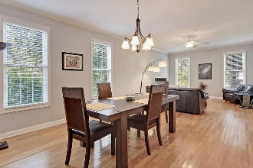
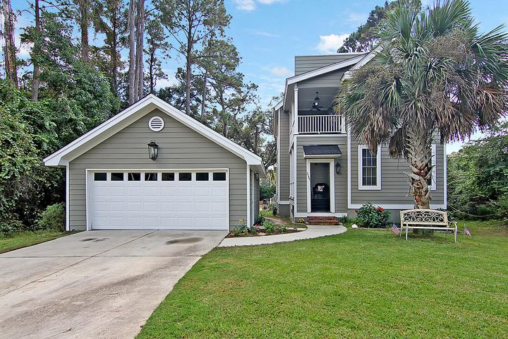
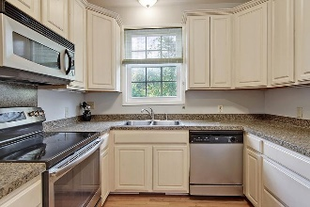
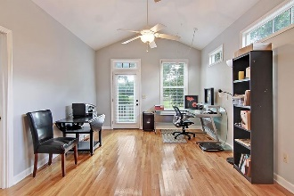
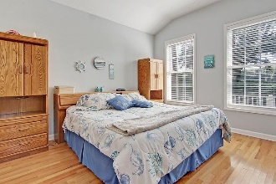
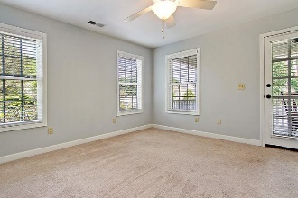
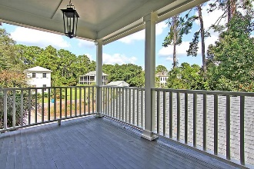
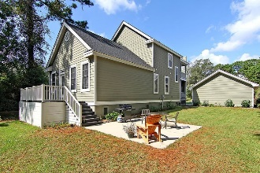
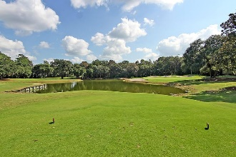


4-Bedroom Deal in Kiawah River Estates
3289 Johnstowne Street
Kiawah River Estates | Johns Island, SC 29455
MLS# 20028404 | $454,000
This charming four bedroom Lowcountry home is situated on the turn of the 14th green and the 15th tee box of Kiawah Island Golf Resort's Oak Point Golf Course in beautiful Kiawah River Estates. Johnstowne Street has an old Charleston feel with its red stamped brick roadway and traditional styled architecture. This home sits across from a landscaped island with palms and a gazebo. The entrance piazza is quintessential Charleston with its brick steps and metal roof accent. Upon entering the first floor you will find a large living room/dining room combination. The master suite is located on this floor at the back of the house. There is a second large living area adjoining the master that makes a great office, media room, or play room. The kitchen, powder room, and laundry room are conveniently located in the middle of the ground floor. Upstairs are three more nice sized bedrooms and a full bath. The front upstairs bedroom has its own private veranda.
There is a detached two car garage for your vehicles, golf cart, and beach chairs. Out back is a large deck and a large poured concrete patio where you can enjoy southern breezes. As a bonus there is a new roof, there is no flood insurance requirement, and the property owner's association fee is extremely reasonable.
This is a wonderful gated community with a clubhouse and fitness room, pool, tennis and pickle ball courts, and community dock, all encompassing Kiawah's Oak Point Golf Course. Owners have the option to join the Kiawah Island Governors Club, and the beach, Freshfields Village, and Bohicket Marina are all within a few miles.
Take a virtual tour: https://my.matterport.com/show/?m=3usAZJNg5C9
Lee Lindler
Cell (843) 637-0803 | lee@akersellis.com
Akers Ellis Real Estate LLC | 3730 Bohicket Road, Suite 5 | Johns Island, SC 29455
akersellis.com

