Slide 1
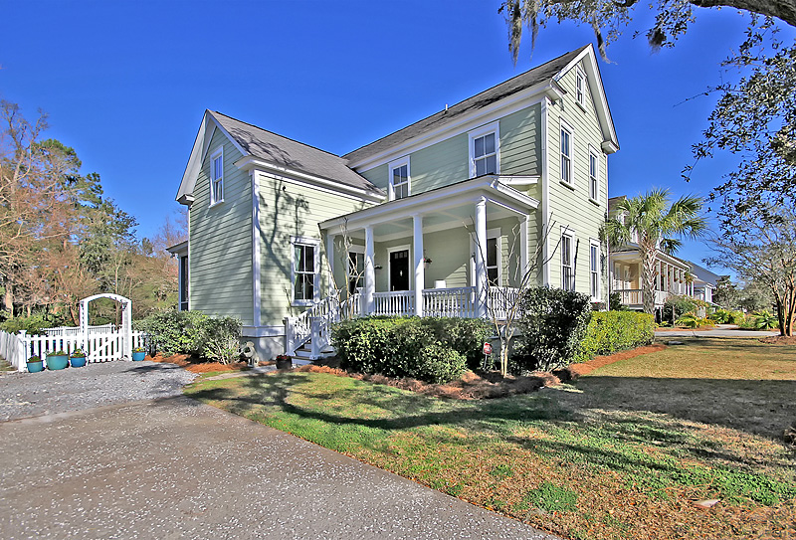
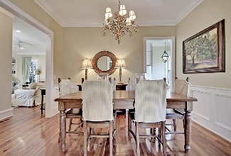
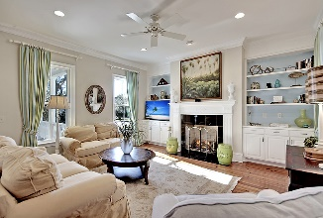
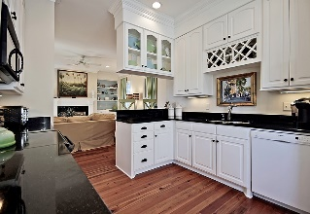
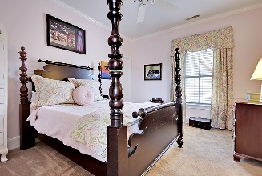
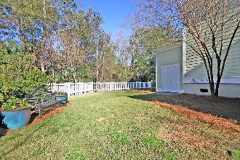

328 Bermuda Towne Row Belle Hall | Mount Pleasant, SC 29464 | MLS# 16005727 | $699,750
Hibben at Belle Hall under $700,000
New Listing in Hibben
Over 3000 sq/ft
Antique Heart Pine Floors
1st Floor Master
Bonus Room (opt. 5th BR)
One of the largest yards in all of Hibben
Screened Porch
Large storage area that can easily be converted to garage
New Carpet in all bedrooms and Bonus Room
Priced below market comps should give new owner instant equity which can be used to convert storage to garage, do updates, or turn into investment property.
Stan Huff
843-670-2835 stan.huff@agentowned.com
Margaret Wannamaker
843-364-5851 wannamom66@gmail.com
www.agentownedrealty.com
AgentOwned Realty Co. Preferred Group, Inc. | 824 Johnnie Dodds Blvd | Mt Pleasant, SC 29464

