Slide 1
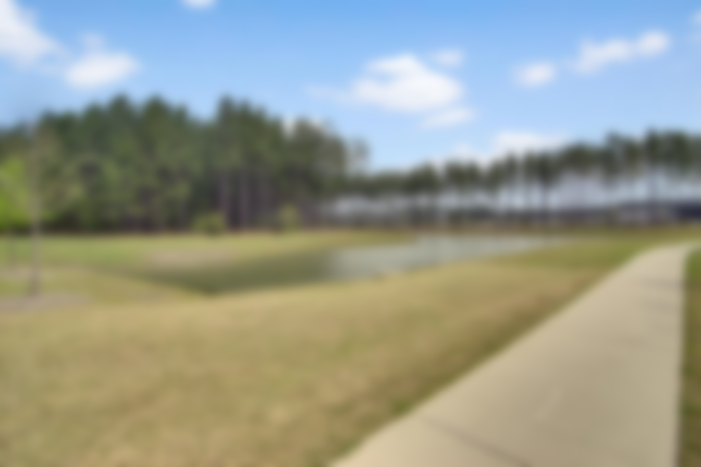
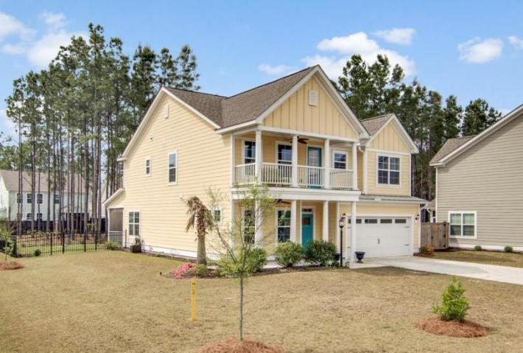
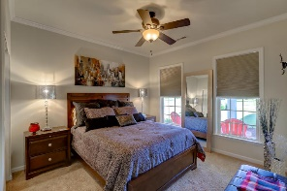
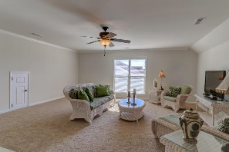
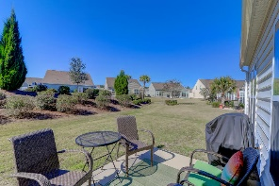
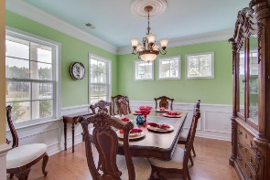
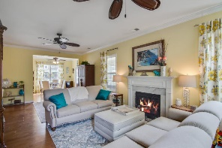
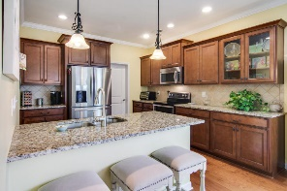
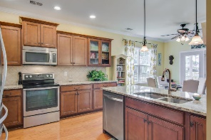
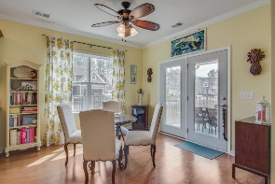
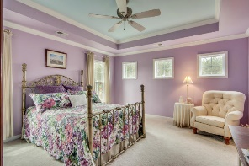
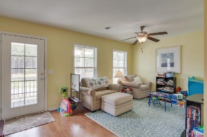
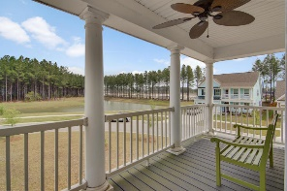
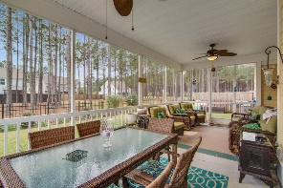
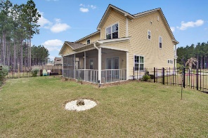


Agent Open House Wednesday 11a - 2p Light Snacks Served ~ Register For Gift Card Drawing
328 Whispering Breeze Lane
Cane Bay Plantation ~ Summerville, SC 29483
MLS# 18010261 ~ $309,900
Don't wait for new construction!!! Welcome Home!!! This beautiful four bedroom two and a half bath home sits on a corner lot with scenic views. This home is The Brighton floor plan and is a beautiful eco- friendly home with high energy efficient standards features E-star appliances, radiant heat barrier, air conditioner specially engineered 80% high efficiency gas furnace, Tankless water heater, programmable Thermostats, LOW-E windows. Many upgrades including recessed lighting, upgraded cabinets, Crown molding, wainscoting, tile in the bathrooms and laundry room, wood floors in the down stairs and upstairs common areas with carpet in the bedrooms. This home has so many upgrades cant list them all but you can ask your agent for a copy of the upgrades form for all the upgrades. Formal Dining room, eat in Kitchen, Extended double screened in porch, with back yard fenced in, Ceiling fans, balcony overlooking the pond. Schedule your private showing right now. Remainder of home builders Structural 2-10 home warranty still in place.
Derek Hayes
(843) 737-1543
dahayes40@yahoo.com
Carolina One Cane Bay/Nexton | 1909 State Rd | Summerville, SC 29486

