Slide 1
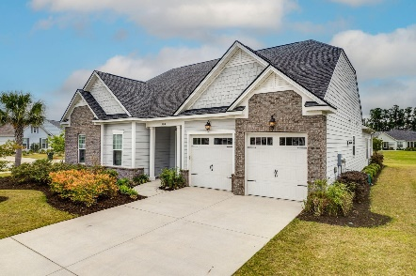
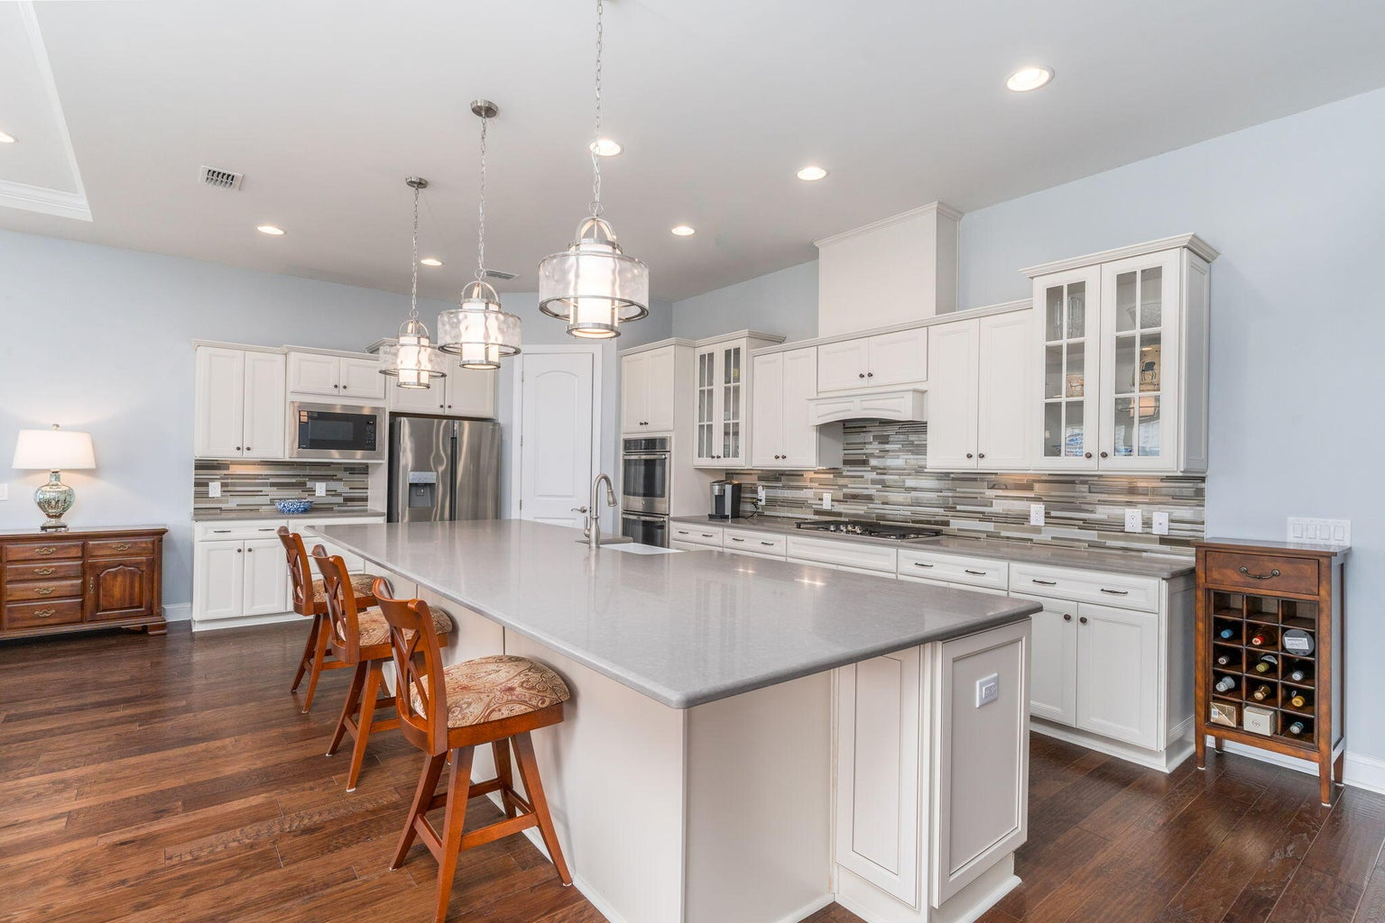
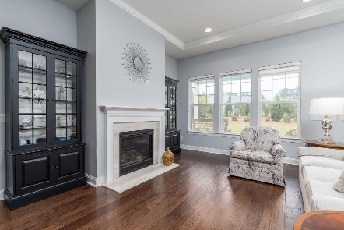
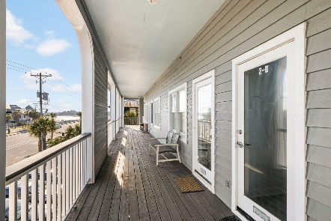
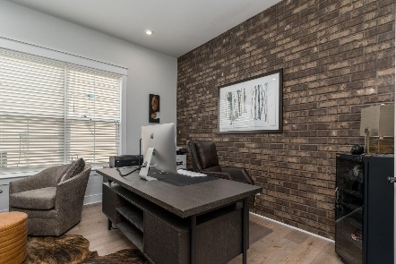
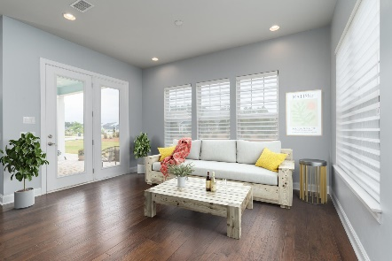
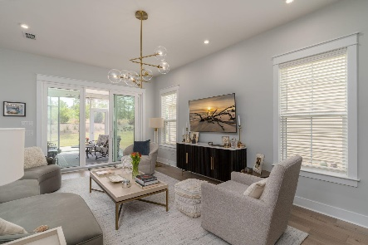
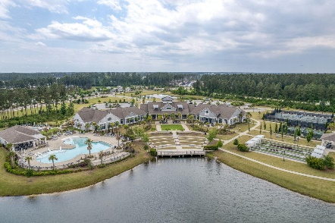

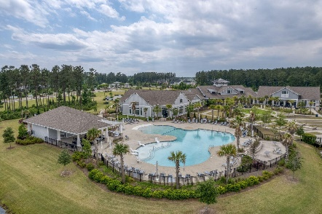
328 Fish Creek Court
Four Seasons @ Cane Bay Plantation | Summerville, SC 29486
MLS# 23016315 | $579,000
Darrell Creek Elevated Home With Elevator & Salt Pool
Back on the Market with Kitchen Facelift
Open House Saturday 7/22 from 12-2PM
Co-sponsored by
Offering $3000
Lender Credit
Welcome Home to 328 Fish Creek Ct, with the freshly repainted kitchen, this home is even more bright and airy than before! This exquisite home is situated on a Tranquil LAKE VIEW CORNER LOT in Four Seasons, Summerville's Premier 55+ Gated Community! Open, elegant, and pristine, this 3-bed, 2.5-bath, has all of the luxury of low country living. Upon entering you will be greeted by soaring 12' ceilings and wood flooring throughout. You will notice so much attention to detail, such as tray ceilings, crown molding, and wainscoting. The home's open floor plan is highlighted by a gourmet Chef's kitchen w/ quartz counters, custom cabinetry with brushed nickel, under cabinet lighting, and farmhouse sink. The BIG draw is the 12-ft quartz island, which makes it the perfect space for entertaining!
The spacious Great Room is also upgraded with tray ceilings and custom gas fireplace. The Living Area also has a Bump-Out, extending to a Sunroom/Sitting area where the sunlight comes pouring through!
Another major highlight of the home is the gorgeous Master Suite, with tray ceilings and sitting area. The Spa-Like En Suite Master Bath boasts a large walk-in shower with his and her sinks. And the Master Closet is a MUST SEE...completely upgraded by Closets by Design, this closet will take your breath away! There are 2 other Guest Rooms, one with En Suite Bath and another that can be used as a 3rd Bedroom, Den, or Office. The Home also features a hallway half bath, Corner Office, Ship-Lapped Drop Zone, and Large Laundry Room off the 2-Car Garage.
Step outside, to your fully bricked Paver Patio and flawlessly landscaped yard! Sip your morning coffee here and watch the wildlife play on the Lake. In Four Seasons you will never be bored, as this is the only Active Adult Community in the area that is built around a 300-acre lake with its own private boat dock! Other amazing amenities include an indoor and outdoor pool, fitness center, dog park, bocce, pickleball, tennis courts, a kayak launch and so much more! There is also a packed monthly events calendar and Full-time Lifestyle Director. Once you move to the Four Seasons, you will never want to leave! And this home is the perfect way to retire in LUXURY!
ALL MAJOR APPLIANCES CONVEY AND $3500 in CLOSING COST AVAILABLE with Preferred Lender!
House Tour | Amenity Tour
Elissa Campbell
843-853-1433 | elissa.campbell@agentownedrealty.com
AgentOwned Realty Preferred Group | 824 Johnnie Dodds Blvd | Mt Pleasant, SC 29464

